Slide 1
Unit 3: Early Modern Times
The Age of Absolutism

Slide 2
Unit 3: Age of Absolutism
Spanish Power Grows

Slide 3
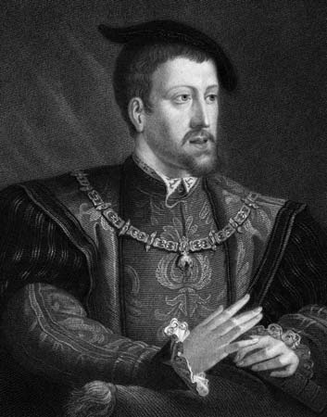
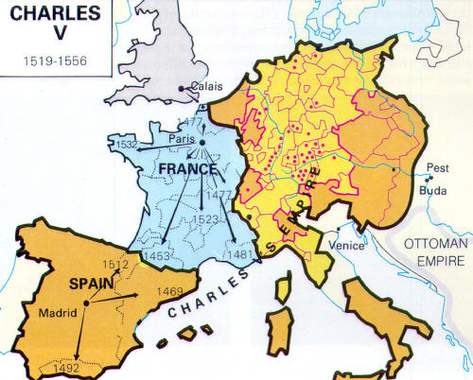
Charles V & 2 Thrones
Charles V - King of Spain – 1516
Grandson of Ferd & Isabella
Charles V takes control of Hapsburg Emp (Ger)
Holy Roman Empire & Netherlands
Devout Catholic
Faced lots of warfare
Empire too hard to control
Leaves the throne

Slide 4
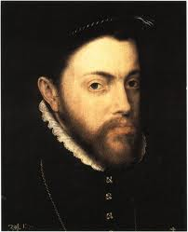
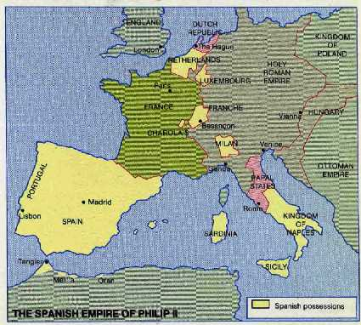
Phillip II
Phillip II takes Spanish throne
Son of Charles V
Absolute monarch – complete control
Believed in divine right – his authority came from God
Fought to defend Catholicism

Slide 5
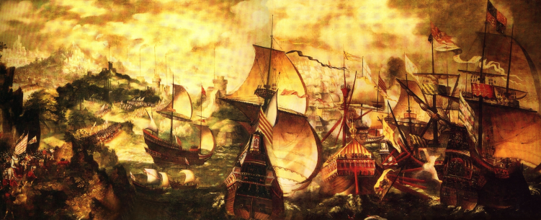
Phillip II & the Armada
Armada = large naval fleet
Elizabeth I (Eng) = his biggest Protest. enemy
Sent attacks on Spanish ships
Phillip organized Spanish Armada to invade England
Defeated ☹
Beginning of end of Spanish power
Poor rulers, economic probs, challenged

Slide 6
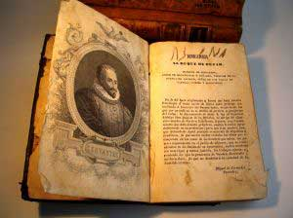
Spain’s Golden Age
1550-1650
Political / economic success
Led the way culturally
Painters: El Greco & Diego Velasquez
Writers: Miguel Cervantes
Wrote Don Quixote (1st modern novel)

Slide 7
Unit 3: Age of Absolutism
France Under Louis XIV (14th)

Slide 8
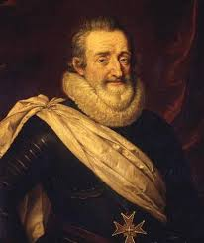
Henry IV Restores Order
1560s-1590s – relig wars btwn French Catholics & Huguenots (F. Prot)
Henry IV (H) issued Edict of Nantes – religious tol to protect Huguenots
Wanted to fix France – govt into all aspects
Henry assas & 9yr old Louis VIII took over
Cardinal Richelieu = chief minister / wanted to increase govt power

Slide 9
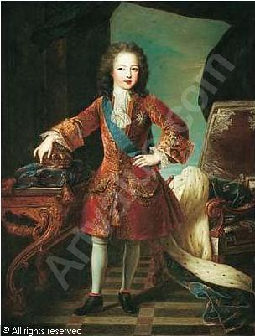
Louis: Absolute Monarch Rises
5yr old Louis XIV takes throne – divine right
Sun as his symbol / “I am the state”
Absolute Monarch – 72 years
Never called the Estates General (rep. assem.)
Strengthened royal power
Expand bureaucracy / appt royal officials / ties with MC / strongest army in Europe
Strong econ policy but couldn’t support Louis’ expensive ways

Slide 10
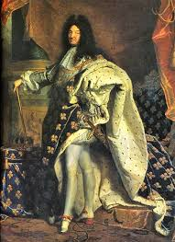
Versailles: Royal Symbol
Louis = very extravagant
Self-centered / spent lots of $
“rising” ritual
Supported the arts
Built huge Palace of Versailles by Paris
Symbol of wealth & power
Housed govt as well

Slide 11
Decline
Louis ruled for 72 yrs – France was strongest in Europe
Lots of $ spent / too costly
Wars / random stuff
War of Spanish Succession
Tried to unite Spain & France
Undid Edict of Nantes
Many protestants left & hurt economy

