Slide 1
Unit 1: Ancient Civilizations
Pre-history, Ancient Middle East & Egypt, Ancient Greece, & Ancient Rome

Slide 2
Unit 1: Middle East & Egypt
Egypt & The Fertile Crescent: City States of Ancient Sumer

Slide 3
The Fertile Crescent
In Middle East btwn Persian Gulf & Mediterranean Sea
Very fertile soil
Diff groups (nomads, invaders, traders) influenced area over time

Slide 4
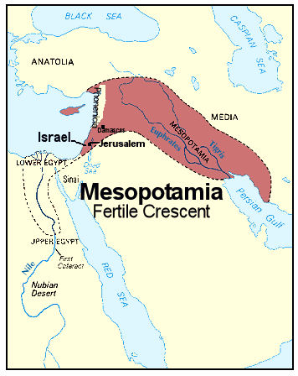
Fertile Crescent

Slide 5
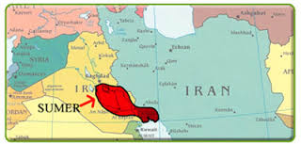
Influence of Geography
Mesopotamia – in Fertile Crescent btwn Tigris & Euphrates Rivers
River was key to development
Major flooding
  Destruction / dev new ways to build
Rivers brought trade
World’s 1st civ – Sumer

Slide 6
Sumerian Civilization
Had 12 city-states
  Area w/ a city & surrounding land/villages
Rivals fought over land/water; led by military leaders
Government:
  Leader to maintain city walls & irrigation; led armies; enforced laws; had ppl to collect taxes

Slide 7
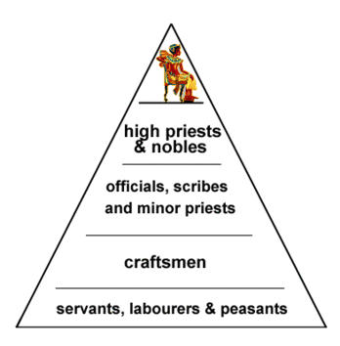
Sumerian Civilization
Society:
  Had social hierarchy (system of ranking groups)
  High class = ruling fam, lead officials, high priests
  Mid class = lesser priests, scribes, merchants, artisans
  Low class = most people; peasant farmers
  Women never = to men

Slide 8
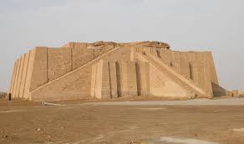
Sumerian Civilization
Religion:
  Polytheistic (had many gods)
  Gods controlled life good/bad
  Ziggurats for worship
    Big temples dedicated to city’s main god/goddess
  Afterlife = underworld with no escape

Slide 9
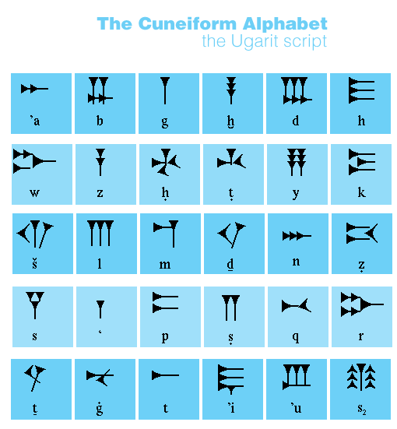
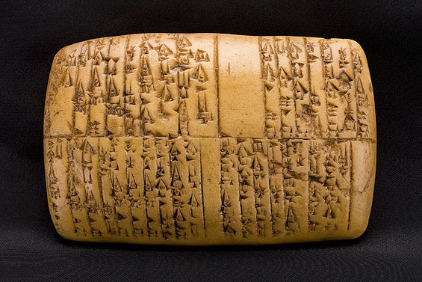
Sumerian Civilization
Writing:
  Invented 1st known form – cuneiform
  Wedge-shaped marks on clay tablets
  Later made symbols

Slide 10
The End & Impact of Sumer
Armies came in & took over
Sumerian civs replaced by new ones
Cuneiform adapted by others
studied astronomy & dev a # sys
Impacted dev of western world

Slide 11
Unit 1: Middle East & Egypt
Invaders, Traders, & Empire Builders

Slide 12
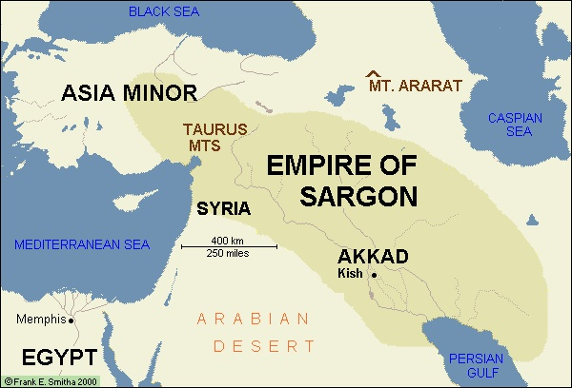
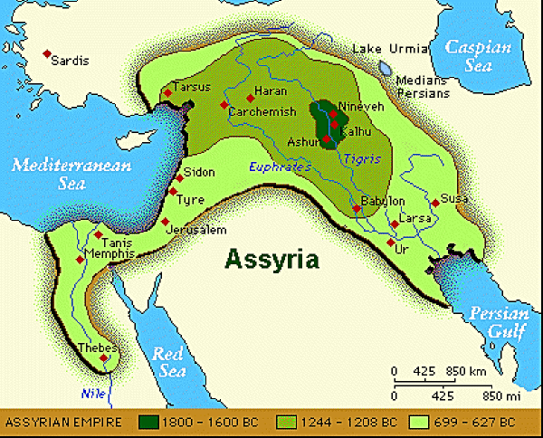
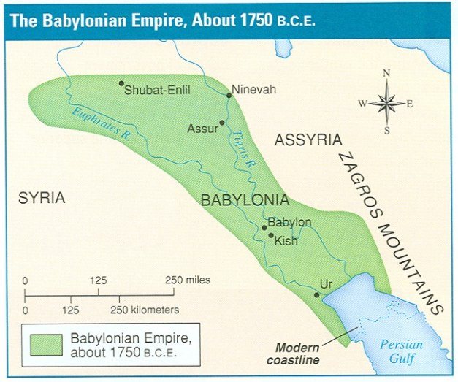
First Empires In Mesopotamia
What’s an empire?
  Group of states/areas ruled by one person
Diff ppl/groups in Fertile Crescent
Powerful leaders created big empires

Slide 13
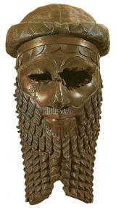
First Empires in Mesopotamia
Sargon – ruler of Akkad (next to Sumer)
  Invaded/took over Sumer ~ 2300 BC
  Built 1st empire in history
  Empire fell after his death
Sumer came back / invaded again

Slide 14
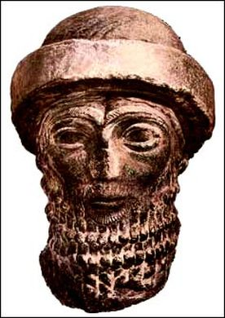
Hammurabi & His Code
Hammurabi – King of Babylon; empire = most of Mesopotamia ~ 1790 BC
Created set of laws: Hammurabi’s Code
  ~300 on stone pillars for ppl to see
    1st written laws
  Est civil law – private rights/issues
    protect the poor/powerless (women, slaves)
    Orderly home makes stable empire

Slide 15
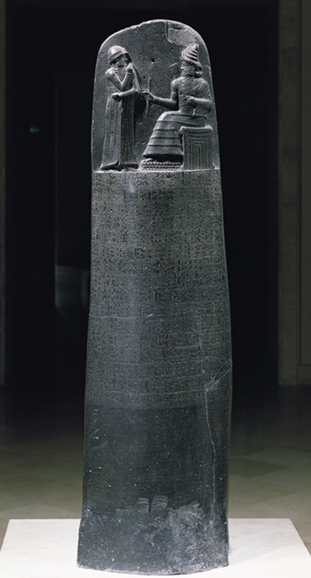
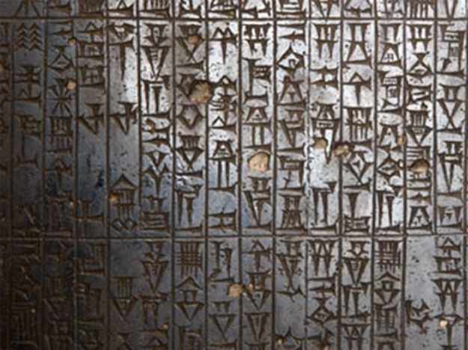
Hammurabi & His Code
Dealt w/ criminal law – crimes against others
  Set specific punishments
  “an eye for an eye and a life for a life”

Slide 16
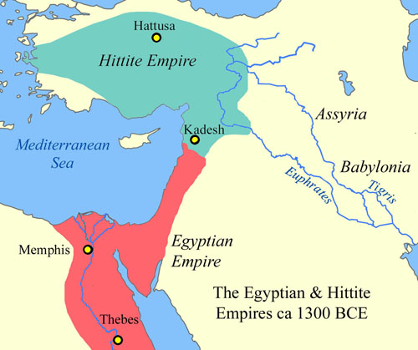
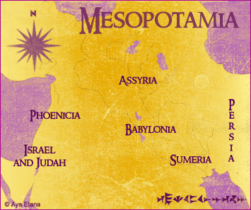
New Empires, New Ideas
Hittites: 1400 BC – 1200 BC
  Used iron to make tools/weapons
Assyrians: 1350 BC – 612 BC
  Feared warriors
  1st to make laws for royal homes

Slide 17
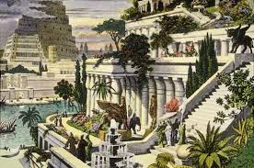
Babylon & The Persian Empire
Babylon: reestablished as a power in 625 BC
  One of largest/best cities
  Hanging Gardens: 1 of 7 wonders of ancient world
Fell to Persians in 539 BC
Persian Empire = largest ever seen

Slide 18
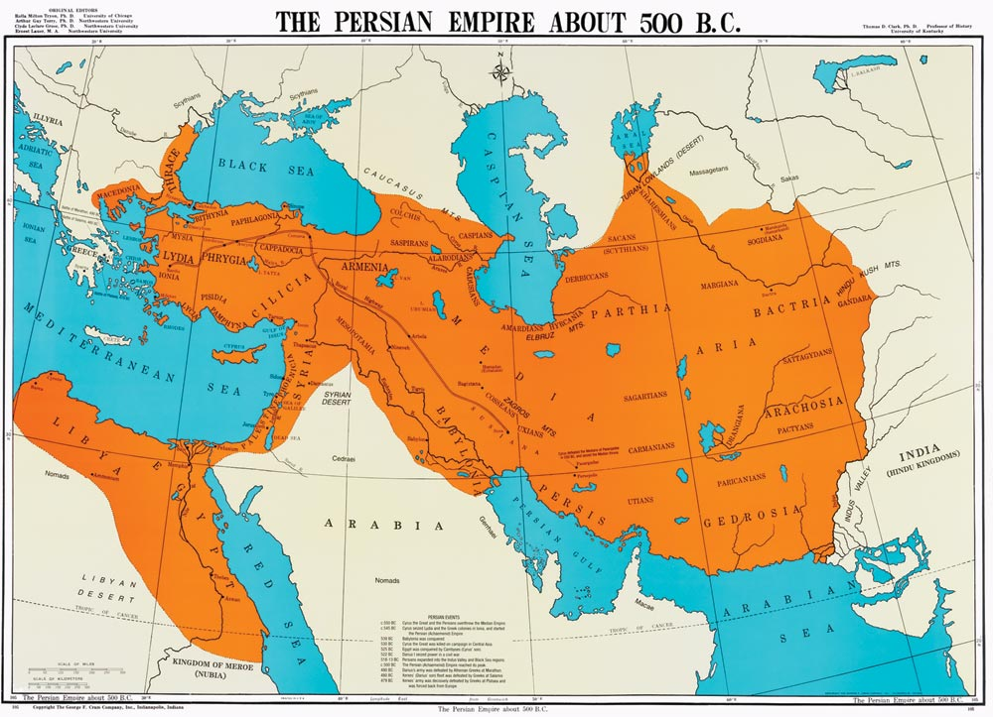
Persian Empire

Slide 19
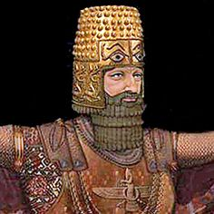
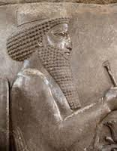
Persian Empire
Diverse groups of ppl
  Persian kings to accept conquered ppl
Real unity w/ emperor Darius I (522-486 BC)
  Est provinces called satrapies; had governor - satrap

Slide 20
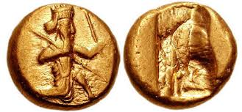
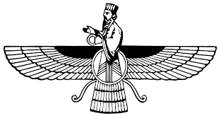
Persian Empire
Changes under Darius
  Barter economy before – traded / no $
  Began using coins / created early $ economy
  New religion – Zoroastrianism by Persian thinker Zoroaster
    No to Persian gods; thought 1 god ruled world; ideas of heaven/hell & judgment day

Slide 21
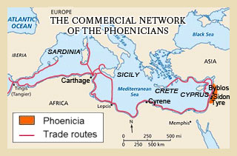
The Phoenicians
Ppl/small state by east Mediterranean coast
  sailors & traders
Expanded manufacturing & trade
  Had colonies all over
  Est alphabet - led to current alphabet

Slide 22
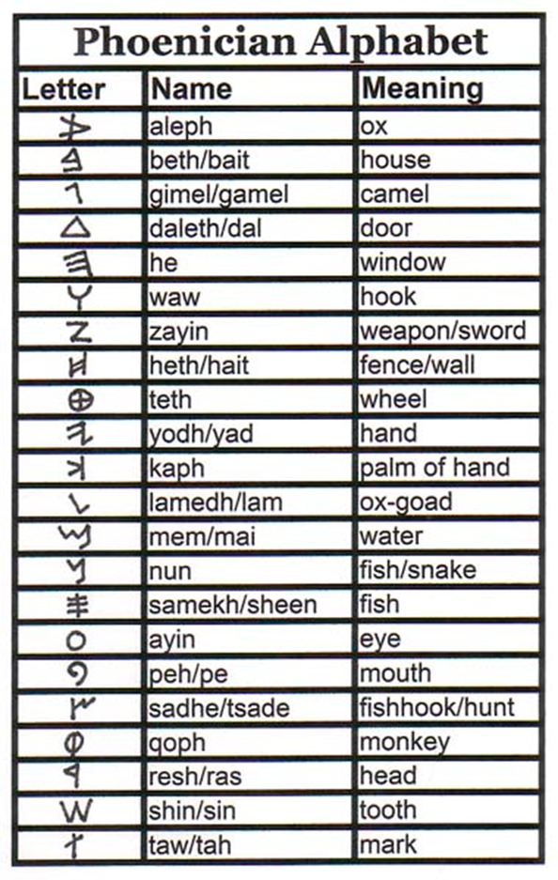
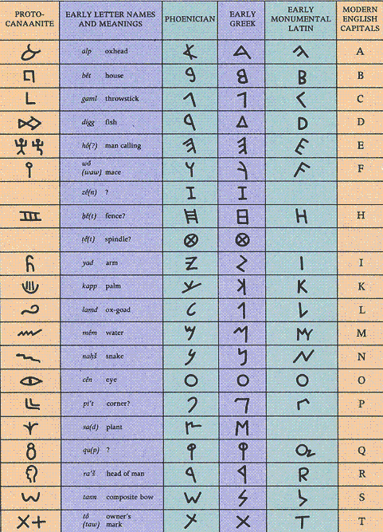

Slide 23
Unit 1: Middle East & Egypt
Egypt: The Kingdom on the Nile

Slide 24
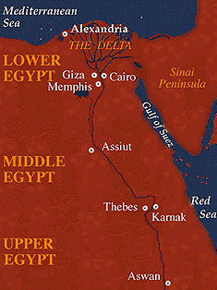
Egypt & The Nile River

Slide 25
Egypt & The Nile River
Farmers came for fertile/valuable land
Became powerful civ & relied on Nile River
Surrounded by desert (“red land”); hot/dry
  Prob not survive w/out Nile’s “black land”
Nile flooded every spring
  Needed for crops

Slide 26
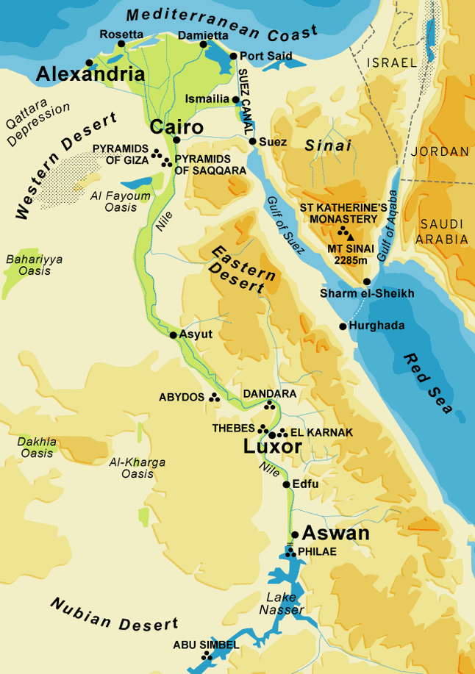
Egypt Shaped by Geography
Ppl had to manage the water
  Made ways to channel & store water for dry season
  Irrigation sys

Slide 27
Egypt Shaped by Geography
Had 2 main regions
  Upper Egypt (south) / Lower Egypt (north)
United by Menes, King of Upper Egypt, ~ 3100 BC
  Nile linked them & used as trade route

Slide 28
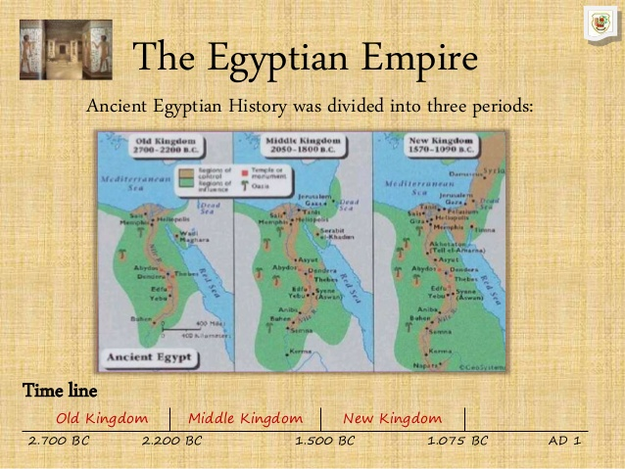
Egypt’s Kingdoms
3 main time periods:
  Old Kingdom: ~2575-2130 BC
  Middle Kingdom: ~1938-1630 BC
  New Kingdom: ~1539-1075 BC
Power passed from one dynasty to another
  Stayed united

Slide 29
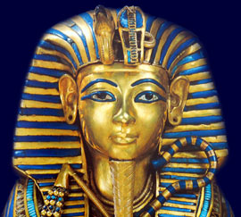
The Old Kingdom
Pharaohs (kings) built strong govt
Pharaohs seen as humans AND gods w/total power & own/rule all land
Wanted justice & order
  Diff jobs & levels of power in govt

Slide 30
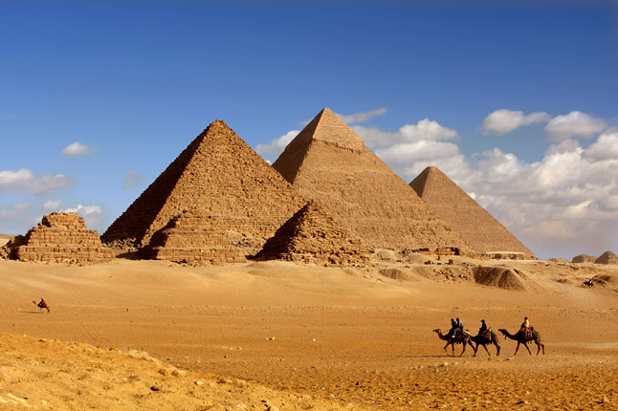
The Old Kingdom
Vizier watched over business of govt
Tombs built in pyramids = pharaohs eternal home
  Great Pyramids at Giza

Slide 31
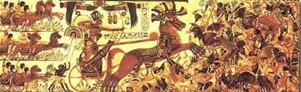
The Middle Kingdom
Old Kingdom fell
  After 100+ yrs new pharaohs reunited land
MK was turbulent time – hard; ups/downs
~ 1700 BC Hyksos invade/take over
  New military ideas - horse drawn war chariots
  rule lasted 100+ years

Slide 32
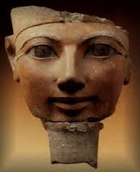
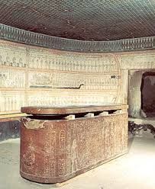
The New Kingdom
Powerful pharaohs; made huge empire
Powerful Rulers:
  Hatshepsut: 1st female ruler 1472-1458 BC
  Thutmose III: her stepson; grew territory; great military general

Slide 33
The New Kingdom
Powerful Rulers:
  Ramses II: ruled 60 years (1279-1213 BC); best known
Battles with Neighbors:
  Faught Hittites during Ramses II
  Signed 1st known peace treaty
  Fighting & trading w/ Nubia to the south

Slide 34
Decline of Egypt
Egyptian power declined after 1100 BC
Assyrians & Persians invade/take over Nile
332 BC: last Egyptian dynasty ended
  Greeks took control
  Romans took from Greeks in 30 BC

Slide 35
Unit 1: Middle East & Egypt
Ancient Egyptian Civilization

Slide 36
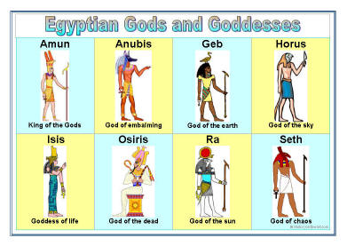
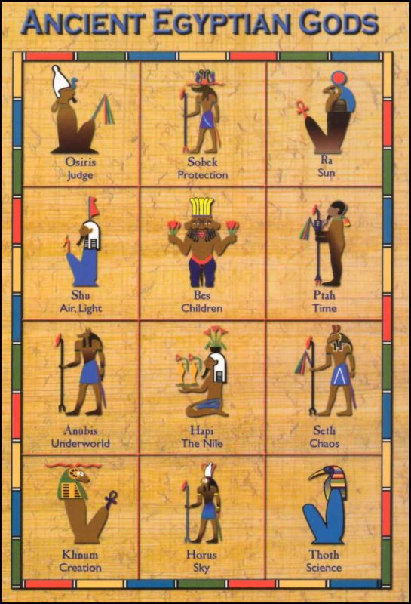
Religion & Life
Religion part of daily life
Sun god was main god
Osiris important
  God of the dead & Nile

Slide 37
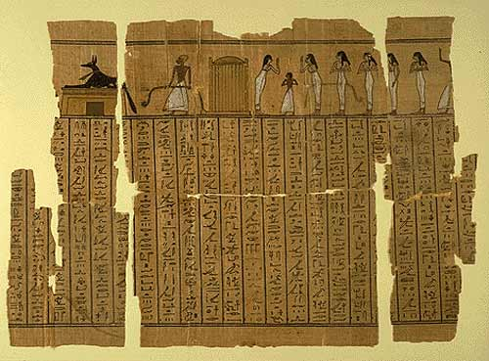
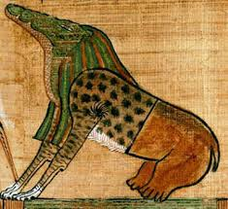
Afterlife
Promised eternal life by Osiris & goddess Isis
Had to pass test
  Judged by Osiris
  Sinners fed to Eater of the Dead
  Worthy ppl entered Happy Field of Food
Used Book of the Dead to make it through underworld

Slide 38
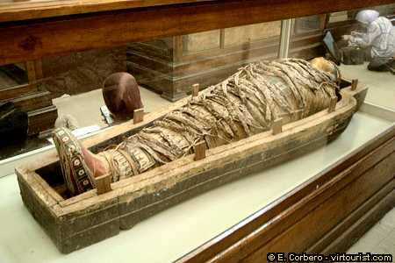
Preparing for the Afterlife
Dead buried with possessions
Mummification preserved the body
  Embalmed & wrapped in cloth
  Process took 90 days (3 months)

Slide 39
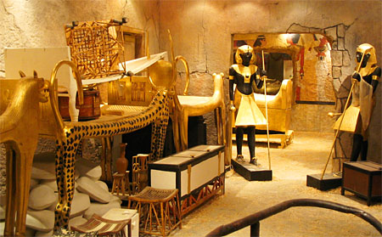
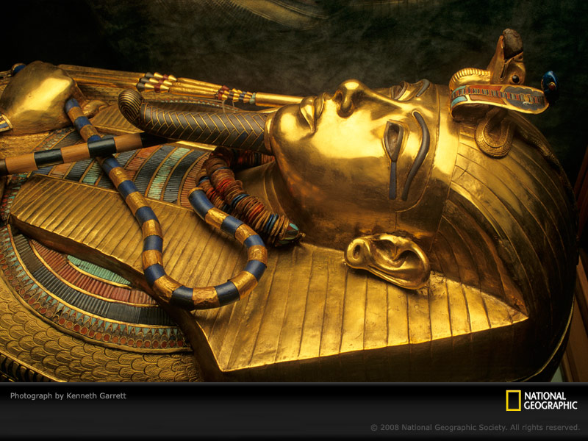
Tombs
Pharaohs buried in tombs with treasures
  Bodies in solid gold coffins - sarcophagus
  Often robbed
King Tut

Slide 40
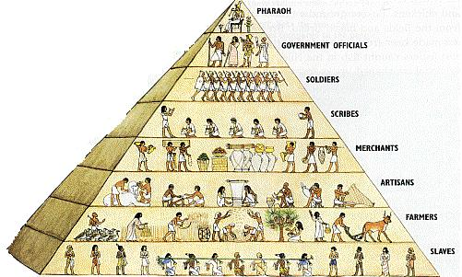
Society
Egypt had a class system (hierarchy)

Slide 41
Society
Most were peasant farmers or slaves
Ppl move up easily during NK bc of trade & warfare
Women had more opportunity
  Could get property, divorce, do business
  Not confined to home
  Still below men

Slide 42
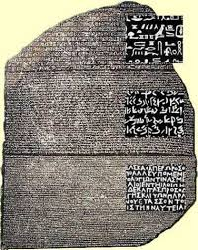
Advances
Dev diff writing systems
  Hieroglyphics – carved in stone by priests/scribes
  Hieratic & demotic – everyday use
Paper from papyrus plant
Rosetta Stone – black stone used to figure out hieroglyphics
Medicine – cures, symptoms, diagnosis, ops
Astronomy – made calendar
Developed geometry

Slide 43
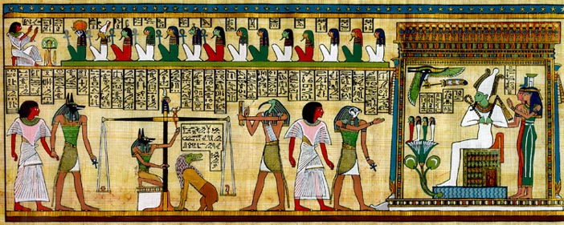
Arts & Literature
Arts:
  Buildings (pyramids), statues, tomb paintings… - gods/pharaohs shown larger…WHY???
  Showed everyday life or ppl w/ animal heads
Literature:
  Poems, hymns, prayers, folk tales

Slide 44

Unit 1: Middle East & Egypt
Egypt: Roots of Judaism

Slide 45
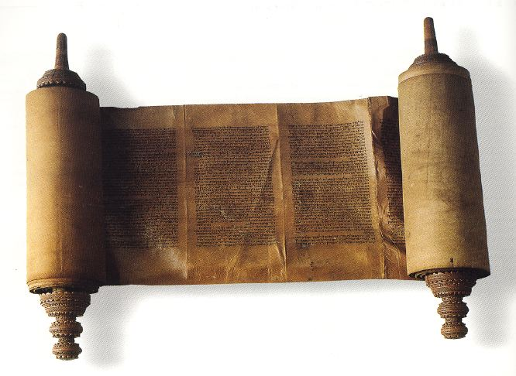
Ancient Israelites & Judaism
Ancient Israelites dev Judaism ~ 4000 years ago
  Today = major faith
Israelites = monotheistic – believe in one god
  All Gods plan
  Torah - sacred text of Israelites (Jews)

Slide 46
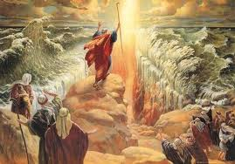
Ancient Israelites
~ 2000 yrs ago Abraham moved to Canaan
  Abraham = father of Israelites
Believed God made covenant w/ Abraham (a binding agreement)
Israelites forced to Egypt & made slaves
Moses led their exodus (departure) from Egypt back to Canaan

Slide 47
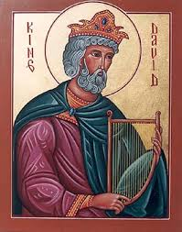
Ancient Israelites
Kingdom of Israel est. in Canaan ~ 1000 BC
  Feuding 12 tribes unite under 2nd King, David
David’s son, Solomon, turned Jerusalem into great capital city
Kingdom split when he died & fell to Assyrians & Babylonians

Slide 48
Israelite Society & Judaism
Patriarchal society – men had authority
Law was central – Torah had laws about most things (cleanliness, food, crime)
10 Commandments in Torah
  Moral conduct & religious duty:
    Keeping the Sabbath, holy day of rest & worship

Slide 49
Israelite Society & Judaism
Prophets, spiritual leaders, part of history/society
  Urged social justice; taught strong code of ethics (moral standards of behavior)
During time period Diaspora, Jews left/were exiled from Israel
  Spread around world
Christianity & Islam grew out of Judaism

