Slide 1
Unit 1: Ancient Civilizations
Ancient Greece

Slide 2
Unit 1: Ancient Greece
Greek Geography: Reading the Map

Slide 3
GREECE

Slide 4
Islands
Isolated Communities
Diet: fish
Need water transportation
Affects trade

Slide 5
Peloponnesus (large land mass)
Dominates the rest of the country b/c of larger population

Slide 6
Rugged Mountains
Isolated communities
Trade is difficult
Communication is difficult
Travel is difficult
Provides protection for the people

Slide 7
Unit 1:Greece
People of the Aegean

Slide 8
Minoans
Founded 2800 BC on island of Crete
Palace complex at Knossos was center of empire
Sea based
Collapsed 1450 BC after invasion by Mycenaeans

Slide 11
Mycenae
First Greek State: 1600-1100 BC
Mostly warriors, took over sur areas
Homer (poet) wrote acct of King Agamemnon & Trojan war story
States fought each other, by 1100, Mycenae collapsed

Slide 13
Dark Ages of Greece
1100-750 BC
Reduced population, food production and record keeping
Increased use of iron, development of alphabet

Slide 14
Homer: Poet of the Dark Ages
Wrote epic poems
Illiad and Odyssey, Account of Trojan War
Illiad: story of Achilles, his anger & downfall
Odyssey: story of Odysseus’ return to wife after Trojan War
Homer recorded poems passed down for gens

Slide 16
Homer: Poet of the Dark Ages
Homer’s writings were used to educate young men in reading and in character

Slide 17
Unit 1: Greece
Greece: Greek City-States

Slide 18
Ancient Greece

Slide 19
Geography Shapes Greece
Mediterranean & Aegean Seas important to Greek civ
Rapid pop growth by 750 BC
Ppl forced to spread out

Slide 20
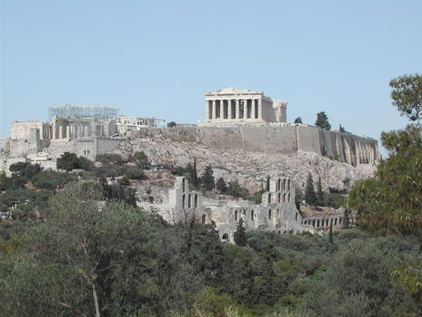
Governing the City-States
Polis = Greek version of city-state
Had major city/town & surrounding area
City itself built on 2 levels:
Acropolis – high city on top of a hill
Walled main city below
Citizens = free residents; pop usually small
Rights of citizens = unequal
Who had the power?

Slide 21
Governing the City-States
Power to male landowners
Govt evolved over time
King ruled polis in a monarchy
Monarchy = govt w/ king or queen; hereditary
Eventually became aristocracy
Aristocracy = rule by landholding elite; hereditary
Became oligarchy
Oligarchy = power in hands of a small, wealthy elite

Slide 22
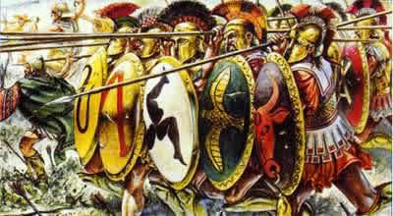
Governing the City-States
Advanced military tech
Gave more power to middle class
Iron weapons replaced bronze
New way of fighting = phalanx
Large formation of heavily armed foot soldier
Reduced class diffs

Slide 23
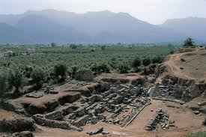
Sparta: Warrior Society
Sparta on south Peloponnesus; settled by Dorian invaders from north
Conquered ppl = state owned slaves - helots
Very brutal
Govt:
2 kings; council of elders; assembly of citizens; 5 ephors (officials)
Citizens = male, native-born Spartans over 30

Slide 24
Sparta: Warrior Society
Discipline in daily life
Prepped to be warriors as kids
Only strong healthy babies kept
Boys began training at age 7 & toughened up
Moved to barracks, tough exercise, diet, strict discipline
Men could marry at 20 – live in barracks 10 more years & eat there for 40 more
Age 30: became member of assembly

Slide 25
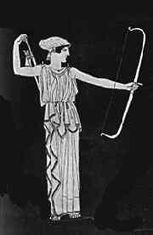
Sparta: Warrior Society
Spartan women:
Expected to have healthy sons for army
Need to be strong & exercise
Obey fathers & husbands
Spartans isolated themselves
Looked down on trade/wealth/travel
“Spartans are willing to die for their city, because they have no reason to live”

Slide 26
Athens & Democracy
Greek city-state north of Peloponnesus
Government:
Monarchy aristocracy
Land owners had power by 700 BC; chose officials, were judges, dominated assembly
Wealth & power grew but so did discontent among people
Resentment, loss of land, slavery, debt

Slide 27
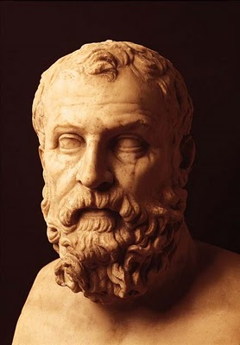
Athens & Democracy
Slowly moved toward democracy…what is democracy???
Democracy – government by the people
Solon appointed chief official in 594 BC
Able to make needed reforms
Outlawed debt slavery / freed those already sold
Granted citizenship to foreigners; gave assembly more say; higher offices to citizens

Slide 28
Athens & Democracy
Solon:
Economic reforms – export of wine, olive oil
Citizenship still limited; continued/widespread unrest
Led to rise of tyrants – ppl who gain power by force
Tyrants gave poor bigger voice, ordinary citizens larger role in govt
Made assembly a legislature – lawmaking body that talked ~ laws before making decisions

Slide 29
Athens & Democracy
Limited democracy: only citizens participate
Women in Athens:
Women guided by men; large public role in religion; managed house
Youth & Education:
Boys attended school if fam could afford
Reading, writing, music, poetry, public speaking
Military training & athletics but knowledge imp

Slide 30
Forces for Unity
Greeks united by common culture
Religion: polytheistic
Gods lived on Mount Olympus
Some Gods/Goddesses:
Zeus – Most powerful; ruled over all
Ares – God of war
Aphrodite – Goddess of love
Athena – Goddess of wisdom

Slide 31
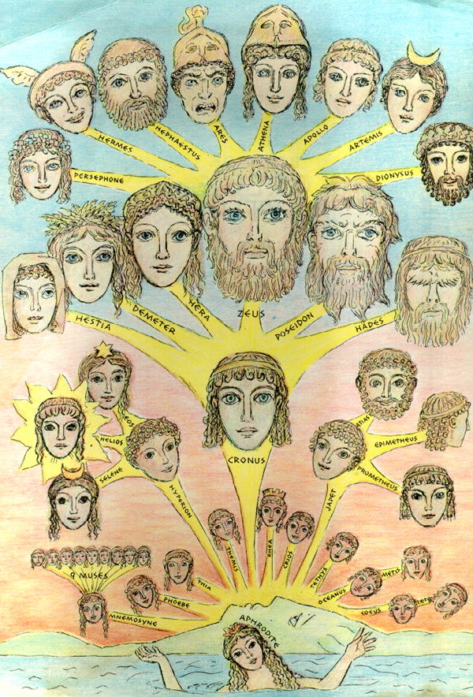
Forces for Unity
Religion

Slide 32
Forces for Unity
Religion:
Honored gods with temples, festivals, sacrifices, feasts, entertainment, athletic competitions
Greek View of Outsiders:
Called foreigners barbaroi (ppl who didn’t speak Greek)
Felt superior to these ppl

Slide 33
Assignment
Draw a comic strip that shows a day in the life of either a Spartan teenager or an Athenian teenager. Remember the differences between them!
You must have 8 squares on your paper

Slide 34
Unit 1: Greece
Conflict in the Greek World

Slide 35
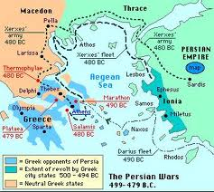
The Persian Wars: 490-479 BC
Persians conquered Ionia, a group of Greek city-states
Ionian Greeks rebelled
Athens came to help
Persians went to Marathon to get back at Athens
Had to retreat
Xerxes became Persian ruler after Darius I
sent larger force to conquer Athens

Slide 36
The Persian Wars
Sparta & other city-states joined with Athens Persia
Thermopylae & Leonidas (Spartan)
Persians burnt Athens to ground
Persians defeated by Greeks
City-states united in victory
Athens became most powerful city-state & formed Delian League
Organized alliance with others
Athens used to their advantage

Slide 37
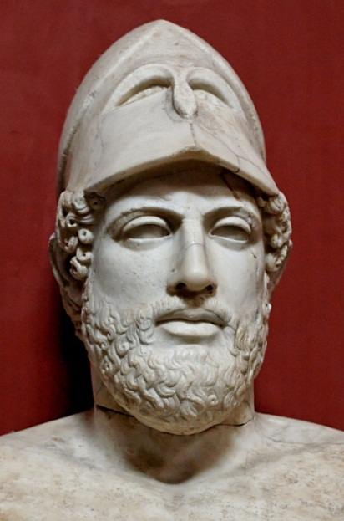
The Age of Pericles & Democracy
Golden Age (460-429 BC) – yrs after wars – Pericles leader of Athens
Created thriving economy; more democratic govt
Thought all citizens should take part in govt
Acropolis was rebuilt
Athens: cultural center of Greece

Slide 38
The Peloponnesian War
Greece split: Athens v everyone else
Sparta & others formed Peloponnesian League
431 BC war broke out btwn Sparta & Athens (27 years)
Sparta allied with Persia and they captured Athens in 404 BC
War ended Athenian domination

Slide 39
Unit 1: Greece
Greece: The Glory That Was Greece

Slide 40
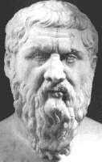
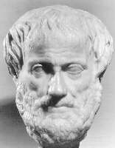
Philosophers
Socrates
Plato
Aristotle

Slide 41
Philosophers: Lovers of Wisdom
Philosophers: Greek thinkers used observations/reason to explain things
“lovers of wisdom”
Explored all areas: logic, ethics, morality
Athens: Sophists dev skills in rhetoric

Slide 42
Socrates
Socrates: Athenian philosopher
Asked ppl about beliefs & get them to examine their answers (Socratic method)
Way to seek truth/self-knowledge
Seen as threat to accepted values/ways of life
Put on trial
Accused of corrupting youth; disrespecting gods

Slide 43
Plato
Plato: Philosopher/student of Socrates
Distrusted democracy after Socrates’ death
Set up the Academy in Athens
School where taught his own ideas
Wrote book: The Republic
Ideal society divided into 3 classes:
Workers to provide
Soldiers to defend
Philosophers to rule

Slide 44
Aristotle
Aristotle: philosopher/student of Plato
suspicious of democracy
Favored rule by single, strong, virtuous leader
Questioned how ppl should live
Good conduct = pursuing the “golden mean” (btwn the extremes)
Thought reason was guiding force of learning

Slide 45
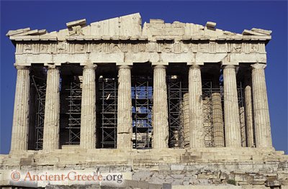
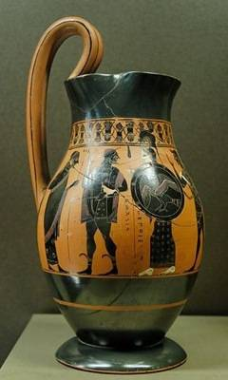
Architecture & Art
Balance, order, beauty
Architecture:
Parthenon: temple dedicated to goddess Athena
Art:
New natural form of sculpture developed
Showed ppl in most perfect, graceful form
Only Greek paintings left are on pottery

Slide 46
Greek Literature
“classical style” seen as model of perfection
Dramas/plays written: moral and social issues
Greatest play writes wrote tragedies
Greek comedies: plays mocking ppl/customs

Slide 47
Unit 1: Greece
Greece: Alexander the Great & the Hellenistic Age

Slide 48
The Empire of Alexander the Great

Slide 49
The Empire of alexander the great
338 BC Athens fell to Macedonian army
Athens & other city-states lost indep
new era in Greece led by Alexander the Great
Macedonia: Rulers were of Greek origin
Phillip II became ruler in 359 BC
Wanted to take over Greece
Conquered many Greek city-states

Slide 50
The empire of alexander the great
All of Greece eventually taken over
Phillip wanted the Persian Empire
Assass before he could take action
Phillip’s son Alexander took over

Slide 51
The Empire of alexander the great
Alex wanted to conquer Persia
Persian empire not what it used to be
Stretched 2,000 miles from Egypt to India
Alex took control of most of Persian Empire but wanted more
Went into northern India in 326 BC

Slide 52
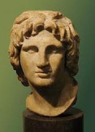
The empire of alexander the great
Died before he could conquer more
32 yrs old; fever
Left his empire “To the strongest”

Slide 53
The legacy
Spread Greek culture across Mediterranean & Middle East
Founded new cities that were influenced by Greece
Local ppl assimilated (absorbed) Greek ideas & Greek ppl took in local customs
Married a Persian woman and adopted Persian culture as well

Slide 54
The legacy
Alexandria, Egypt
Heart of the Hellenistic world
Cultural capital city of Egypt
Created new roles for women
Royal women had power
Cleopatra came to rule in Egypt
Women learned to read & write

