Slide 1
Unit 1: Ancient Civilizations
Ancient Rome

Slide 2
Unit 1: ROME
The Roman World Takes Shape

Slide 3
Geography
Italian peninsula surrounded by water
Tiber River essential
Geography made unification easier
Mountains, not too rugged
Fertile land / supported pop
Rome by coast but center of Italy
Important for growth
Built on 7 hills

Slide 5
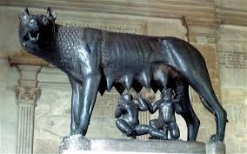
Roman Civilization Arises
800 BC – Latins settled Tiber River
Small villages over 7 hills
Villages become Rome
Called city on 7 hills
Legend of Romulus & Remus
Twin brothers founded city
Sons of Latin woman & war god Mars

Slide 6
Roman Civilization Arises
Greeks in the south
Etruscans north of Rome
Ruled Rome/most of central Italy
Influenced by Etruscans
Adapted Etruscan alphabet taken from Greeks
Architecture (arch)
Engineering (drain marshy lands)
Merged Etruscan gods/goddesses w/theirs

Slide 8
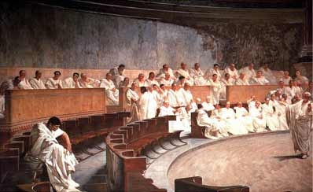
Roman Republic
753-509: ruled by Etruscan kings
509: end of Etruscan rule / estab of Roman state/republic
Lasts 500 years
Form of govt = republic: ppl choose officials
Individuals couldn’t get too powerful

Slide 9
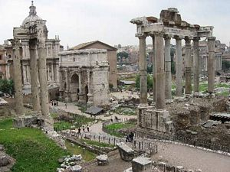
Government Structure
Senate of 300; had most power early on
At first only patricians - landowners, ruling class
Every year 2 patricians nominated to be consuls – supervised govt & lead armies
Dictator chosen by Senate in event of war
Ruler who has complete control over govt
Could only rule for 6 months

Slide 10
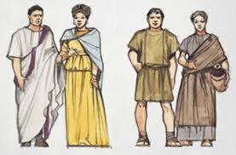
Plebian Rights
Plebeians – most of pop: farmers, merchants, artisans, traders
Little say / few rights – fought for power
Got right to elect their own officials - tribunes
Could reject (veto) laws
Senate forced to + their power/role in govt

Slide 11
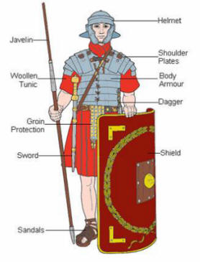
Growth of the Republic
Armies expand power
By 270 BC Rome controlled most of Italy
Roman Army:
Basic unit = legion (~ 5,000 men)
Citizen soldiers
Big rewards, harsh punishments
Conquered ppl treadted fairly
Accept Roman leadership, pay taxes, supply soldiers
Keep customs, money, govt

Slide 12
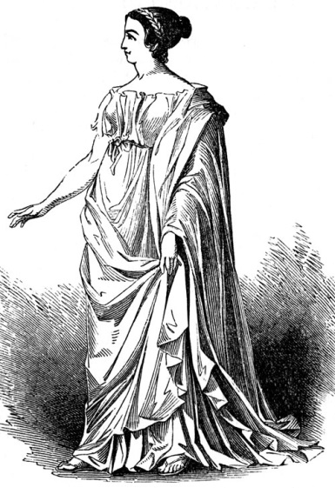
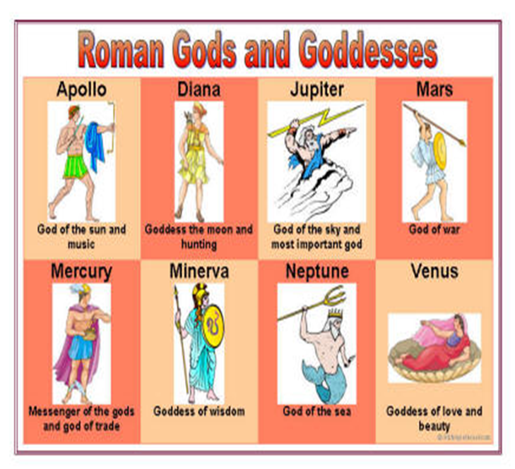
Roman Society
Family = imp to society
Male = head & power
Wife = obey authority
Ideal woman = loving, dutiful, dignified, strong
women gain freedoms
Own prop, run businesses
Most = mother/homemaker
Boys/girls ed: reading/writing
Religion:
Polytheistic
Adapted from Greeks

Slide 13
Unit 1: Ancient Rome
From Republic to Empire

Slide 14
Rome Grows
Began expands around Med Sea
Carthage – city state in N. Africa
Conflict btwn them – Punic Wars
Punic Wars – 3 wars btwn Rome & Carthage
Carthage led by military gen Hannibal
1st Punic War:
Rome wins & gains Sicily, Corsica, Sardinia

Slide 15
Rome Grows
Punic Wars cont…
2nd Punic War:
Hannibal led army/elephants over Alps to surprise attack Romans
FightingCarthage wanted revenge
led back to Carthage – Rome wins
3rd Punic War:
Carthage destroyed by Romans, ppl killed or made slaves
Rome dominated Med
Committed to imperialism – est control over foreign lands

Slide 16
Rome Grows
Conquest = trade & $ to Romans
Gap btwn rich/poor bigger
Wealthy grew & built latifundias & had slaves
Hurt farmers fled to Rome for work
Ppl rioting/protest greedy wealthy Romans / wanted reform
Tiberius & Gaius Gracchus – attempted reforms & angered Senate
Brothers & followers killed

Slide 17
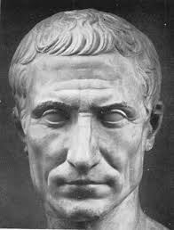
Republic Declines
Civil wars over issues / who should hold power
Senate or pop leaders
Armies became loyal to their generals rather than Rome
Conflicts btwn armies
Julius Caesar: military leader/commander
Dominated with commander Pompey
Conquered Gaul

Slide 18
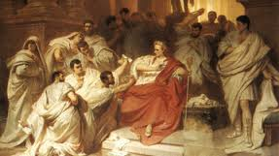
Republic Declines
Pompey betray Caesar / Caesar crushes Pompey
Forced senate to make him dictator
Ppl fearful he’d make himself king – they killed him
Ides of March (March 15th)
Civil wars / fight for power after JC death
Marc Antony v. Octavian – Octavian wins becomes 1st Emperor

Slide 19
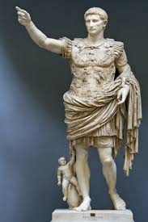
Roman Empire Begins
Octavian given title Augustus
Stable govt set up
Kept senate / opened jobs to ppl regardless of class
Allowed self-govt
Economic reforms:
Took census (pop count), created postal service, new coins
Big issue was who would take over as emperor

Slide 20
Roman Empire
Many diff emperors after Augustus
Caligula & Nero = evil & insane
Series of “good emperors”
Hadrian – codified Roman law (made same everywhere)
Marcus Aurelius
Period of Pax Romana – 200 yr span - Augustus to Aurelius
Time of “Roman Peace”
Prosperity, unity, order, + trade, spread of ideas, entertainment

Slide 21
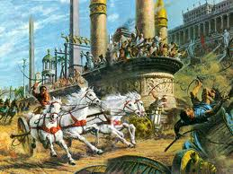
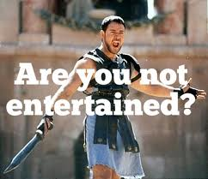
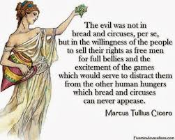
Roman Empire
Pax Romana cont…
Hidden/underlying social & econ problems
Entertainment & free grain used to hide probs from public/distract them
Chariot races, gladiator contests
Policy of “bread & circuses”

Slide 22
Unit 1: Ancient Rome
The Roman Achievement

Slide 23
Roman Ideals & Civilization
Spread through conquest
Admired Greek arts/sciences
New civs blend Roman, Greek, & Hellenistic
Led to Greco-Roman civilization

Slide 24
Literature
Latin used by great Roman writers
Virgil – wrote epic poem Aeneid to show heroic Roman past & bring unity
Others wrote to satirize (make fun of) Roman society

Slide 25
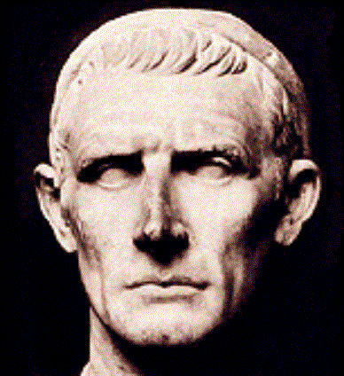
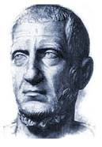
History
Roman historians focused on rise & fall of Rome
Livy – build patriotism by focusing on heroic past
Tacitus – focused on downfalls of Roman past; thought rulers took Roman liberty

Slide 26
Philosophy
Barrowed a lot from Greeks
Hellenistic idea of stoicism
Influenced many
Ideas shown in later Christian teachings
Based on ethics/divine reason

Slide 27
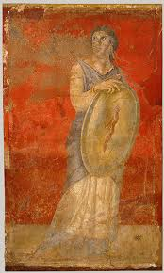
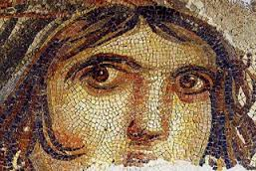
Roman Art
Dev from Greeks & Etruscans
More expressive
Sculptures focused on character
Some idealistic
Artwork showed literature & daily life
Frescoes
Mosaics – pic from pieces of colored stone/glass

Slide 28
Roman Architecture
Dev from Greeks & Etruscans
Big impressive buildings - show power/ dignity
Palaces, temples, stadiums
Improved arches & columns
Used concrete
Dev rounded dome roof

Slide 29
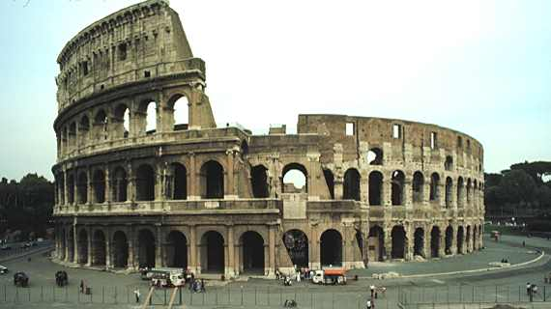
Architecture
Pantheon
Colosseum

Slide 30
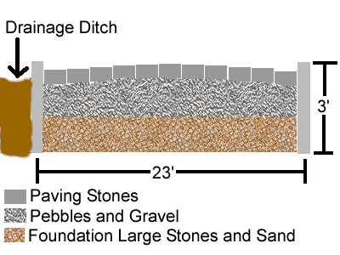
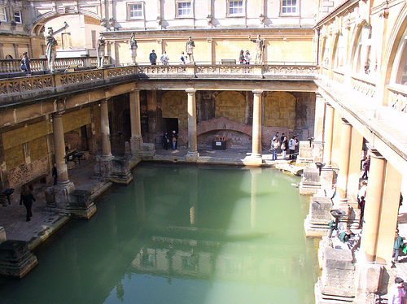
Science and Math
Engineering – science/math to create structures & machines
Roads, bridges, etc
Built aqueducts
Bridgelike stone structures - carried water from mountains to cities
Rich had water in homes
Bath houses

Slide 32
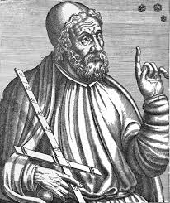
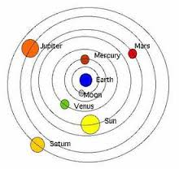
Science and Math
Ptolemy – astronomer; said Earth was center of universe
Stuck for 1500 years
Romans used science practically
maps

Slide 33
New Law Codes Protect the Empire
Big on rule of law & justice
Roman ideas basis for legal systems (US)
Civil law + law of nations
Fair laws applied equally to all ppl
Innocent until proven guilty
Punish for actions, not thoughts
Guilt be est “clearer than daylight”
Judges

Slide 34
Unit 1: Ancient Rome
Christianity in the Empire

Slide 35
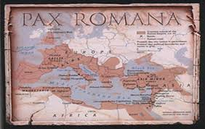
Early Empire
Pax Romana: “Roman Peace”
Christianity dev
Official religion = Roman gods/goddesses
Allowed others in conquered places
Ppl still had to show loyalty to Rome
Honor Roman gods / acknowledge divine spirit emperor

Slide 36
Early Empire
Romans took Judea ~ 63BC
Most Jews lived here
Excused them from worship
Divisions among Jews
Zealots wouldn’t live under Roman rule
Zealots want own state & to revolt
Believed a messiah (king sent by God) would come/lead them to freedom

Slide 38
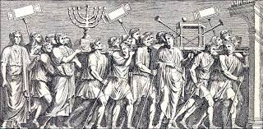
Jews
AD 66: Jewish revolt in Jerusalem
Crushed by Rome 4 yrs later
Romans destroyed Jewish temple/took Jerusalem
Jews fled Judea

Slide 39
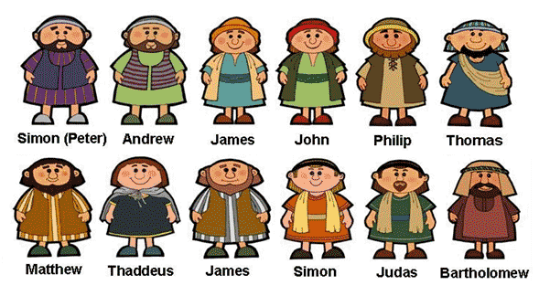
Jesus & His Teachings
Jesus: Born in Bethlehem ~ 4 BC
Jewish teacher / humility, charity, love and forgiveness
The messiah; called “the Son of the Most High God”
Began preaching / recruited disciples (followers) to help
12 disciples / apostles

Slide 40
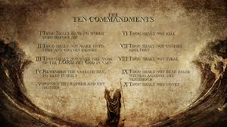
Jesus & His Teachings
Rooted in Jewish tradition
1 God / 10 Commandments
Seen as troublemaker by Jewish leaders & Roman officials
Arrested & crucified
Disciples spread his teachings

Slide 41
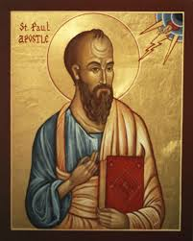
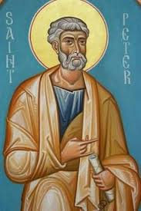
Christianity Spreads
Christians: Jesus = messiah = Christ
Ap. Peter est Christianity in city of Rome
Ap. Paul: most influential in spread
Spread to gentiles (non-Jews)
Believers / followers got salvation (eternal life)

Slide 42
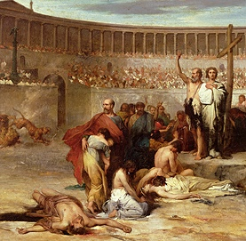
Persecution
religion & persecution grew
Rome feared Christians had higher loyalty
Nero (54-68AD) heavy persecution, fighting in Colosseum, scapegoats
Martyrs – Christians killed – ppl who suffer/die for beliefs

Slide 43
Message & Acceptance
Religion spread despite persecution
Missionaries used Greek philosophy to appeal to educated Romans
Unity of Roman empire helped
Persecution ends 313 AD with emperor Constantine

Slide 44
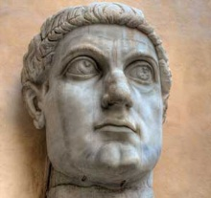
Constantine
Ruler beginning in 313
After winning issued the Edict of Milan: freedom of worship to all citizens of the Roman Empire

Slide 45
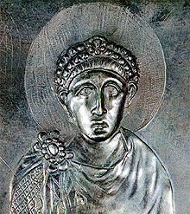
Theodosius
In 392 AD, forbade all religions other than Christianity
Made Christianity official religion of Roman empire

Slide 46
Early Christian Church
Ppl had to be baptized to join church
Blessed with holy water
Ppl gathered Sundays for ceremony of thanksgiving to God
Eucharist – sacred rite where baptized ate bread & drank wine in memory of Jesus
Clergy – grp of ppl who conducted Christian services
Only men

Slide 47
Early Christian Church
Diocese = clergy and Christian community
Each diocese had own priest
Bishop – high Church official responsible for those in his diocese – presided over priest
Bishops of most important cities gained greater authority
Called patriarchs – authority over other bishops

Slide 48
Church Hierarchy
Church developed hierarchy
Rivalry developed
Bishops of Rome called = popes
Started to claim authority over all others
Heresies – beliefs that differ from official Church teachings – caused divisions
Scholars of early Church
Augustine – bishop in N. Africa

Slide 50
Unit 1: Ancient Rome
The Decline and Fall of Rome

Slide 51
Division of the Empire
Political & economic probs after Pax Romana
Political Violence & Instability:
Emperors overthrown by power hungry ppl or military gens; cycle of power & assass
26 emperors in 50 yrs

Slide 52
Division of the Empire
Social & Economic Problems:
High taxes
Farmers left land for protec and lived on large estates
Worked for landowners / farmed small personal plots
Emperor Diocletian wanted to restore order (284)
Divided empire into 2 parts (east/west)
He controlled east; co-emperor Maximian west

Slide 53
Division of the Empire

Slide 54
Division of the Empire
Diocletian fixed prices to slow inflation – rapid rise of prices
Rules to ensure steady food production
312 – Constantine takes throne
Continued reforms
Est new capital, “New Rome” at Constantinople; eastern empire center of power
Reforms only temporary fix

Slide 55
Invaders
Migrating Nomads:
Huns – nomadic ppl of East Asia – migrated to eastern Europe ~ 370 (leader = Attila)
Fought Germanic ppls along the way
Germanic ppl fled to Roman territory for safety
Rome couldn’t keep invaders out; surrendered parts of emp & eventually Rome itself

Slide 56
Invaders
Rome sacked by Visigoths in 410
Germanic grps took over much of western empire
434 – Attila (the “scourge of God”) set out for conquest across Europe
476 – Germanic leader Odoacer ousted Roman emperor
Referred to as the “fall” of Rome

Slide 57
Invaders

Slide 58
Problems/Causes
Military Attacks
Most obvious = invasions
Roman soldiers weaker; mercenaries hired (foreign soldiers serving for pay)
Little to no loyalty to Rome
Political Turmoil
Govt lost support of the ppl; Corrupt officials
Division of Rome while under attack = bad idea

Slide 59
Problems/Causes
Economic Weaknesses
Heavy taxes; reliance on slave labor
Middle class into poverty; population declined
Social Decay
Decline in Roman values (patriotism, discipline, loyalty)
Upper class care only about themselves

Slide 60
The End of Rome???
Eastern part of Roman empire existed for another 1,000 yrs
The Byzantine empire
Roman civilization survived
Under new rule
Germanic ways eventually took over
Christian Church kept aspects of Roman civ

