Slide 1
Chapter 12: Civilization in East & Southeast Asia
2 Golden Ages of China; Mongol & Ming Empires; Korea; Japan

Slide 2
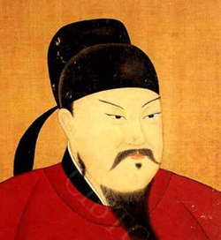
2 Golden Ages of China
Tang Dynasty Reunifies China After 400 years
Tang Dynasty emerged 618
Empire grew / conquered Central Asia territories
Forced Vietnam, Tibet, Korea to be tributary states (rule themselves but China was overall ruler; had to pay tribute to emperor)
Economy grew; initiated land reforms (redistributed land)
Dynasty weakened / overthrown in 907

Slide 3
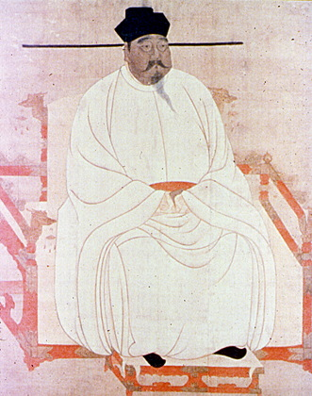
2 Golden Ages of China
Song Dynasty founded 960; Reunification
Ruled 319 years
Foreign trade grew
Under Both Dynasties:
Well ordered society w/ social classes
Gentry – wealthy land owners
Peasants – most people
Women had some status / still treated poorly
Wives/mothers managed servants & family finances
Had feet bound
Peasant women worked in fields

Slide 4
Mongol & Ming Empires
Mongols – 1200; nomadic; chieftain Genghis Khan; vast empire from Pacific Ocean to E. Europe
Invaded China using missiles & cannons; Khan died before conquest of China finished
Took over full rule of China – 1279
Control over the Silk Road / trade grew
Wanted all Mongol government; only Mongols could serve in military; chose non-Chinese for offices instead of Chin.
Established Yuan Dynasty
Ended in 1294

Slide 5
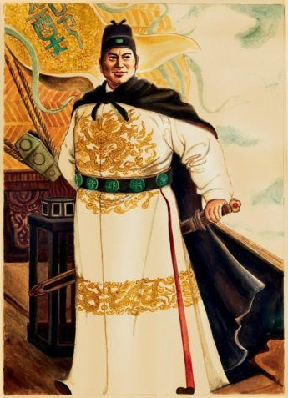
Mongol & Ming Empires
New Chinese dynasty founded in 1368 – Ming
Wanted to show Chinese greatness
Economy grew
Fertile plains; industries in cities
Began overseas exploration
7 expeditions starting in 1405 – led by Zheng He
1435 Zheng He died; exploration ended
Expensive to explore & profit wasn’t good enough

Slide 6
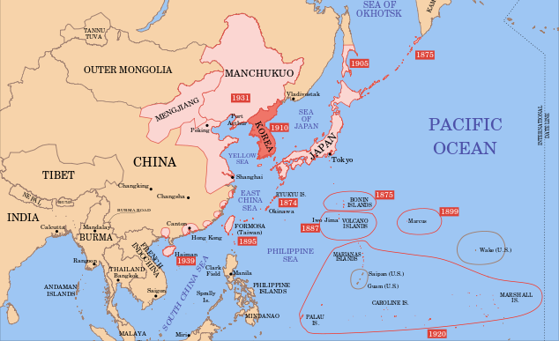
Korea
Peninsula below China
Mountains separate
Geography: Mountains cover 70%; water
Greatly influenced by China b/c of this
Adapted Chinese traditions / passed to Japanese
Government, farming, writing, culture

Slide 7
Japan
Geography was big influence on development
Archipelago: chain of islands
Protected & isolated by surrounding seas
Ppl migrated from Asia mainland
Had a feudal society with an emperor (king)
Emperor really only figurehead – didn’t have much power
Warlords fought for land
Samurai = to vassals/knights

