Slide 1
Unit 4: Enlightenment & Revolution
The Enlightenment & American Revolution

Slide 2
Unit 4: Enlightenment & A. Rev
The Enlightenment

Slide 3
What was it?
Philosophical mvmt / focused on reason
Using scientific meth in all areas of study
Natural law - rules of conduct through reason - chelp explain aspects of humanity
Better understand society, politics, & econ

Slide 4
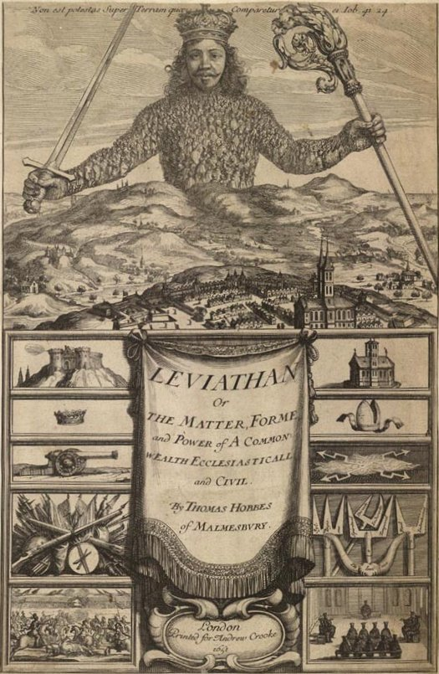
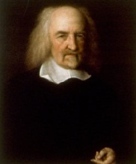
Fathers of the Enlightenment
Thomas Hobbes
Wrote Leviathan – said ppl are naturally cruel, greedy, & selfish
Need control
Ppl should enter into social contract – agreement to give up freedom for organized society
Believed in powerful govt – absolute monarch

Slide 5
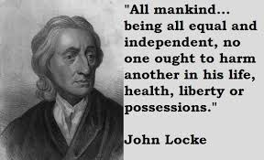
Fathers of the Enlightenment
John Locke
Ppl = decent & had natural rights – for all humans from birth (life, liberty, property)
govts to protect these rights
Best govt was limited & liked by all
ppl have right to take out govt if it fails/violates ppl’s rights
Ppl molded by experiences
Environment shapes the person

Slide 6
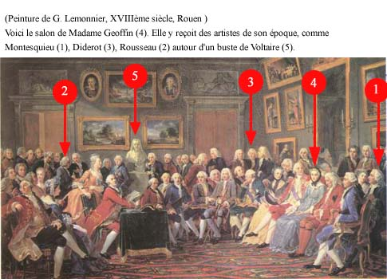
The Philosophes
Enlight ideas big in 1700s
French Enlight thinkers used science to understand / fix society
Use of reason
Called philosophes

Slide 7
Thinkers of the Enlightenment
Montesquieu – studied govts
Wrote Spirit of the Laws in 1748
Govt best divided into 3 branches
Separation of powers, checks & balances…
Ideas = big influence on US Constitution

Slide 8
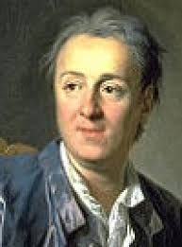
Thinkers of the Enlightenment
Voltaire: criticized Christianity; focus on tolerance & inequality; fought for freedom of speech
“I might disagree with your opinion, but I am willing to give my life for your right to express it.”
Diderot: wrote Encyclopedia; set of 28 books that spread Enlight ideas

Slide 9
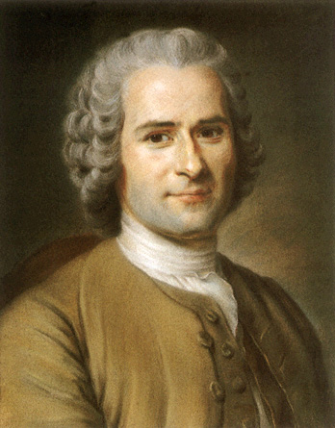
Thinkers of the Enlightenment
Rousseau: ppl naturally good / corrupted by evils of society
Wrote The Social Contract – freely elected govts should have control
Good of community was most imp
Women men
Had nat rights but limited to home/fam
Women begin protest – mid 1700s
Want equal ed & to make own decisions

Slide 10
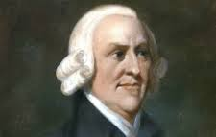
New Economic Thinking
French economic thinkers = physiocrats
Rational sys based on natural laws of economics
Rejected mercantilism (govt reg of economy)
Supported free trade & opposed tariffs (tax on imports)
Adam Smith – Scottish economist
Wrote The Wealth of Nations – wanted free market to reg bus activity
Invisible Hand Theory & Laissez Faire– little or no govt in bus
laid back / hands off approach to economy
Supply, demand, competition fix econ naturally

Slide 11
Unit 4: The Enlightenment & A. Revolution
Spread of the Enlightenment

Slide 12
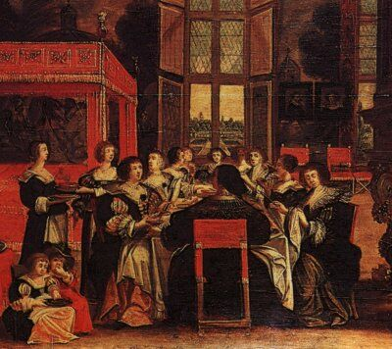
Ideas Challenge Society
Heart of Enlight = Paris
Upper class spread w/books
Most wanted change & just society
Censorship used to keep old ways
Fiction used as loop hole
Ideas spread in salons
Social gatherings
Put on by women

Slide 13
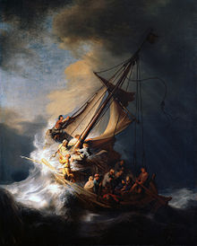
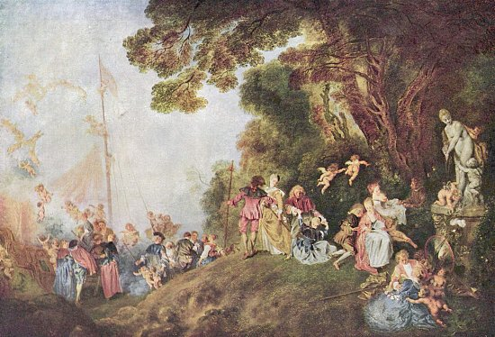
Arts/Lit Reflect New Ideas
Art style changed w/Enlight
Before = baroque – large, ornate, colorful, battles… - during time of Louis XIV
Rococo style dev – charming, lighter, elegant, flowers, pastels
Big w/ upper class

Slide 14
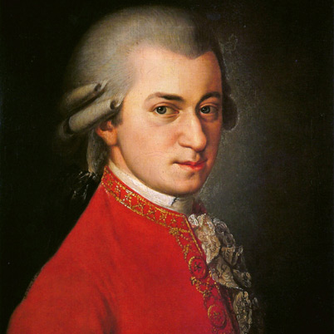
Arts/Lit Reflect New Ideas
New music – classical
Ballets & operas
Sebastian Bach
Mozart
New literature & bigger audience
Middle class
More novels

Slide 15
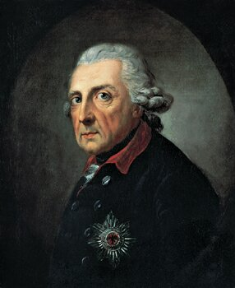
Enlightened Despots
Monarchs split btwn absolutism & enlight ways
Enlightened despots – abs rulers who brought change
Frederick the Great (Prussia, 1740-1786)
Tight control/worked for common good
Reduce torture, free press, simplified laws, religious tolerance

Slide 16
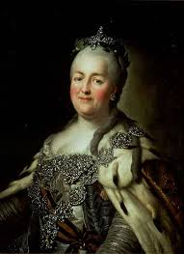
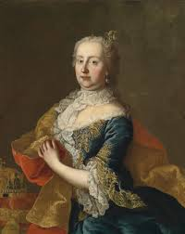
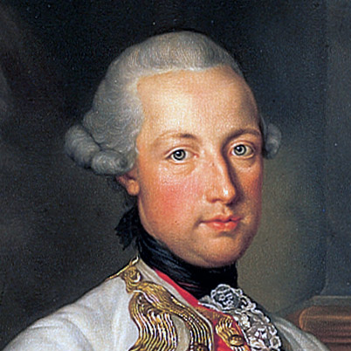
Enlightened Despots
Catherine the Great (Russia; 1760s)
Wanted equality & liberty
Abolish torture, est relig tolerance
Still had tight control
Maria Theresa (Austria)
Wanted better life for peasants
Joseph II (Austria) – most radical
Relig equality, no censorship, no serfdom

Slide 17
Slow Change
Peasant life didn’t change much
Very slow change
Many resisted enlightenment
Eventual transformation in 1800s

Slide 18
Unit 4: Enlightenment & Amer Revolution
The American Rev & Birth of the US

Slide 19
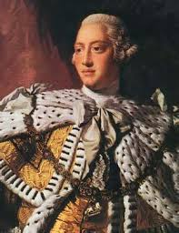
Britain Becomes Global Power
Controlled trade – mercantilism/great location
Won conflicts / control slave trade
Big territory – made United Kingdom of Great Brit (1707 / Ireland joined 1801)
George III – 1760 made king (60 yrs)
Controlled / restricted 13 colonies
In power at time of American Revolution

Slide 20
Colonist Discontent
F&I War put Brit in debt
George made colonists pay
taxes:
Sugar Act (1764): import taxes
Stamp Act (1765): taxes on printed materials
Colonists oppose/angry
“No taxation w/out representation”
Led to tension/restrictions/+ tax

Slide 21
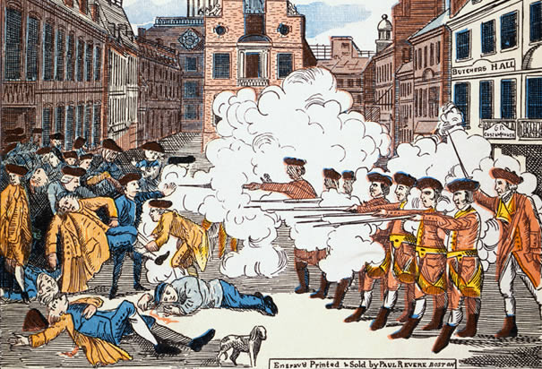
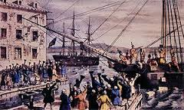
Colonist Discontent
Boston Massacre – March 1770: fight btwn colonists & Brit soldiers
British shoot into crowd / parts still unknown
5 colonists killed and called massacre by colonists
Boston Tea Party – col dump tea in Boston Harbor

Slide 22
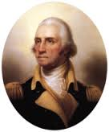
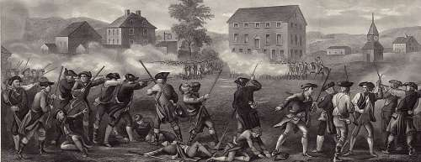
Colonist Discontent
Col reps met in Philly to decide action
John Adams & George Washington there
Led to war:
Lexington & Concord was start of the Rev War
Washington led Continental Army (patriots)

Slide 23
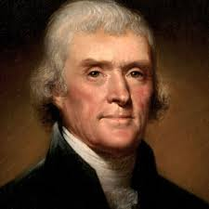
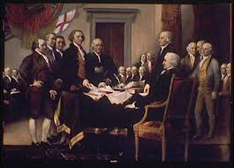
Independence
2nd Continental Congress vote for independence
Thomas Jefferson: main writer of Declaration of In.
Used Locke’s views: “life, liberty, & property”
Popular sovereignty: govt of the people
July 4, 1776 – Declaration adopted
Still not “free”

Slide 24
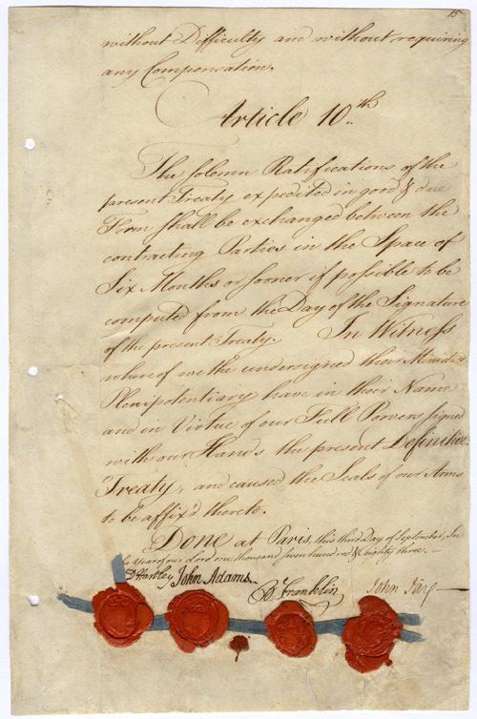
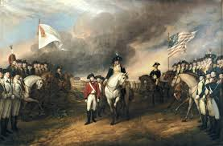
The Rev Continues
1/3 of colonists = loyalists (support Britain)
France help colonists after Battle of Saratoga in 1777
1781 – war ends at Yorktown, VA
Treaty of Paris ended the war

Slide 25
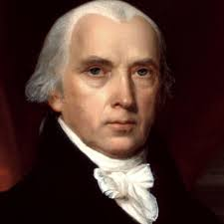
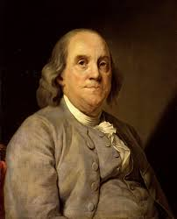
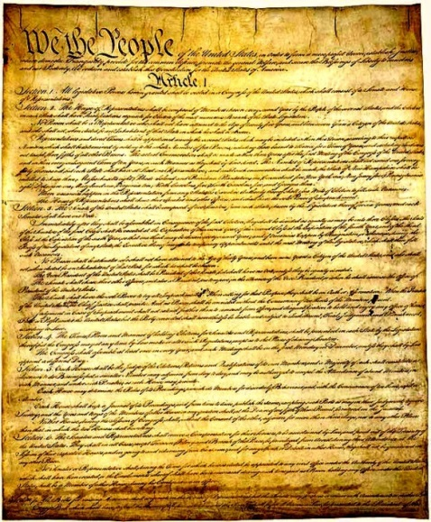
A New Constitution
1st govt = Articles of Confederation
Too weak; too much state control
Met in Philly again (1787) to fix prob
James Madison, Ben Franklin, G. Wash
Wrote the Constitution
Created federal republic w/ divided power (3 branches)
Separation of powers

Slide 26
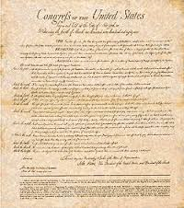
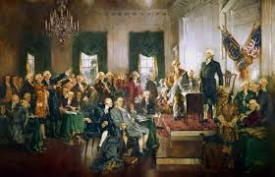
A New Constitution
Ideas of Enlight in Constitution
Not everyone liked
Bill of Rights included before states would ratify/approve
Adopted in 1789

