Slide 1
Unit 7: Economics and Choices
The Economic System at Work

Slide 2
Economic Systems
Economics = study of decision making in world w/ limited resources
System used to produce/distribute goods/services
Vary all over world
Want-satisfaction chain = goods/services to satisfy wants
Competition = main factor in setting prices

Slide 3
Types of Economic Systems
Traditional Economy – based on traditions, culture, hist
Grow / make goods to survive
Barter sys / trade
Undeveloped countries
Command Economy – govt makes all decisions
Govt owns all factors of prod & nat resources
Communist govts (Cuba & N. Korea)

Slide 4
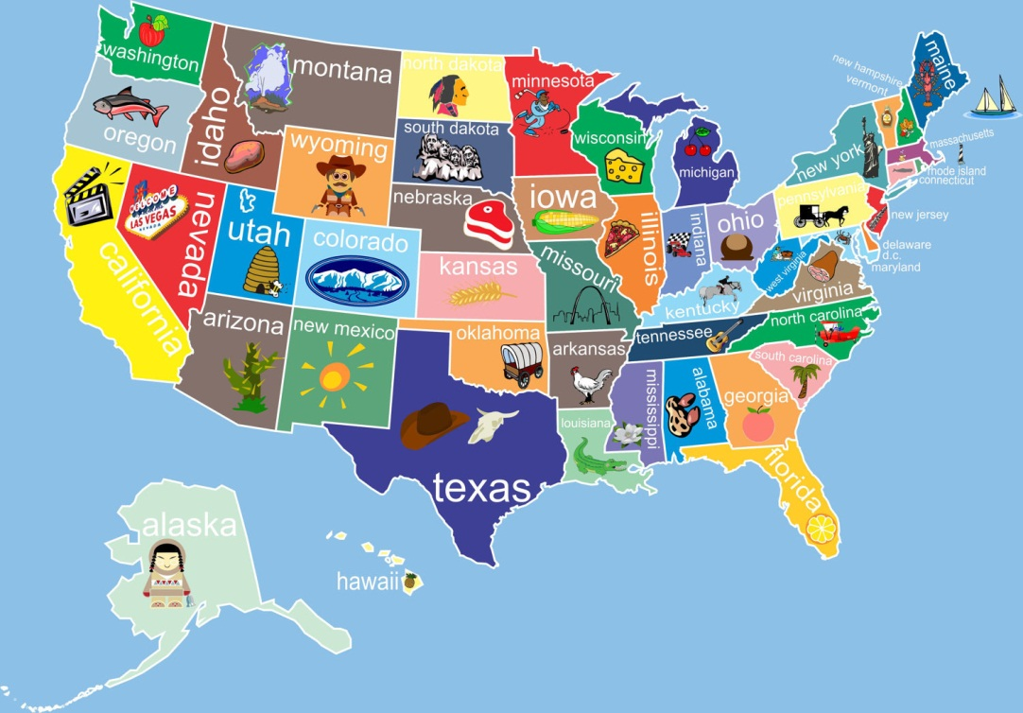
Types of Economic Systems
Market Economy – decisions made by the ppl
Personal needs/interests put 1st
Based on freedoms & rights
Little/no govt interference or reg
Free market – right to buy & sell goods as you choose
Most countries

Slide 5
Market Economy
Based on 5 economic freedoms
Freedom to compete
To own property
To buy & sell
Of workers to compete for jobs
To earn profits
Want to make profit – $ left after expenses
Competition for resources

Slide 6
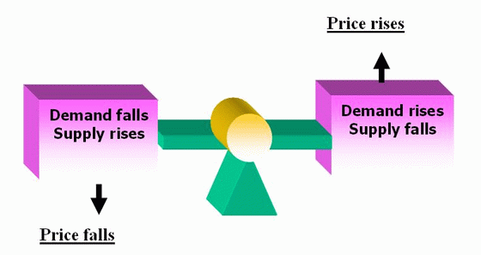
Market Economy
Supply & Demand:
Most basic of all economic principals
Leads to price changes
Law of supply – if price goes ↑, supply goes ↑; if price goes ↓, supply goes ↓
Law of demand – if price goes ↑, demand goes ↓; if price goes ↓, demand goes ↑
Want balance / equilibrium price

Slide 7
Market Economy
Free enterprise: bus. operate w/ little govt interference
No limit on profits / no success guarantee
Comp important for low prices, high quality
Innovation – new ideas
Patent – rights to sell for certain time
Copyright – right to publish/sell writing, art, music
Capitalism: productive resources privately owned
Driving force of Amer econ
Encourages $ investment to make $
Freedom to buy/sell as you please
Benefits society as a whole

Slide 8
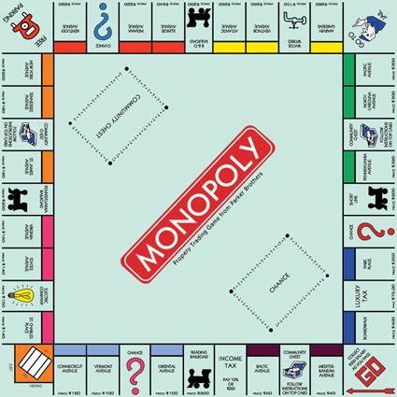
Market Economy
Monopolies: only 1 company selling product/service
Usually banned in most market econ
Price fixing / gouging occurs
Quality = problem
Natural monopolies are legal – certain public utilities

Slide 9
U.S. Economic System
Mixed economy – combines elements of diff econ sys
Bus have freedom / regulations to meet
Ex: wage laws, discrimination laws
American business
Large bus grew in late 1800s
Big business essential
Big businesses join together = conglomerates

