Slide 1
Unit 4: Enlightenment & Rev
The Industrial Revolution

Slide 2
Unit 4: The Industrial Revolution
The Beginning

Slide 3
What Was It???
1750s-1850s
Time when ppl/nations went from agrarian lifestyles to more industrial/urban
Why would this change lives/how society works? Why was this a turning point in world history????

Slide 4
What Caused It???
Agricultural rev during 1700s
Improved farm prod, experiments, crop rotation
Dutch led / British adv.
Enclosure – taking & consolidating land that was shared by peasant farmers
Farmers kicked off land & moved to towns/cities
Workers of the rev

Slide 5
What Caused It???
Pop growth bc of ag rev
~5 million in 1700 to ~ 9 million in 1800 (Brit)
In Europe: ~ 120 mil to 180 mil
Dev of new tech was key
New sources of energy; Coal = original source
1712: steam engine
1764: James Watt improved steam engine (“Father of the IR”) – key power source of IR

Slide 6
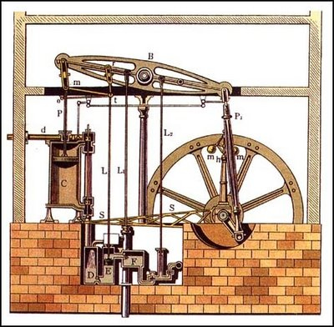

Slide 7
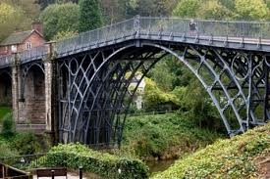
What Caused It???
New tech cont…
New ways to produce iron: needed coal
1709: used coal to smelt iron – separate it from its ore
Produce less expensive & better iron – made parts for steam engine
Built bridges, railroads, etc.

Slide 8
Unit 4: The Industrial Revolution
Britain Leads the Way

Slide 9
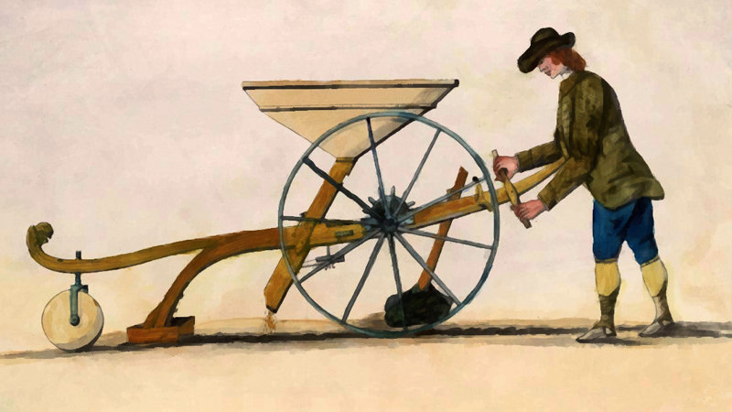
Causes Review
Agricultural revolution
Population growth
New technologies & energy sources
Iron
Enclosure

Slide 10
Why Britain???
Lots of natural resources
Natural ports, rivers, coal, iron
High demand for goods & money
Capital - $ used to invest in businesses
Enterprise – businesses organization
British govt supported econ growth
Protect waters & trade

Slide 11
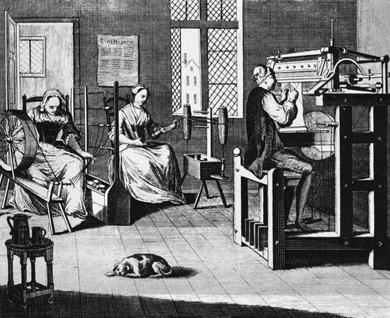
Textile Industry
Largest industry in Britain – cloth
The putting-out system – at home cotton cloth industry (cottage industry) – very slow
Peasants got raw cotton, spun it & wove it, cloth given to people to finish

Slide 12
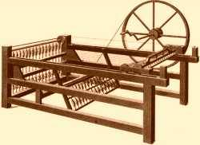
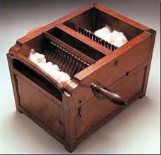
Textile Industry
New machines = faster production in Brit
Eli Whitney cotton gin in the US
Took out seeds
Cottage industry replaced by factories

Slide 13
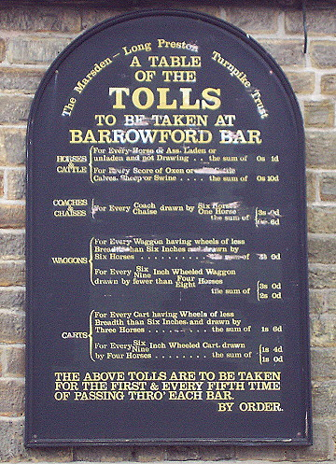
Transportation Revolution
Why is better, faster transportation necessary???
Needed to move product w/ increased production
Ppl built turnpikes – private roads that charged fee
Stronger bridges

Slide 14
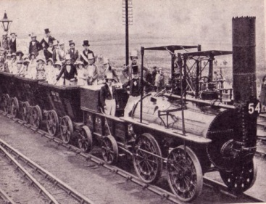
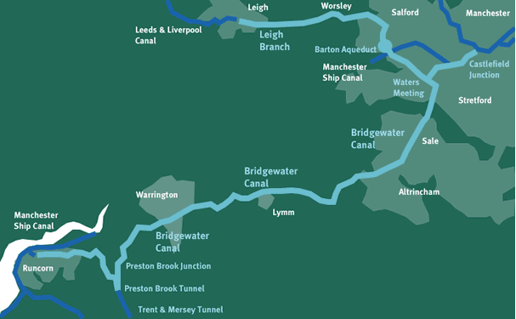
Transportation Revolution
Canals dug connect rivers / towns to ports
Canal companies created, made coal cheaper, made $ on tolls
Died out when RR came
Steam locomotives (trains & RRs)
Could ship over land
1st major rail line from Liverpool – Manchester in 1830

Slide 15
Unit 4: The Industrial Revolution
Social Impact

Slide 16
Move to the Cities
IR brought rapid urbanization – ppl moved to cities
Small towns popped up out
Mainly around coal or iron mines
Grew into big cities
Cities around factories
Changed distribution/location of labor/ppl

Slide 17
New Social Classes
New middle class created
Industrial middle class (bourgeoisie)
Owned/operated new factories, mines, RR…
Lived comfortably, no sympathy for poor, focus on raising kids & getting ahead
Industrial working class – poor who lived in bad conditions
Tenements – buildings w/ small crowded apts - no running water, no sewage, terrible smell, piled up garbage/waste; diseases spread

Slide 18
New Social Classes
Secret labor unions (worker organizations) existed – illegal
Wanted work reforms: better pay, conditions
Industrial riots (textile workers)
Religious mvmt attracted workers
Methodism (Methodist) – spread into slums
Bring hope/comfort to struggling workers/poor

Slide 19
Working Conditions
Harsh living/working conditions
Factory workers: long hours (12-16 hrs), no safety, accidents & disease, terrible pay
Initially women
Mine workers: better pay & worse conditions
Very dangerous, got sick, women & children worked mines too

Slide 20
Working Conditions
Children:
Start around 7/8 years old
Worked under machines in factories
Hauled coal, worked in the dark
Child labor laws (“factory acts”) passed early 1800s
Reduce hrs to 12/day, none under 8 yrs in cotton mills
Laws not usually followed; more put into place

Slide 21
Results of the IR
Various social problems
Positives:
Demand increases → new factories → jobs
Higher wages
More opportunities for people

Slide 22
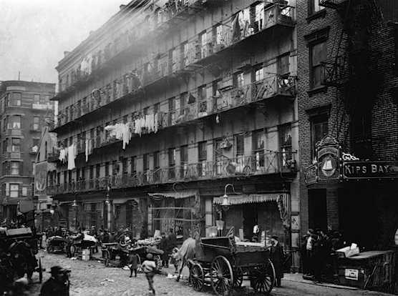
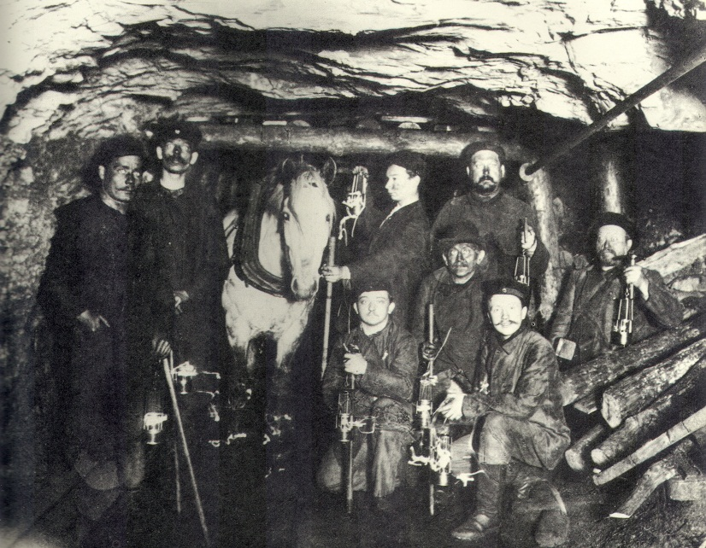
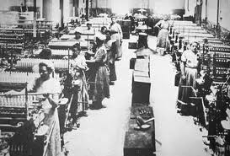

Slide 23
Unit 4: The Industrial Revolution
New Ways of Thinking

Slide 24
Laissez Faire Economics
Adam Smith – “hands off” approach to econ
A free market & free enterprise
Thomas Malthus – pop outgrow food supply – poor would suffer (proved wrong)
David Ricardo – British economist
Working class wouldn’t escape poverty
Malthus/Ricardo: no govt help for poor
Improve through hard work & limiting fam size

Slide 25
Utilitarians For Limited Govt
Ppl wanted to modify laissez faire to include some govt inv.
Economist Jeremy Bentham:
Utilitarianism – idea that goal of society should be “greatest happiness for the greatest number” of it’s citizens
Supported indiv freedom / some govt involv.

Slide 26
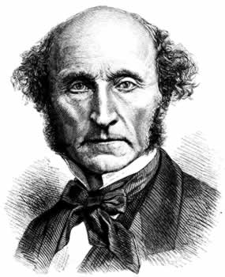
Utilitarians For Limited Govt
Economist John Stuart Mill – govt supposed to step in / help working class
Wanted workers & women to vote
Middle class didn’t agree

Slide 27
Socialist Thought
Ppl thought cap brought huge gap btwn rich & poor, poverty & injustices
Solution = socialism – sys where ppl as a whole, not individuals, own all property / operate all businesses & means of production
MoP: farms, factories, RR, other bus that produce goods
From enlightenment; faith in progress, concern for social justice; belief in goodness of human nature

Slide 28
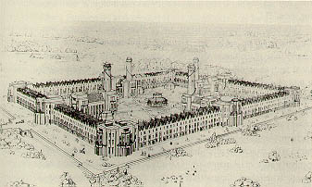
Socialist Thought
Early socialists estab communities
Socialist communities: ppl shared work/prop
These early socialists called Utopians
No rich/poor, no fighting…impractical dreamers
Robert Owen – Utopian opened comm in Scotland put own ideas in practice

Slide 29
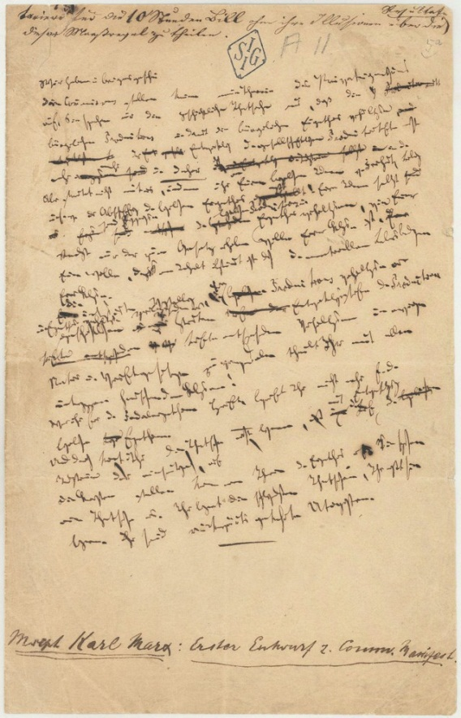
Karl Marx: Class Struggles
Karl Marx – German philosopher
1840s: condemned utopian ideas (unrealistic)
New theory of “scientific socialism”
Wrote Communist Manifesto 1848
Basically dev communism – form of socialism where inevitable struggle btwn social classes lead to classless society where all MoP were owned by community/govt

Slide 30
Marxism in the Future
1860s Germany adopted Marx’s ideas
Formed social democracy – gradual transition from cap to soc
Russian socialists adopted Marxism in late 1800s
Russian Revolution of 1917 brought communist govt

Slide 31
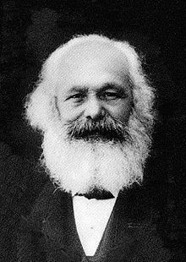
Marxism in the Future
World revolutionaries adapted idea to fit their needs (Asia, Latin America, Africa)
Lost appeal w/ failures of Marxist govts
Ppl were more loyal to nations rather than their social class

