Slide 1
Unit 2: Regional Civilizations
The Middle Ages

Slide 2
Unit 2: regional civs
Middle Ages: Feudalism

Slide 3
What is Feudalism???
Middle Ages = 1000 yrs btwn fall of RE and start of the Renaissance
Feudalism = loosely organized system of rule
Society = network of mutual obligations/agreements
Reason for it:
Safety from invaders
Ppl needed to live in groups
Fighting groups needed to be organized

Slide 4
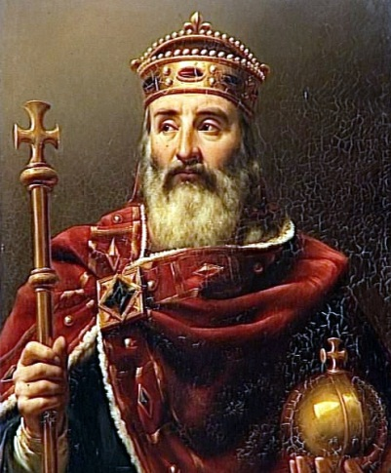
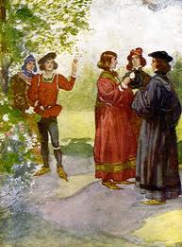
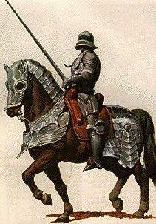
Feudalism Hierarchy
KINGS
LORDS
(NOBLES)
VASSALS
(KNIGHTS)
SERFS

Slide 5
Feudal People
Lords- leaders who gave land to vassals for military service
Ex: dukes, counts
Vassals- warriors who swore oath to their leader
become knights – mounted warrior
Serfs- ppl tied to the land

Slide 6
Feudalism
Feudal contract = exchange of pledges btwn lords & vassals
Vassals could have own vassals
Land = wealth
Plot of land = fief

Slide 7
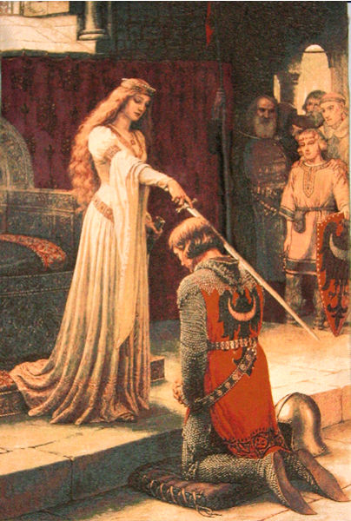
Knights and Nobles
Warfare = way of life
Rival lords – constant battles
Trained as boys for future as a knight
Sent away at 7 / Learned to ride/fight
Training = hard/disciplined; laziness not tolerated
Youth called knight after training finished
Public ceremony
Fought on horseback/used swords, axes, lances
Wore armor & carried shields
Others – on foot / used daggers, spears, crossbows…
Tournaments – mock battles

Slide 9
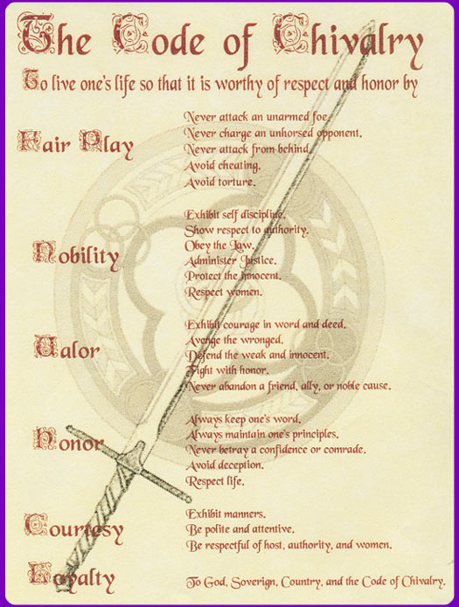
Chivalry
Knight code of conduct in later MA – chivalry
Be brave, loyal, true to word
Fight fairly in war
Protect the weak – peasants & women
Women put on pedestals
Rules only applied to nobles
Troubadours – wandering musicians sang ~ brave knights & their lady loves

Slide 10
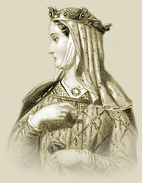
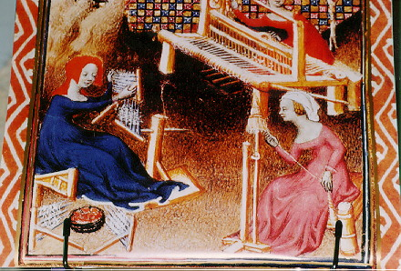
Noblewomen
“lady of the manor”
active role in warrior society
Took over duties while men off fighting
Some participated in politics – Eleanor of Aquitaine
Usually no inheritance – went to eldest son
Arranged marriages as early as 12
Marriage training / kids & dutiful wife

Slide 11
The Manor: An Economic System
Lord’s estate = manor = heart of med econ
Manor = 1+ villages & surr. lands
Peasants (serfs) lived on / worked the manor
Lords & peasants had mutual obs:
Peasants farmed land; repairs; had to ask to marry; paid fees/fines
In return – farmed some land for self; protection; couldn’t be forced off land; given food, housing, land
Manor was self-sufficient – produced things needed for themselves

Slide 12
The Manor

Slide 13
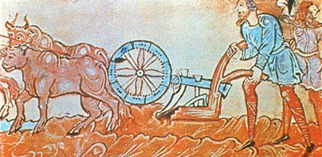
Peasant Life
Harsh, hard work sun up - sun down
Hunger/disease probs
Many didn’t live past 35 / poor diet – little meat
Fam & animals slept together in hut
Week off during Xmas & Easter

Slide 14
Unit 2: Regional civ
Middle ages: castles

Slide 15
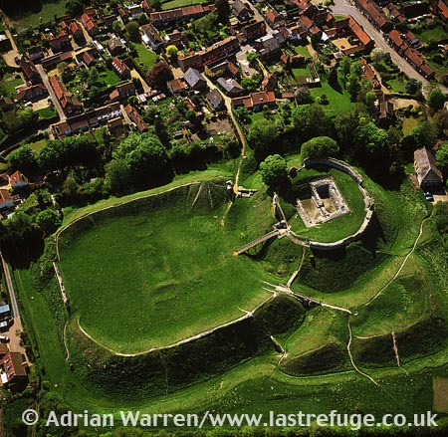
Early Castles
Early Castles: Motte and Bailey style
Had to get a “License to Crennilate”

Slide 16
Early Castles
1127: Rochester Castle in England, first stone keep (tower)
Keep has: Forebuilding, Thick walls
There were both royal and private castles

Slide 17
Rochester Castle

Slide 18
Development of Castles
Small windows
Grew in size
Grew in shape
Purpose: look so tough, no one will want to attack

Slide 19
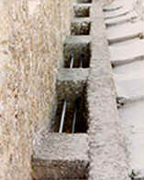
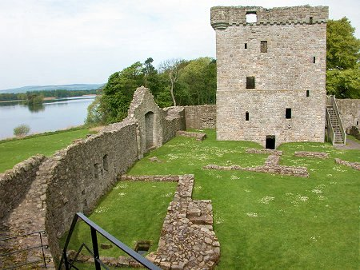
Later Developments
Curtain Walls around the castles
Mechicolations
Drawbridges

Slide 20
Unit 2: Regional Civs
The High & Late Middle Ages: Royal Power Grows

Slide 21
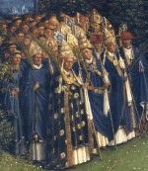
Monarchs, Nobles, & the Church
High Middle Ages: ~ 1000-1300
Nobles & clergy almost as powerful as monarchs
Monarchs not happy; wanted all power
Power began to shift during HMA

Slide 22
Monarchs, Nobles, & the Church
Monarch used various ways to centralize power
Expanded royal domain (area)
Set up system of royal justice (challenged other courts)
Organized govt bureaucracies
Created tax system
Built armies
Strengthen ties w/ middle ppl

Slide 23
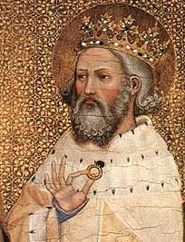
English Kings = More Power
Many groups settled England in EMA
English rulers in control & kept kingdoms united most of EMA
1066: Anglo-Saxon king Edward died w/out heir
Harold picked to rule (bro in law of Ed)
William, Duke of Normandy claimed throne
Eddy

Slide 24
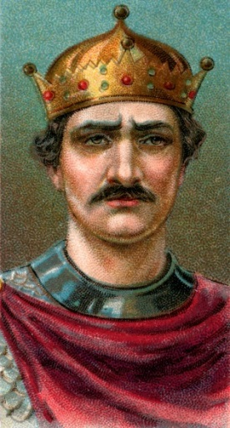
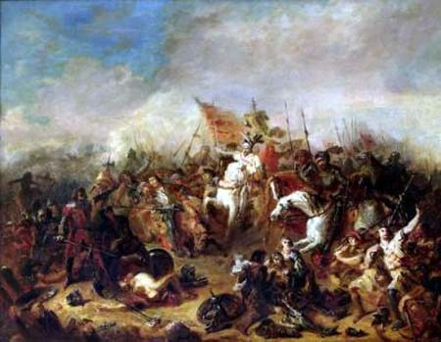
English Kings = More Power
William of Normandy: French
Raised army & Pope on his side
Defeated Harold at Battle of Hastings
Became known as “William the Conqueror”
Made king on Christmas Day 1066
New French pop blended w/ English Anglo-Saxons
New customs, traditions, languages

Slide 25
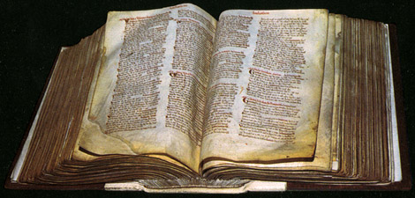
English Kings = More Power
William wanted control over land
Distributed land
Monitored castle building
Vassals to swear ultimate allegiance to him over others
Took census – Domesday Book
create efficient tax system
Royal treasury eventually created
1154: Henry II inherited throne
Henry expanded royal justice sys & sent traveling judges

Slide 26
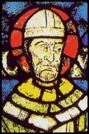
English Kings = More Power
Royal court decisions = basis of English common law
Legal sys based on custom / court rulings
for all ppl in England
Early jury sys. created under Henry II
Henry fought w/ church over legal authority
Archbishop of Canterbury murdered (Thomas Becket)
Henry let up on clergy regulation

Slide 27
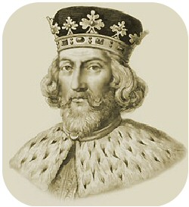
Evolving Traditions of Government
English rulers clashed w/ nobles & clergy
King John: son of Henry II, clever, cruel, untrustworthy
3 powerful enemies during rule & lost to all
King Phillip II France; Pope Innocent III; His own English nobles
Lost land in France & Excommunicated by Pope
England under interdict – couldn’t have church services
England made fief of papacy / pay Rome yearly fee

Slide 28
Evolving Traditions of Government
John taxed nobles & abused power = angry nobles
Grp of rebellious lords forced him to sign the Magna Carta – great charter
Limited King’s power
Legal rights of townsppl & church
Great Council -> Parliament during 1200s
Became England’s legislature

Slide 29
Successful Monarchs in France
Kingdoms in France = broken/ruled by powerful nobles = probs for monarchs
987: Hugh Capet elected French ruler
Started weak/slowly increased royal power
Made throne hereditary (Capetian dynasty lasted 300 yrs)
Gained land & support of the Church & Built effective govt
1179: Philip II made king of France
Paid middle class ppl to be officials in exchange for loyalty

Slide 30
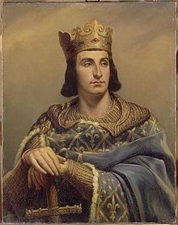
Successful Monarchs in France
Philip II
Granted new charters; New national taxes
Quadrupled royal land
Most powerful ruler in Europe before death in 1223
1226: Louis IX made king of France
Very religious / led French in 2 Crusades against Muslims
Declared saint by Church
Outlawed private wars, ended serfdom, expanded royal courts

Slide 31
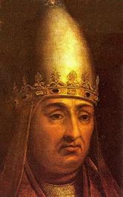
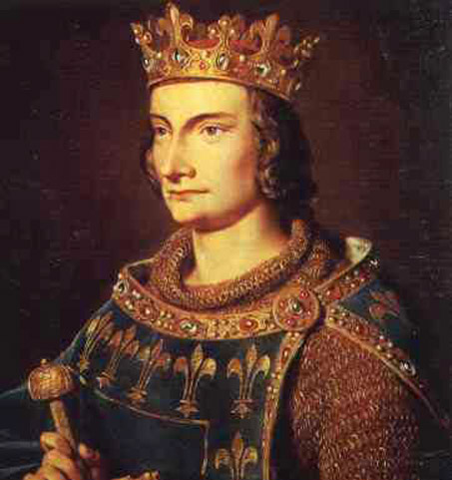
Successful Monarchs in France
Philip IV: Louis’ grandson – ruthless
Clashed with Pope Boniface VIII over taxing clergy; pope fled
1305 – Frenchman elected pope & moved papal court closer to France
Led to Church crisis with pope elected in Rome

Slide 32
Unit 2: Regional Civs
The Middle Ages: The Crusades

Slide 33
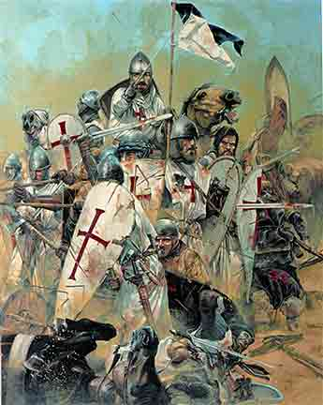
The Crusades
Crusades:
Series of wars; Began in 1096; lasted ~ 200 years
Christians battles Muslims for land in Mid East
Goal: to free Jerusalem and the Holy Land from Muslim Infidels
1095: Pope Urban II promised remission of sins for all who went
Reasons to go:
Religion – “God wills it”
Adventure & Gain Land
Trade Opportunities

Slide 35
First Crusade: 1096-1099
Mostly Frenchmen
Took Jerusalem, massacred inhabitants
Established 4 kingdoms surrounded by Muslims
Jerusalem, Edessa, Antioch, Tripoli

Slide 36
Second Crusade: 1147-1149
Muslims tried to destroy 4 crusader states (kingdoms)
A total failure by Europe
1187: Jerusalem fell to Muslims

Slide 37
Third Crusade: 1189-1192
Led by Frederick of Germany, Richard I of England, and Phillip I of France
Fail
Richard negotiated safe passage for Christian pilgrims to Jerusalem

Slide 38
Fourth Crusade: 1202-1204
Crusaders fought other Christians
Italians attacked Constantinople
Another failure

Slide 39
Aftermath & Effects
Muslims control Crusader States / Christians killed
European economies grow
Trade & Money economy
Kings gained land/power
Discrimination against Jews (Anti-Semitism) & religious hatred
Expanded world view (exploration)

Slide 40
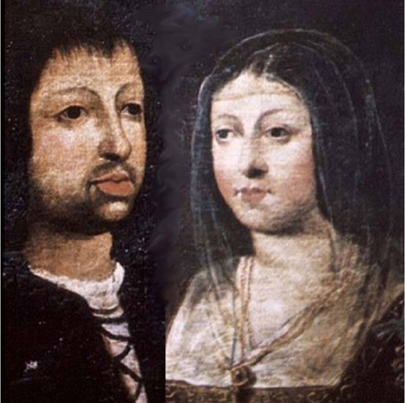
The Reconquista
Christians in Iberian peninsula still fought Muslims
Campaign to drive them out = the Reconquista
1300 Christians control
1469 Spain created with marriage of Ferdinand & Isabella
Made everyone Christian & created the Inquisition – Church court to try those practicing other religions

Slide 41
Unit 2: Regional civs
Middle Ages: The Plague

Slide 42
The Plague
Entered Europe through the port of Caffa in 1347.
Spread via trade routes, carried by people from town to town
In England 1348
~25 million dead; killed 1/3 of population

Slide 45
Bubonic Plague
30-75% death rate
Spread through flea bites, fleas traveled on rats
Symptoms: swollen lymph nodes, headaches, vomiting, fever.

Slide 46
Pneumonic Plague
90-95% death rate
Flea bites, traveled on rats
Infected lungs, victims died quickly (within a week)

Slide 47
Septisemic Plague
99.9% mortality rate
Spread through airborne germs
Fever, skin bruises, people died the same day as symptoms appeared

Slide 48
Treatments for the Plague
Scents: “Ring around the Rosie”
Sounds
Charms/potions
Quarantine of houses/ships/towns
Fire (burn bodies or houses of victims)

Slide 49
Effects of the Plague
Killed clergy and health workers
Loss of some skills
Workers could demand more money
Death of law enforcement led to lawlessness
Loss of power for church

