Slide 1
Pre-history: Studying & Understanding Our Past

Slide 2
History & Prehistory
Historians – people who study/write about the historical past
Prehistory - period of time before people invented writing
Divided into different eras or periods
Old Stone Age or Paleolithic Period = 2 million BC to ~ 10,000 BC
New Stone Age or Neolithic Period = 10,000 BC to end of prehistory (when writing was invented)

Slide 3
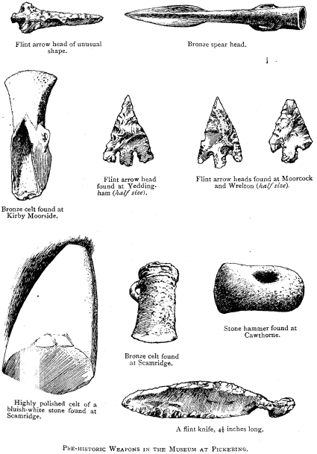
Old Stone Age
Time of early modern humans
Nomads – people who move from place to place in order to survive and find food
People made tools/weapons out of things in their environment (stone, bone, wood)

Slide 4
New Stone Age
People learned to farm
Neolithic Revolution – Switch from nomadic lifestyle to settled farming
First permanent villages settled by farmers

Slide 5
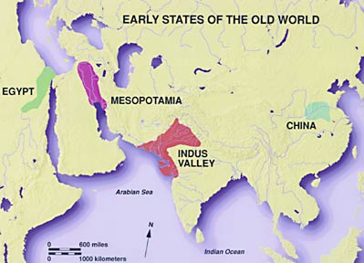
Beginnings of Civilization
Civilization – complex, highly organized social order
Early civilizations all built near major water source
Allowed for transportation and regular water supply
1st Civilizations
Sumer, Egypt, and the Indus
Cities are main feature

Slide 6
7 Basic Features of Civilizations
Organized governments
Complex religions
Job specialization
Social classes
Arts and architecture
Public works
Writing

