Slide 1
Unit 3: Early Modern Times
The Renaissance, The Protestant Reformation, & Scientific Revolution

Slide 2
Unit 3: Early modern times
The Italian Renaissance

Slide 3
What Was It?
Italy 1300-1550
Rebirth of interest in the arts, architecture, new thinking, etc…
Focused on the “human experience”
Ideas from ancient Greece and Rome

Slide 4
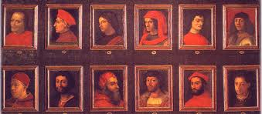
Why Italy?
Location – better for trade
City-States controlled by families
Milan
Venice- trade center
Florence – banking center; Medici family – cloth manuf / politics / arts
High regard for human ability/worth – “Renaissance Man”

Slide 5
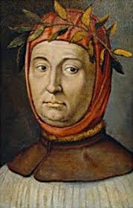
New Thinking: Humanism
Intellectual movt
Used classical G/R to better understand own times
Focused on dif worldly subjects not just religion
Focused on humanities
Poetry, rhetoric, history
Petrarch – early humanist
Put together library of anc G/R writings

Slide 6
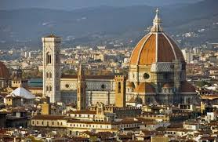
The Arts
Paintings, sculptures, architecture
Art reflected humanist ideas
Realism / use of perspective
Studied anatomy
Architecture went back to classical styles
The dome – Brunelleschi

Slide 7
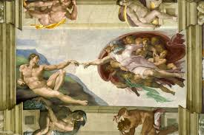
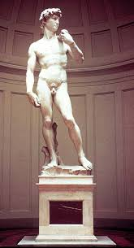
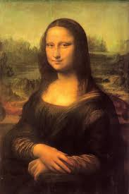
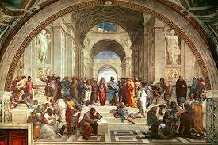
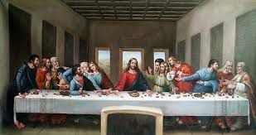
Key Artists
da Vinci: Mona Lisa, The Last Supper
Michaelangelo: The David, Sistine Ch.
Botticelli:The Birth of Venus
Raphael: The School of Athens

Slide 8
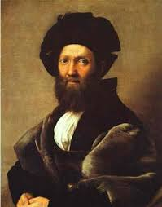
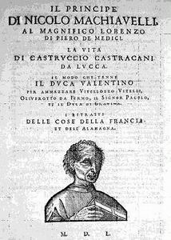
Writings
Guidebooks written for success
Castiglione – wrote The Book of the Courtier
Gave guidelines for Nobles
Nobles born, not made; mil & academic skill; good conduct
Machiavelli – wrote The Prince
Guidelines for rulers / how to gain & maintain power

Slide 9
Unit 3: Early Modern Times
The Protestant Reformation

Slide 10
Main Idea
1517
Criticism of the Roman Catholic Church led to a religious mvmt called the Protestant Reformation
Brought changes in religion & politics across Europe
Divided Christianity into Catholic and Protestant groups

Slide 12
Reasons for the Reformation
Corruption in the Catholic Church
Desire for Religious/Spiritual Experience
Rise in nationalism

Slide 13
Martin Luther
Monk and professor
Came to understand salvation through grace, not works
Believed Jesus was only head of church
Oct 31, 1517: nailed “95 theses” to door of church

Slide 14
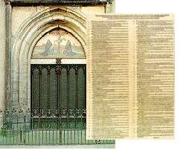
“95 Theses”
His way of making a public complaint about the church
Intended for church leaders
Denied that indulgences had the power to remit sins
Pardon for sins committed during life; could be bought
Criticized power of the pope and wealth of the church
Eventually published

Slide 15
Division
Luther called for reform:
Clergy could marry
Emphasis on faith over works

Slide 16
Diet of Worms
Decree: declared ML an outlaw & condemned his writings
Excommunication Hearing in 1521
Refused to renege
Declared a heretic
Went into hiding

Slide 17
Ulrich Zwingli
In Zurich, Switzerland
Abolished relics and images in the church
In 1531: war between Protest/Cath broke out in Switzerland and he was killed

Slide 18
John Calvin
Wrote The Institutes of Christian Religion in 1531
Ideas were close to Luther’s
Emph. Predestination: that God knows in advance who would be saved

Slide 19
John Calvin
Based in Geneva, Switzerland
Set up theocracy: govt run by religious leaders
Set up “consistory” to enforce church teachings (no dancing, no cards)
Geneva became the center of the reformation

Slide 20
Anabaptists
Didn’t want any church influence in gvmt.
Believed in adult baptism- membership in the church was voluntary
All members were equal in the church

Slide 21
Anabaptists
Churches chose their ministers
Were considered radicals by both Protestants and Catholics

Slide 22
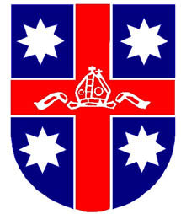
Reform in England
King Henry VIII was devout Catholic – protested ML’s ideas
Wanted marriage annulled/split from Catholic Church
Established the Church of England – the Anglican Church
King was head of the Anglican Church

Slide 23
Unit 3: Early Modern Times
The Reformation Spreads

Slide 24
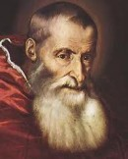
Catholic Reformation
Reform mvmt w/in Catholic Church (Counter Reformation)
Led by Pope Paul III (1530s-1540s)
Bring back moral authority to church
Council of Trent – 1545
Catholic leaders decided what direction to take the Church in
Salvation through good works/faith

Slide 25
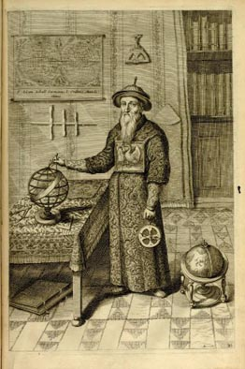
Catholic Reformation
Punishment for corruption
Est. schools for clergy
Inquisition included Protestants
Books by Luther or Calvin banned
1540 Society of Jesus (Jesuits)
Defended & spread Catholicism
Renewed faith
Majority of Europe Catholic (1600)

Slide 26
Persecution
Widespread from Catholics & Protestants
Anabaptists, Jews, witches
Witch hunts 1450-1750
Usually women accused / agents of the devil
German states, Switzerland, France
Jews
Italy: had them live in ghettos
Expelled from some lands; Charles V from Spanish
Pope Paul IV placed restrictions
1500s Jews migrated to Medit. & Netherlands

Slide 27
Unit 3: Early Modern times
The Scientific Revolution

Slide 28
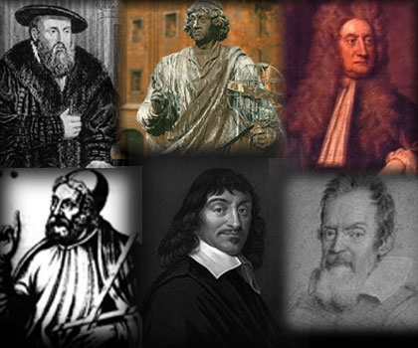
Changing views
Mid 1500s – final break from medieval era
New thinking ~ physical universe
Mathematics = basis = physical world shaped by ppl
Who were views shaped by before this time????
Aristotle, Ptolemy, etc.
Questioning of old knowledge & assumptions
Questioning & replacement of religious beliefs
Rise of science & reason

Slide 29
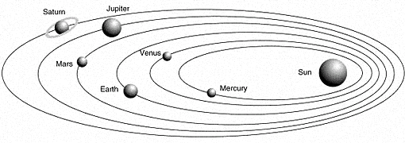
Changing views
1543 – Nicolaus Copernicus
Idea of heliocentric universe – sun is the center
Rejected by most…why???
Others supported heliocentric theory
Tycho Brahe – set up observatory
Johannes Kepler – astronomer / mathematician
Supported Copernicus
Discovered planet move in oval-shaped orbit (ellipse)

Slide 30
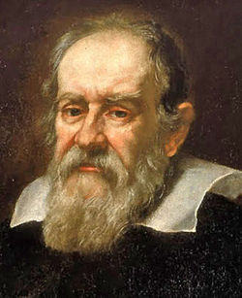
Changing views
Galileo – Italian astronomer
Developed telescope for astronomy
Discovered 4 moons of Jupiter & supported heliocentric theory
1633 – accused of heresy & tried by the Inquisition

Slide 31
New scientific method
New approach to science – observation & experimentation
Math important (Plato)
Francis Bacon & Rene Descartes: truth found at the end not known at the beginning
Bacon – experimentation / observation
Wanted science to make life better w/ practical technologies
Descartes – human reasoning for best understanding
“I think, therefore I am”
Their step by step method became the scientific method
Process of discovery that used data, reasoning, and a hypothesis (possible explanation)

Slide 33
Medicine & chemistry
Major advances during 16th & 17th centuries
1st detailed study of human body/anatomy
Grave robberies
Use of artificial limbs
New scientific instruments
Discovered the heart pumps to the rest of the body
Microscope

Slide 34
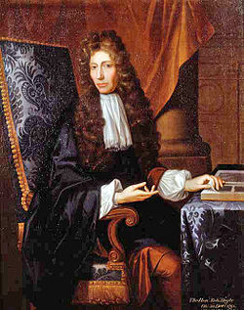
Medicine & chemistry
Alchemy – term for chemistry
Robert Boyle – revolutionary chemist – “Father of Modern Chemistry”
Basic building blocks of alchemy/chemistry
Matter made up of tiny particles
Discovered differences btwn individual elements & chem compounds
Researched effects on gases
Opened doors to modern chemistry

Slide 35
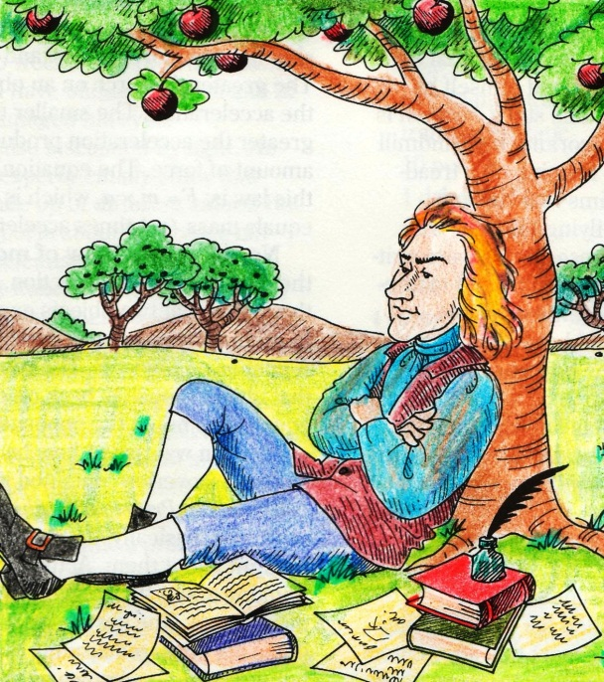
Isaac newton & gravity
Isaac Newton developed theory to explain planet movement
Gravity – force that keeps planet in orbit ~ the sun
Partially developed calculus
He was thought to have linked the sciences

