Slide 1
Unit 5: World Wars & Rev
The Russian Revolution

Slide 2
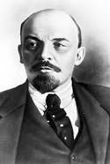
Unrest
Russia under control of Romanov Dynasty
Leader = Tsar Nicholas II
Resisted change / ppl unhappy
Pol/Econ/Soc probs – WWI made worse
Ppl protested & the tsar fled
Temp govt in place
Bolsheviks = grp of extreme socialists
Led by Vladimir Lenin

Slide 3
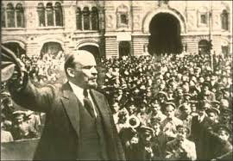
Lenin & Revolution
Lenin adopted Marx’s ideas
Led fight for revolution/change
Promised “Peace, Land, and Bread” to the ppl
Helped by Leon Trotsky
October/Bolshevik Revolution – Nov 1917
Bolsheviks overthrew temp govt
Bol renamed Communists

Slide 4
Civil War
Russia withdrew from WWI
3 yr Civil War
Communists “Reds” v. counterrevs “Whites”
Tsar & family shot
Cheka formed – secret police to keep ppl in line
Renamed Russia -> USSR ( Union of Soviet Socialist Republics) / Soviet Union
Peasants/workers were to have power/cont
Really controlled by Communist Party

