Slide 1
Unit 10: Personal Finance
Businesses & Labor

Slide 2
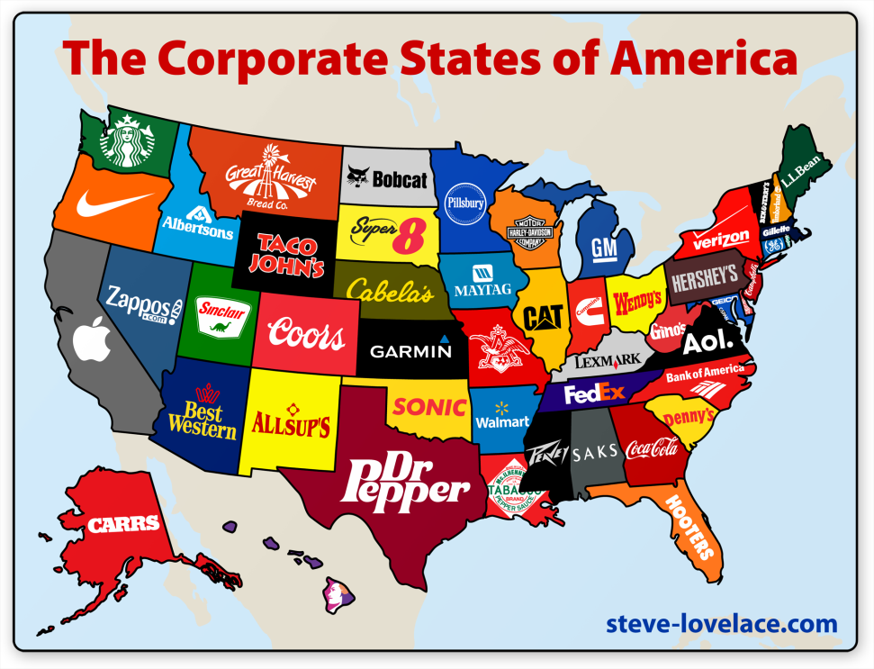
Types of Businesses
Sole proprietorship: bus owned & operated by single person
Partnership: bus owned by 2+ ppl
Corporation: bus org owned by many ppl but treated by as if it were one person

Slide 3
Corporations
Thought of as separate legal entity from the ppl who own it
Raise $ by selling stock – shares of ownership
Stockholders = ppl who buy/own stock
Have say in bus
Corporate profits paid to stockholders = dividends

Slide 4
Other Businesses
Non-profit organization – provid g/s without earning $ for stockholders (don’t make a profit)
Charities, research assoc, cultural programs
Run on donations
Some large non-profits are corps
Red Cross, United Way, Boy Scouts, Girl Scouts

Slide 5
Types of Workers & Skill
Blue-collar – work in crafts, manufacturing, non-farm work
White-collar – work in offices, sales, prof positions
Agricultural workers – farm labor
Skill Categories:
unskilled workers – job needs no specialized training
Semi-skilled workers – job needs some training in job related skills (modern technology)
Skilled workers – learned trade/craft in school or apprenticeship
Professional – highly educated w/ college degree & train.

Slide 6
Labor Unions
Labor unions – orgs of workers formed to improve wages/working cond
Became big in early 1900s bc of industrial rev
Improved factory cond, wages, hours, child labor laws
Recent decline in membership
Overseas jobs, poor economy

Slide 7
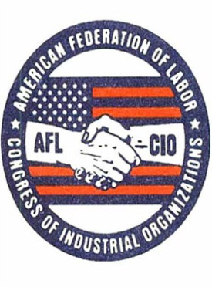
Labor Unions
Types/Examples:
Craft Union – made up of skilled workers in specific trade/industry; earliest type
Industrial Union – made up of all workers in an industry regardless of job/skill
AFL – CIO – American Federation of Labor & Congress of Industrial Organizations
Combined craft & industrial unions; common now

Slide 8
Collective bargaining
Collective bargaining – when union & company meet to discuss terms of workers’ contracts
Mediation – 3rd party brought in to help reach agreement; not forced decision
Arbitration – 3rd party listens to both sides & makes final decision

Slide 9
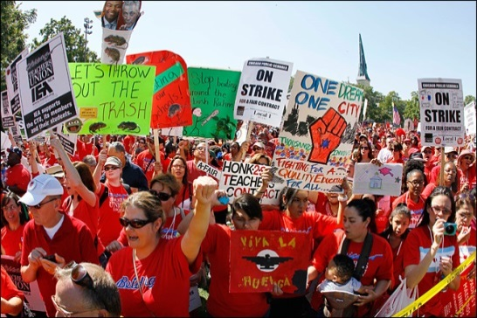
Collective Bargaining
Strike – union workers refuse to work until demands met
Picketing – carrying signs to alert public
Boycott – workers tell public not to buy g/s bc of worker treatment
Lockout – company blocks workers from building until they agree on contract

