Slide 1
Unit 10: Personal Finance
Banks & Banking

Slide 2
Origins
Goldsmiths gave ppl loans; promised to pay by certain date w/ interest
Ppl used property/things to guarantee repayment
These properties/things = collateral

Slide 3
The Banking System
Different types of bank accounts
Checking accnt
Demand deposit – bank must give you your $
Savings accnt - $ earns interest (good)
Time deposit – bank requires $ in acct for certain time
Certificates of deposit (CDs) – longer time deposit accnt
Money market – keep min balance & get higher interest rate

Slide 4
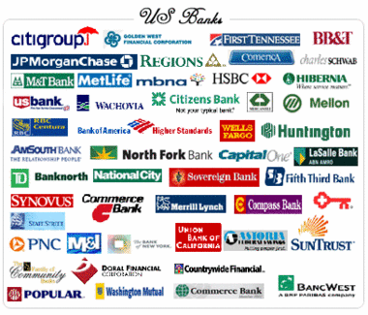
The Banking System
4 main types of banks
Commercial banks – most banks in US
Lots of services (accts, loans, credit cards…)
$ insured by govt agency (Federal Deposit Insurance Corporation – FDIC)
Insured up to $100,000
Savings banks – started 1800s for saving
Other services: home loans…
Insured by FDIC

Slide 5
The Banking System
Savings & Loan Associations – S&Ls
Mid 1800s for home buyers
Lots of home mortgages today / other serv.
S&L crisis in 1980s
Credit Unions – est. for certain comp/org
Owned/operated by members
Deposits = buying interest paying shares
$ insured by National Credit Union Association (NCUA) – up to $100,000

