Slide 1
Unit 10: PFL
Credit & Cards

Slide 2
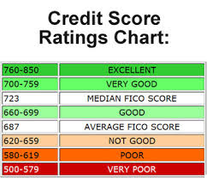
Credit
What is your credit score?
Basically your financial history report card
Shows if you’re financially responsible
Payment history
Credit history

Slide 3
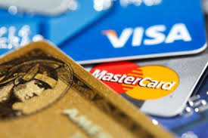
How to Establish Credit
Get checking/savings acct in your name.
Apply for a charge card in your name from a retail store or financial institution
Must make at least min monthly payment
Apply for a loan in your name
Must make all payments on time
Apply for a credit card
Make at lest min monthly payment

Slide 4
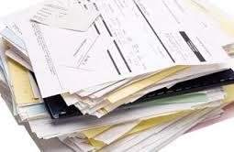
Building Good Credit
Pay bills on time
Make regular deposits into your savings account
Only apply for credit that you need, be selective
Maintain a low balance on one card and pay it off each month
Maintain job for at least 6 months
Don’t bounce checks

Slide 5
Things That Will Hurt Your Credit
Making late payments
Bouncing checks
Having too many accounts open
Having too many credit cards or changing cards frequently
Moving from job to job

Slide 6
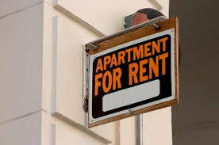
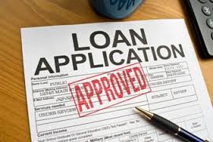
Who Looks at Credit Scores
Lenders
Employers (a new trend)
Apartment Leasing Offices
Cell Phone Companies
Insurance Companies (especially Auto)
Utility companies (establishes deposits)

Slide 7
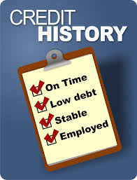
What Determines Your Score
Payment History 35%
Amounts Owed 30%
Length of Credit History 15%
Types of Credit in Use 10%
New Credit 10%
Other Factors
How long at current residence
How long on current job

Slide 8
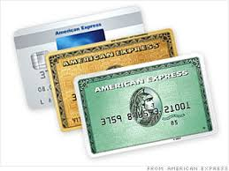
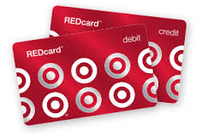
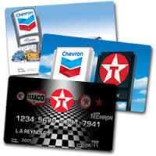
Types of Credit Cards
4 Basic Types:
Travel & Entertainment
Ex: American Express
Charge annual fee / full balance must be paid at end of month
Department Store / Charge Card
Offered by most retailers
No annual fee / high interest rates

Slide 9
Types of Credit Cards
Types Cont…
Major Credit Cards
Ex: Visa, Mastercard
Various incentives & interest rates
Bank Cards
Attached to bank account but can be run as credit
Charged interest
Takes longer to process

