Slide 1
Amendments Amending the U.S. Constitution

Slide 2
Proposal [ask to create]
Vote of 2/3 of members of both houses
Or
By national convention

Slide 3
Ratification [approve]
Approved by 3/4 of 50 state legislatures
Or
Approved by 3/4 of conventions held in 50 states
APPROVED

Slide 4

Let’s Review! (do not write)
Which amendment grants you the right to a trial by jury in a criminal case?
  6th Amendment
Which amendment protects you from cruel and unusual punishment?
  8th Amendment

Slide 5
Review…
Which amendment protects your freedom of religion?
  1st Amendment
Which amendment states that all powers not listed in the Constitution are reserved for the states?
  10th Amendment

Slide 6

Review…
Which amendment grants you the right to bear arms?
  2nd Amendment
Which amendment gives you the right to a trial by jury in a civil case?
  7th Amendment

Slide 7
Review…
Which amendment states that you cannot be forced to quarter soldiers during peacetime?
  3rd Amendment
Which amendment states that all rights not listed in the Bill of Rights are still protected?
  9th Amendment

Slide 8

Review…
Which amendment states that you have the right to remain silent?
  5th Amendment
Which amendment protects you from illegal search and seizure?
  4th Amendment

Slide 9

11th Amendment (1795): Suits Against States
Limits suits brought against states
Citizens of one state cannot bring a lawsuit against another state
CANNOT
SUE
NY
NC

Slide 10

12th Amendment (1804): Election of the President
Electoral College must vote for President and V.P. on the same ticket (someone must run for V.P.)
No more 1st and 2nd place winners

Slide 11
13th Amendment (1865): Abolish Slavery
Bans slavery and forced labor
NOT the same as the Emancipation Proclamation!

Slide 12

14th Amendment (1868): Equal Rights
Guaranteed equal rights to ALL citizens
Declared all former slaves to be U.S. citizens

Slide 13

15th Amendment (1870): Right to Vote
Race can’t be used to deny voting rights; African Americans were given the right to vote

Slide 14
Amendments 13-15 are known as the Civil War Amendments.

Slide 15

16th Amendment (1895): Federal Income Tax
Gives the federal gov’t the authority to collect income taxes

Slide 16
17th Amendment (1913): Election of Senators
The people, not state legislators, elect their Senators

Slide 17
18th Amendment (1919): Prohibition
Prohibition was established—banning the sale, consumption, and production of alcohol
X

Slide 18
19th Amendment (1920): Women’s Suffrage
Granted women suffrage (the right to vote)

Slide 19

20th Amendment (1933): Commencement of Terms
Set date for Congress to begin its term (Jan. 3rd) and for the inauguration of the President & V.P. (beginning of term) (Jan. 20th)

Slide 20
21st Amendment (1933): Repeal Prohibition
Repealed (got rid of) the prohibition of alcohol

Slide 21

22nd Amendment (1951): Presidential Term Limits
Limits president to only serving 2 terms

Slide 22
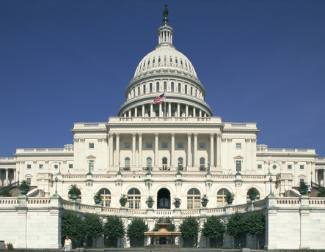
23rd Amendment (1961): DC Vote
Gave residents of Washington D.C. votes in the Electoral College

Slide 23
24th Amendment (1964): Poll Tax
Prohibits poll taxes so that even the poor can vote; got rid of the “grandfather clause” and literacy tests to vote

Slide 24
25th Amendment (1967): Presidential Secession
Defines succession of the president
States who takes over if the president dies

Slide 25

26th Amendment (1971): Voting Age
Lowered the voting age to 18
Due to the Vietnam War

Slide 26
27th Amendment (1992): Congressional Pay
Members of Congress cannot get pay raises until the beginning of a new term

