Slide 1
Unit 1: Foundations & Development
Colonial North America

Slide 2
Types of Colonial Government
Royal – run by the King
Proprietary – given by King for one person to run
Joint-Stock – owned and run by investors
Self-governing – started and run by themselves

Slide 3
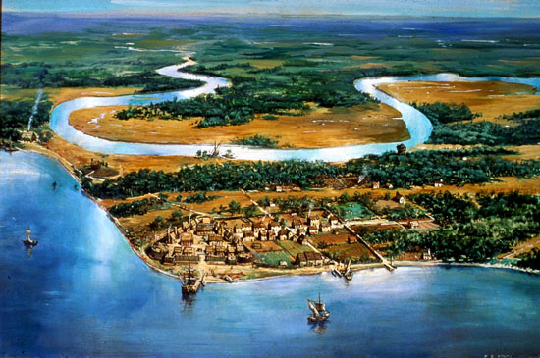
Jamestown
Established in 1607
First permanent English settlement
Was a joint-stock colony, made profit from tobacco
In present day Virginia

Slide 4
Religious Dissenters
Pilgrims – built settlement called Plymouth in 1620 in modern day Massachusetts.
Wanted to separate from church of England
Quakers – persecuted for beliefs; settled in PA
Pacifists (against war);
Catholics – members of original Christian church & persecuted in England
Founded Maryland
Puritans – wanted to purify Church of England
Settled in Massachusetts
Famous for their persecution of “witches” during the Salem Witch Trials of the 1600s

Slide 5
Colonial Economy
Mercantilism—theory that a country should sell more goods than it buys
Gave Britain a favorable balance of trade (they made money)
Hard on colonies - sell raw goods to Britain for cheap & had to buy expensive products
Plantation system—large farm; used slave labor or other workers; used to grow cash crops (cotton, tobacco, rice, indigo…)
Indentured servants the other workers, ppl work for certain period of time in return for travel expenses, shelter, food, pay off debt

Slide 6
Slavery
Favored over indentured servants
Brought from Africa to America on the Middle Passage of the Triangular Trade Route
Africa (slaves)
America/Caribbean (rum, sugar, cotton, raw materials)
England (manufactured goods)
Draw a diagram of the triangular trade route in your notes

Slide 7
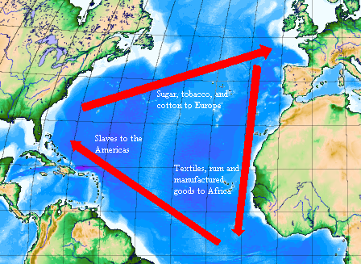

Slide 8
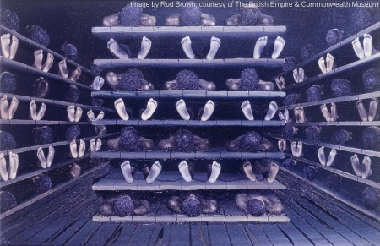

Slide 9
Native Americans
Already in America, many killed off by disease
Numbers too small to fight off Europeans
Many deaths due to conflicts, population plummeted
Some groups able to coexist peacefully…at least for a little while

Slide 10
Bacon’s Rebellion
Natives seen as threat
Nathaniel Bacon, a farmer, reacted to his hatred of N.A. in 1676
He raised an army of farmers on Virginia frontier to fight them
Successful —but still mad
Marched men to Jamestown to confront officials about lack of representation in frontier and unfair high taxes
Set fire to the town and almost completely destroyed it

