Slide 1
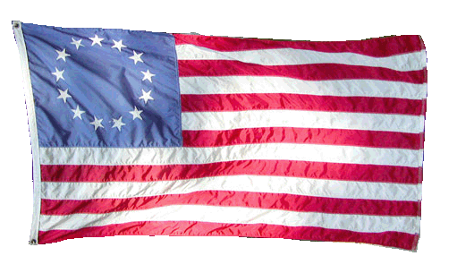
Unit 1: Foundations & Development :The Road to Revolution…

Slide 2
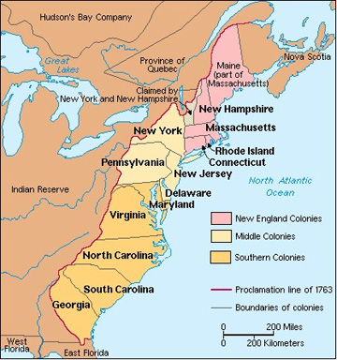
13 Colonies

Slide 3
Life in the colonies…
Colonies had decent amount of freedom before the American Revolution = salutary neglect
England did place some restrictions on colonies such as:
trade – Navigation Acts
$$$ taxes
13 colonies
$$$$

Slide 4
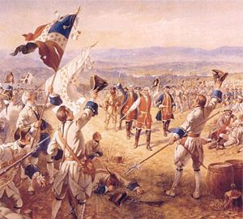
England goes in DEBT!
French and Indian War
Who? England, France, Indians
Why? Gain territory
Where? North America
When? 1754-1763
Result? England defeats France

Slide 5
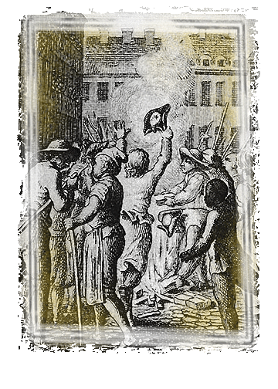
England has to find more $$$
Question:
How does England pay off the debt from the war?
Answer:
England creates higher taxes on colonists
Stamp Act (1765):
Required colonists to attach expensive tax stamps to all papers

Slide 6
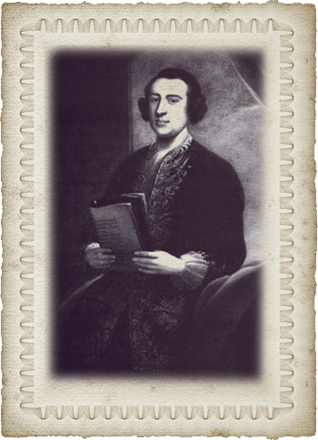
More restrictions…
Townshend Acts (1767):
New taxes on items sent to the colonies such as:
- glass
- tea
- paper
- lead
- paint

Slide 7
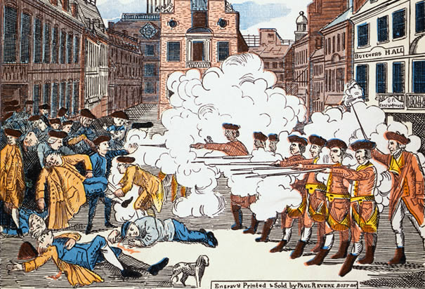
Boston Massacre
March 5, 1770: colonists threw snowballs at British guard
British officers/soldiers gathered to help
Actual accounts are unknown
Someone yelled “FIRE!” – British soldiers fired into crowd
5 colonists died & colonists named it the Boston Massacre

Slide 8
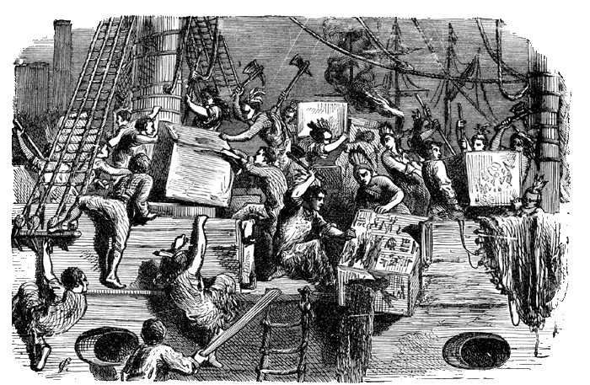
More restrictions…
Tea Acts (1773):
Allowed England to sell tea much cheaper than colonial sellers, essentially bypassing them and making more a profit.
Cut out the middle man & took colonist’s profit

Slide 9
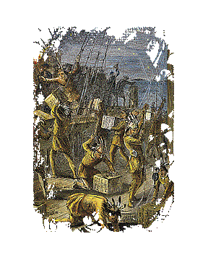
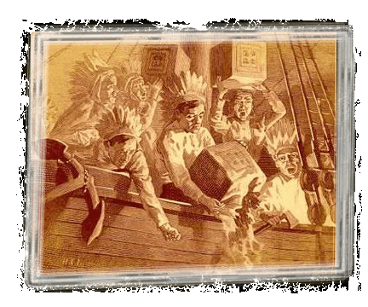
Boston Tea Party
Colonists revolted against English for unfair taxes
Dumped shipment of British tea into Boston Harbor
Done by Sons of Liberty

Slide 10
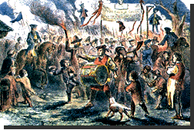
How do the British react?
MORE RESTRICTIONS!
Intolerable/Coercive Acts:
No longer a right to trial by jury
Allowed British soldiers to search and even move into the colonists’ homes
Writs of Assistance
Quartering Act

Slide 11
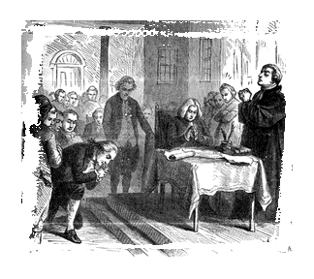
Moving toward Independence!
Delegates (colonial reps) are sent from the colonies to meet in Philadelphia.
Why?
To create a group to represent American interests and challenge England.

Slide 12
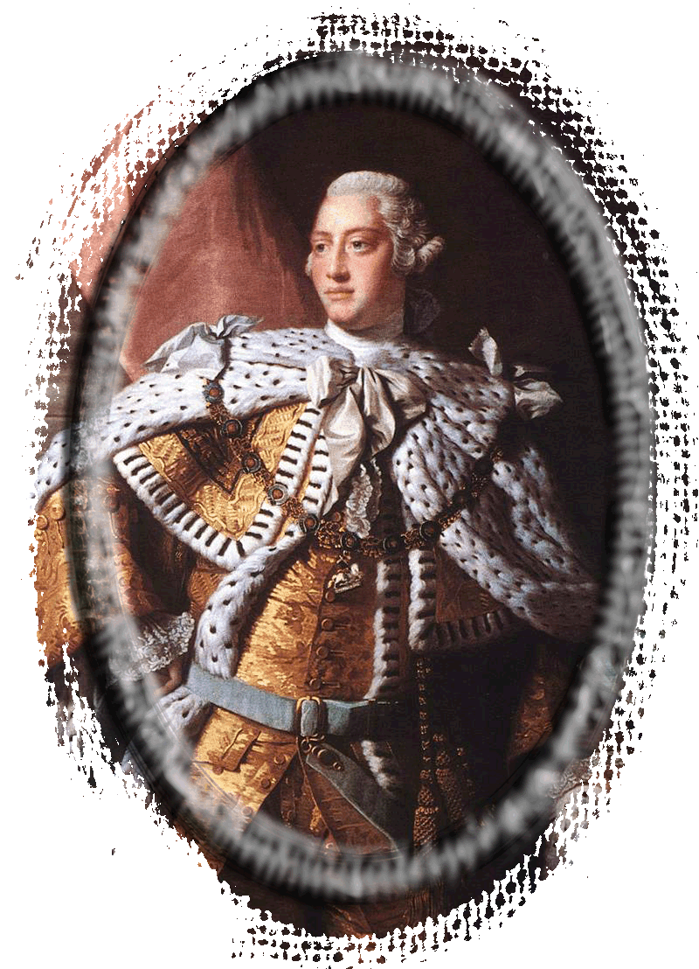
The First Continental Congress
Sept 1774 in Philadelphia
56 delegates; Georgia not represented
Appeal to King George III
10 things they wanted
England responds with FORCE!
Two battles erupt between the British and colonists as a result.

Slide 13
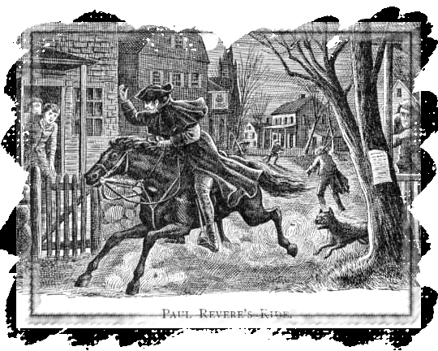
Lexington and Concord
1775 – colonists created militias called minutemen
Colonists stock piled weapons in Concord, Massachusetts.
Nearly 800 British soldiers march to Concord as a result.
Eventually retreated to Boston; never found weapons
“The British are coming!” – Paul Revere

Slide 14
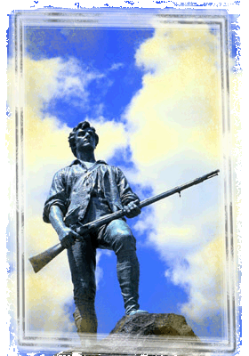
Reluctant Revolutionaries
“Stand your ground, don’t fire unless fired upon. But if they mean to have a war, let it begin here!”
Captain Parker

Slide 15
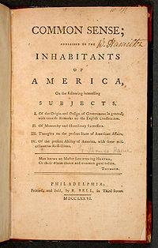
The Second Continental Congress
1775 in Philadelphia
Only 12 of 13 colonies
Met to plan overthrow of England bc they felt natural rights of ppl had been violated
Created Continental Army
Common Sense by Thomas Paine (1776)
Promoted independence from England
June 7, 1776 – committee formed to create a declaration of independence

