Slide 1
Unit 1: Foundation & Development
The First Government

Slide 2
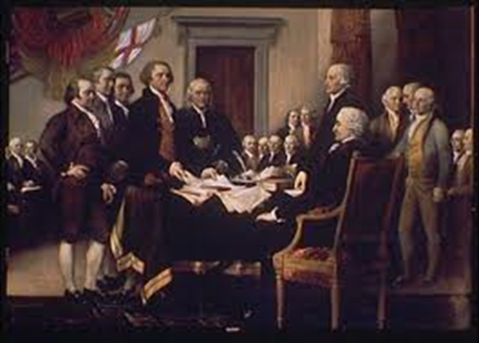
The Declaration of Independence
Declaration of Independence mostly written by Thomas Jefferson
Approved by Congress July 4, 1776
What did it do????

Slide 3
The Declaration of Independence
Gave reasons why colonies separated from British
Purpose of govt = protect human rights / basic rights for all
“We hold these truths to be self-evident, that all men are created equal, that they are endowed by their Creator with certain unalienable Rights, that among these are Life, Liberty, and the pursuit of Happiness.”

Slide 4
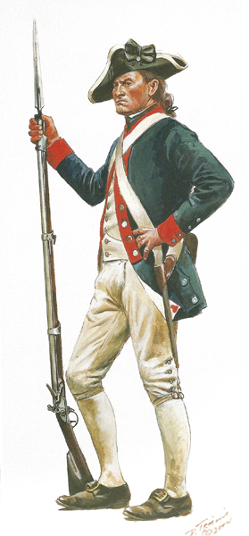
The DoI & the American Revolution
Continental Army led by George Washington
CA soldiers = Patriots
Battles in north & south
British forced to surrender in New England (1777)
Southern battles continued

Slide 5
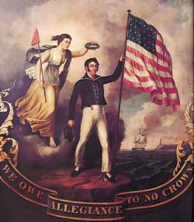
The DoI & the American Revolution
Continental Army officer Benedict Arnold became traitor
British surrendered in South at Yorktown
The Battle of Yorktown = last major battle
(1783) Treaty of Paris
Great Britain recognized independence of US

Slide 6
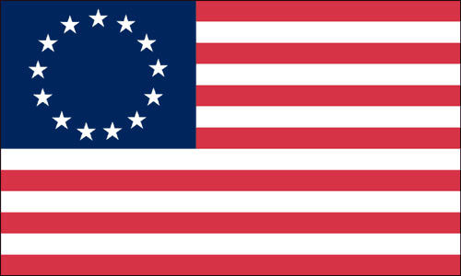
The Articles of Confederation
1777 – Congress adopted plan of govt: the Articles of Confederation
13 states approved 1781
Revolutionary War ended 1783
Colonies = The United States of America

Slide 7
Government Under The Articles of Confederation
Confederation = loose association of states
“firm league of friendship” btwn 13 states
Congress = the national government
New national govt had little power
Each state had one vote in Congress

Slide 8
Government Under The Articles of Confederation
Wanted to keep the states’ sovereignty
Sovereignty = absolute power
States had power to enforce national laws, not the national govt
After the war…
Trade slowed, debt, loss of property
Why?
States = too much power / national govt weak

Slide 9
Government Under the Articles of Confederation
States had issues w/ each other but national govt had no power to solve probs
United States seen as weak by other countries
US needed a change in govt….what did they do???
Wanted to revise the AoC
Delegates from each state to meet in 1787

Slide 10
Weaknesses of the Articles
Why was national govt weak?
Couldn’t pass laws
Needed 9/13 states to agree
No officials to make sure laws were carried out
No way to interpret laws/judge those who broke them
No money = no paying off debts
Couldn’t collect taxex

