Slide 1
Unit 1: Foundations & Development
Creating the Constitution

Slide 2
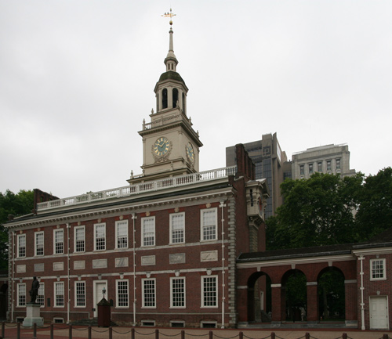
The Constitutional Convention
Also called Philadelphia Convention bc it was held in Philadelphia(1787)
Purpose = to fix the Articles
All13 states to send delegates to Philadelphia
55 delegates

Slide 3
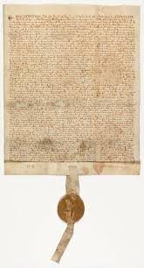
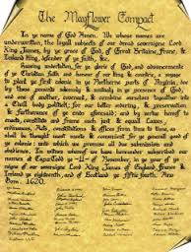
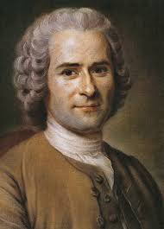
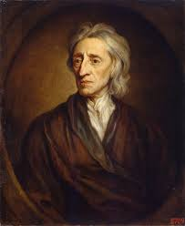
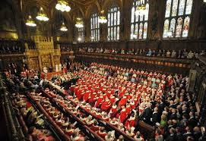
The Constitutional Convention
Rhode Island didn’t attend
wanted control of own state
Delegates influenced by British principles & thinkers:
Magna Carta, British Parliament, Mayflower Compact, English Bill of Rights, The Enlightenment & its thinkers (John Locke, Thomas Hobbes, Jean-Jacques Rousseau)

Slide 4
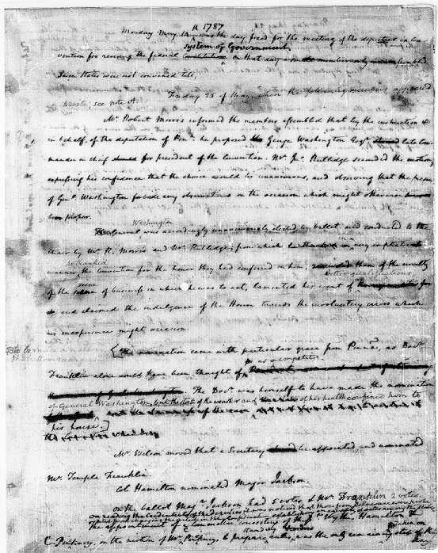
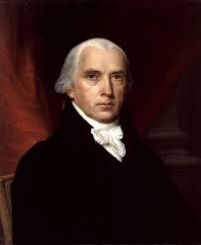
The Constitutional Convention
Delegates kept meetings secret
Didn’t want pressure or public interference
Know what happened b/c James Madison kept diary
Called Father of the Constitution

Slide 5
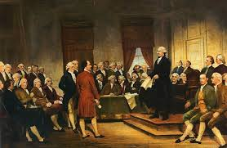
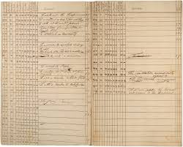
The Constitutional Convention
Initial goal = revise the AoC
Eventually threw out AoC
Decided new constitution (govt) needed to strengthen govt

Slide 6
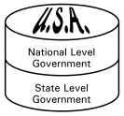
Writing the Constitution
Framers estab sys of govt called federalism
Divides govt’s powers btwn national govt & state govt
Delegates wanted diff things under federal sys
The Great Compromise:
Set up & representation in Congress
Congress = 2 houses
Senate - equal representation
House of Representatives - based on state population

Slide 7
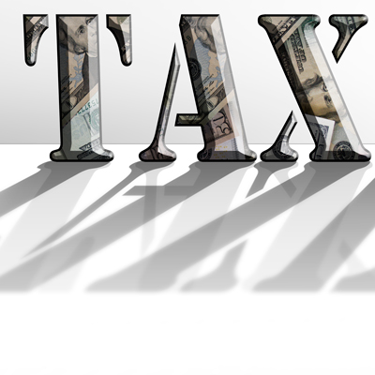
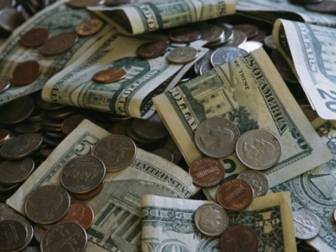
Government Becomes Stronger
Constitution gave national govt more power:
Power to coin/print money; set taxes
Raise armed forces
Regulate trade
A president will carry out nation’s laws
Created Supreme Court to interpret laws

Slide 8
Government Becomes Stronger
Constitution completed September 1787
39 of 42 delegates that were present signed the Constitution
Needed to be ratified to become law
Ratification = approval
9 of 13 states needed to ratify/make law

Slide 9
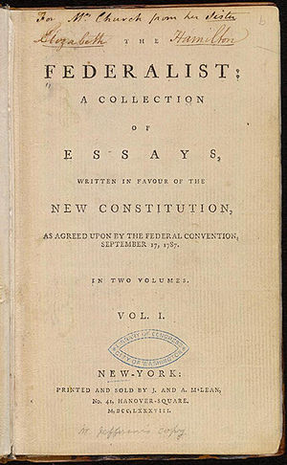
Approval of the Constitution
Ppl took sides & tried to persuade others
Federalists – supported Constitution & strong national govt
Needed to keep country unified
Alexander Hamilton, John Jay, James Madison
Created the Federalist Papers to gain support
Paper #10 : “A Republic, by which I mean a Government in which the scheme of representation takes place . . . Promises the cure for which we are seeking . . . .” - James Madison

Slide 10
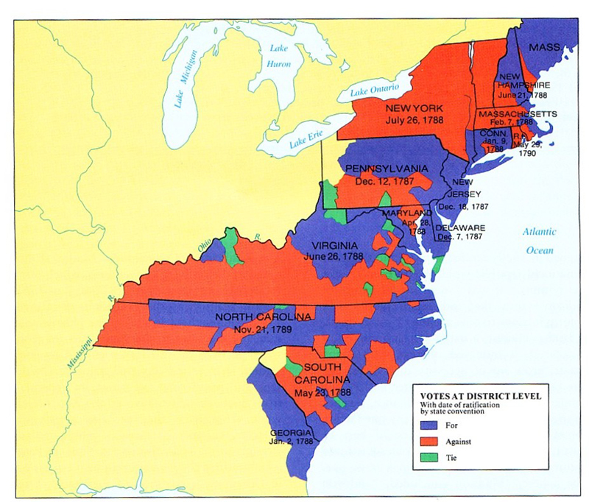
Approval of the Constitution
Antifederalists – ppl against the Constitution & new system of govt
Thought went against what they fought for in the war
Didn’t think would protect states’ power/ppls freedom
Federalists got support but ppl wanted their rights listed
States wanted a bill of rights added to ratify Constitution

Slide 11
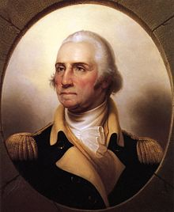
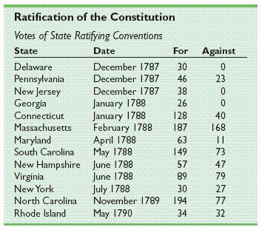
Approval of the Constitution
Most states ratified in 1787 & 1788
NC & RI didn’t approve until after in effect
New US govt began operating in March 1789
Washington sworn in as 1st president April 30, 1789

