Slide 1
Unit 1: Foundations & Dev
The Constitution & Its Parts: Ideals & Goals of the Constitution

Slide 2

What does our Constitution represent?
Our system of government
Basic beliefs and ideals

Slide 3
Breakdown of the Constitution
3 Main Components
  Preamble – Why the Constitution was written
  Articles (7) – Explain how the govt. is to work
  Amendments (27) – changes made to the Constitution & citizens’ rights

Slide 4
Preamble
We the People, in order to form a more perfect union, establish justice, insure domestic tranquility, provide for the common defense, promote the general welfare and secure the blessings of liberty to ourselves and our posterity do ordain and establish this Constitution of the United States of America.

Slide 5
Preamble – Purposes of Government
To form a more perfect union
Establish Justice
Ensure domestic tranquility
Provide for common defense
Promote the general welfare
Secure liberty

Slide 6
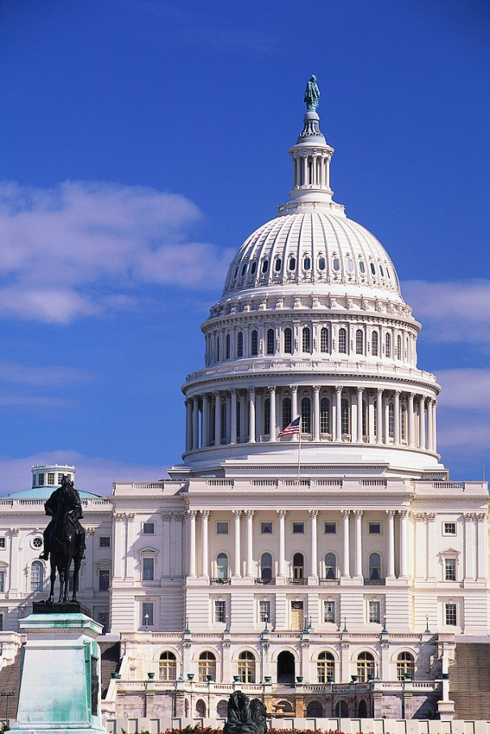
Articles
Article I – Legislative Branch
  Makes the laws

Slide 7
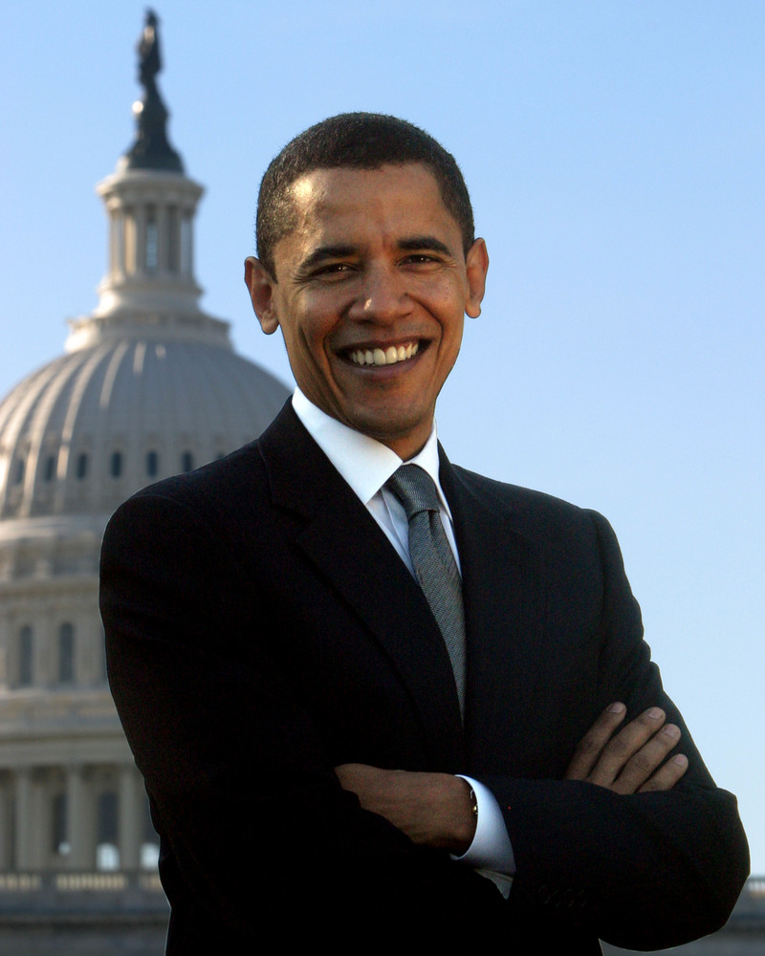
Article II – Executive Branch
  Enforces the laws

Slide 8

Article III – Judicial Branch
  Interprets the laws
  Established the U.S. Supreme Court

Slide 9
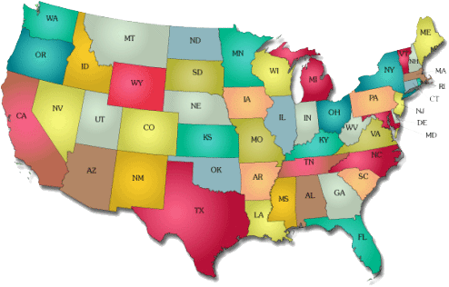
Article IV – Relations Among States
  Ppl from other states get same rights as ppl living there
  How to admit new states
  National govt will protect states

Slide 10
Article V – Amendment Process
  Explains how to amend (change) the Constitution

Slide 11

Article VI – National Supremacy
  Includes the “supremacy clause” – says the Constitution is “Supreme Law of the Land” & national govt rules all

Slide 12
Article VII – Ratification
  Discusses approval of the Constitution & that it would take effect after 9 states ratified, or approved, it

Slide 13
Principles, Powers, and Clauses in the U.S. Constitution

Slide 14
Basic Principles
Popular Sovereignty
  Idea that power lies with the people
Rule of Law
  Law applies to everyone, even those who govern

Slide 15
Federalism
  Creation of national and state governments
Separation of Powers
  Creation of 3 branches of government
Checks and Balances
  Each branch is able to check/oversee the powers of the others

Slide 16
Types of Powers
Enumerated Powers
  Powers given only to the federal govt
  A.K.A. – Delegated Powers
Reserved Powers
  Powers reserved for state govts only
Concurrent Powers
  Powers shared btwn state & federal govts

Slide 17
Expressed Powers
  Powers of Congress that ARE specifically listed in the Constitution
  Ex: Congress can declare war
Implied Powers
  Powers of Congress that ARE NOT specifically listed in Constitution but are known
  Ex: Create an Air Force

Slide 18
Clauses
Elastic Clause
  In Article I
  Gives Congress the right to make laws they think are “necessary and proper”
  A.K.A. – Necessary and Proper Clause
Full Faith and Credit Clause
  In Article IV
  States must recognize laws, documents, & judicial decisions of other states
Supremacy Clause
  National govt rules over all / is supreme

