Slide 1
Unit 1: Foundations & Dev
3 Branches of Government

Slide 2


The 3 Branches of Government

Slide 3
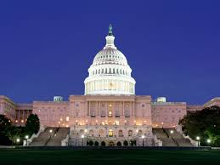
Legislative Branch: Makes the Laws

Slide 4
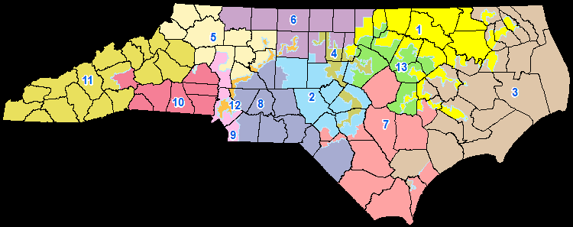
House & Senate
House of Representatives
  Number determined by population
  435 members
  Each reps a Congressional District
  Serve 2-year terms
  NC has 13 representatives
Senate
  Equal representation
  100 members = 2 per state
  Represent state as a whole
  Serve 6 year terms

Slide 5
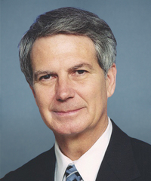
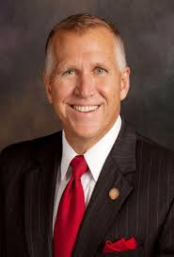

Requirements for Congress
House:
  25 years old
  U.S. citizen 7 years
  State resident
Senate
  30 years old
  U.S. citizen for 9 years
  State resident
Rep Walter Jones Jr. (R)
Sen. Richard Burr (R) Sen. Thom Tillis (R)

Slide 6

Congressional Terms & Sessions
Each new Congress is given a # to identify it
  1789: 1st Congress
  2015: 114th Congress
Each term is divided into 2 sessions
  Run from January to late November/December
Special sessions called by Pres in times of crisis

Slide 7
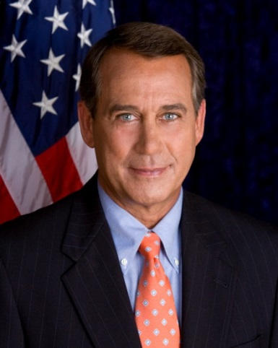
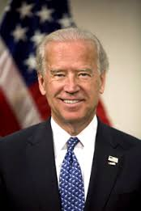
Leaders of Congress
Speaker of the House: leader of HoR
  Member of majority party
  Role: runs/organizes debates, influence others, get laws passed for party
President of the Senate: Vice President
  Rarely attends Senate debates
  Only role is to vote in a tie
Rep. John Boehner (R)
VP Joe Biden (D)

Slide 8
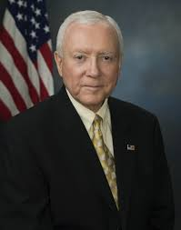
Leaders of Congress
President Pro Tempore
  Leader of Senate when VP isn’t there
  Member of majority party
  Role is more ceremonial
Minority & Majority Leaders
  Leaders of political parties in each house
  Get laws passed for their own party
Party Whips: Keep their party in check
  Makes sure members show up to vote
Orrin G. Hatch (R)

Slide 9
Committee System
Members put in committees that focus on passing laws in one area
  Education
  Agriculture
Types of committees:
  Standing: permanent committee
  Select: limited amount of time
  Joint: includes members from both houses
  Conference: temporary; helps the House & Senate reach agreement on a proposed bill

Slide 10
Seniority System
Members put in certain committees based on seniority
Leaders also look at expertise & loyalty to party
Freshman
Junior
Senior
Sophomore

Slide 11
Powers of Congress
Expressed powers
Implied powers
Non-Legislative Powers: Not related to law-making
  Impeachment – accusing officials of misconduct through a trial
    Starts in HoR & trial in Senate
  Propose amendments
  Approve/reject appointments
  Censure – punish President for inappropriate behavior (no real punishment)
  Immunity – makes person/grp free from legal action

Slide 12
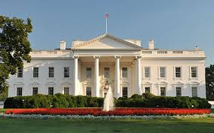
Executive Branch: Enforces the Laws

Slide 13
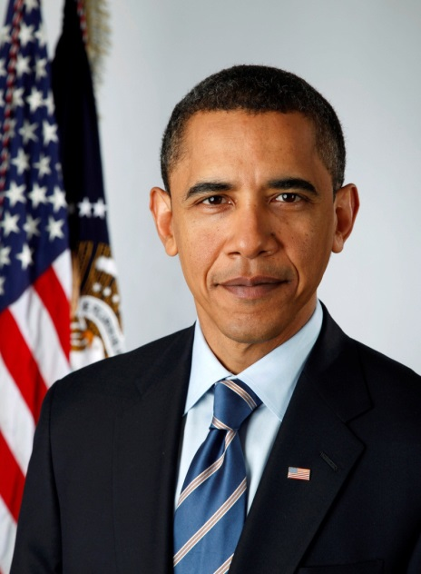
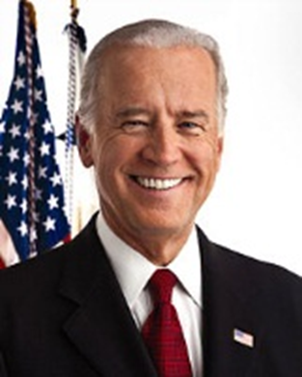
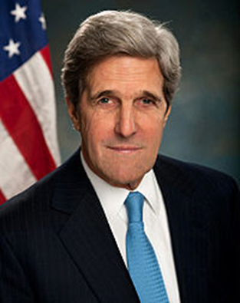
The Executive Branch
President
Vice President
Cabinet
  15 executive departments
    Most recent: Dept of Homeland Security (2002)
  Advisors

Slide 14




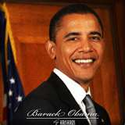
EXECUTIVE BRANCH
ROLES OF THE PRESIDENT
Chief Executive
Commander-in-Chief
Chief of State
Foreign Policy Maker
QUALIFICATIONS
35 years old
Natural born citizen
Resident of US for at least 14 years

Slide 15
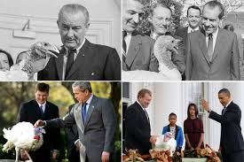
Powers of the President
Give State of the Union address every January
Give Executive Orders—rule/command w/ force of law
Appoint Judges, Cabinet Members, & Ambassadors
Send troops into battle
Grant Pardons—gives forgiveness/freedom from punishment
Grant Reprieves—delay of punishment
Grant Amnesty—give pardon to a group of ppl

Slide 16
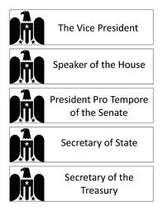
Succession
Top 4 after V.P.
  Speaker of the House
  President Pro Tempore
  Secretary of State
  Secretary of Treasury

Slide 17
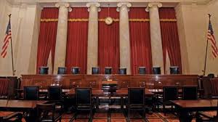
Judicial Branch: Interprets the Laws

Slide 18
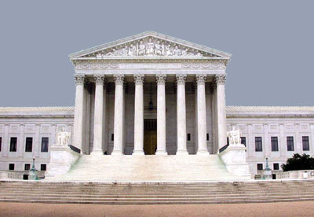
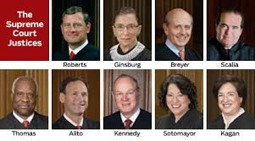
JUDICIAL BRANCH
SUPREME COURT
9 Justices (8 & 1 chief) – Appointed by President
Serve for life
Oversees actions of Congress & President
Uses Const to make sure things are Constitutional

Slide 19
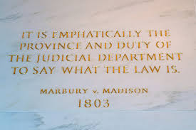
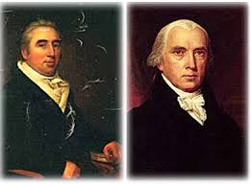
Powers of the Court
Judicial Review
  Power to say if a law is constitutional or not
  Est by Supreme Court Case
    Marbury v. Madison, 1803

Slide 20


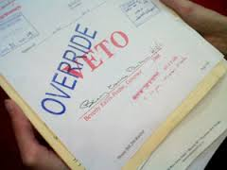
Checks and Balances
President Congress
  Pres can veto (reject) laws made by Congress
    Pres has veto power
Congress President
  Congress can override vetos & pass laws rejected by the pres
    Needs 2/3 majority in both Senate & House

Slide 21
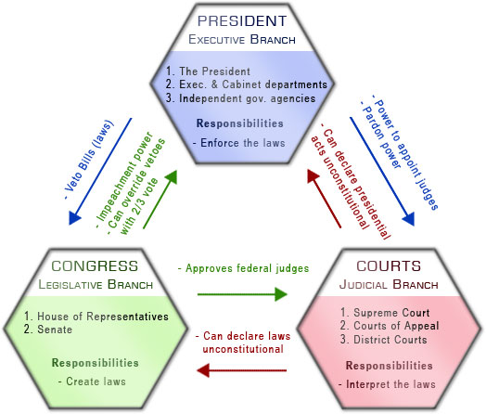
Checks and Balances

