Slide 1
Goal 1: The Constitution
An Enduring Document

Slide 2
Envisioning Change
Constitution written in 1787 – 226 yrs ago
Framers realized change would happen
Included process for making changes
What are some changes in today’s world that framers prepared for, but never could have foreseen?

Slide 3
Changing the Constitution
Difficult process
Didn’t want politics / quick changes in public opinion to influence
Changed in 2 different ways:
Formally – amendment
Informally – govt acts or by custom

Slide 4
The Amendment Process
Must be proposed then ratified
Amendments can be proposed in 2 ways:
Congress
Propose amendment with 2/3 vote in BOTH houses
Constitutional Convention
2/3 of the state legislatures (34/50) call convention to propose amendments

Slide 5
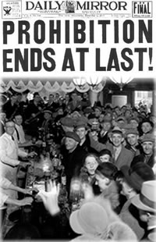
The Amendment Process
2 ways to ratify an amendment:
¾ of state legislatures approve (38/50)
Sent to state conventions for consideration
Becomes part of written Constitution
Another amendment my be passed to repeal (cancel it) if unpopular
Ex: 1933 – 21st amendment passed to repeal the 18th amendment

Slide 6
Interpreting the Constitution
Constitution sets broad/general guidelines
Open for interpretation
Many changes in govt bc of customs & traditions
“Unwritten Constitution” – accepted and unwritten practices/traditions
Ex: Meetings btwn president and his cabinet – advisors/department leaders

Slide 7
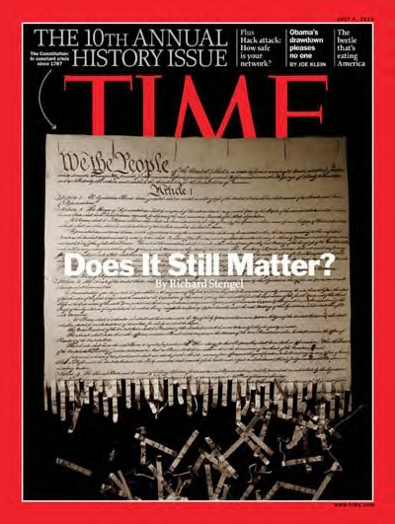
What makes the Constitution an enduring document and why is it important??? Is it???

