Slide 1
Unit 2: Regional Civilizations
Muslim Civilizations

Slide 2
Unit 2: Muslim Civilizations
The Rise of Islam

Slide 3
The Rise of Islam
Islam
Followers = Muslims
Emerged in Arabian Peninsula
Bedouins – nomadic herders
Mecca
Thriving center of trade
Most Arabs prayed at the Kaaba (temple) to Pagan gods
Pilgrims made Mecca merchants wealthy
Muhammad
Born in Mecca ~ 570
Worked as shepherd w/Bedouins
Later became a successful merchant

Slide 4
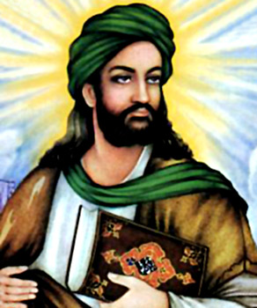
The Rise of Islam
Muhammad Cont.
Married wealthy widow @ 25
Known for his honesty; troubled by probs in soc.
Accord to Muslim tradition he became a prophet at 40
Asked by Angel Gabriel to be God’s messenger.
Beginning of Islam
Monotheistic – God = Allah

Slide 5
The Rise of Islam
Muhammad Cont.
622 he/followers fled Mecca for Yathrib (later called Medina – (“city of the Prophet”)
Merchants fearful of his teachings
Journey = hijra
Islam
Thousands converted
Loyal/peaceful comm of Muslims - umma
Muslims defeated Meccans
Muhammad returned to Mecca - 630
Kaaba dedicated to Allah & became holiest Islamic Site
632 Muhammad dies

Slide 6
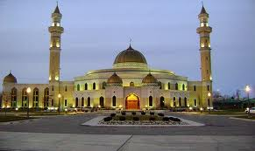
The Rise of Islam
The Religion of Islam
The Quran = sacred text of Islam.
Believed to be direct word of God; Arabic
God sent other prophets to teach (Abraham, Moses, Jesus); Muhammad = last/greatest
Mosque – house of worship

Slide 7
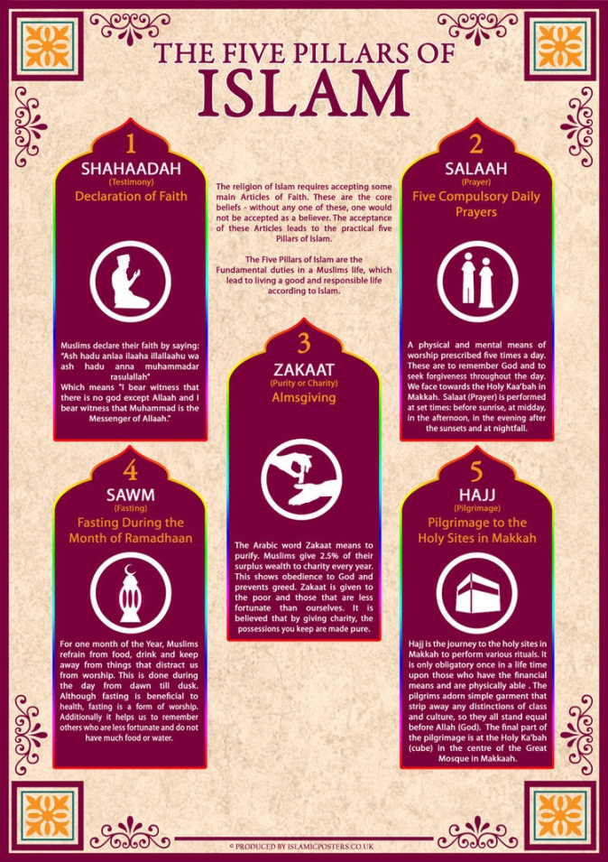
The Rise of Islam
Muslims perform 5 duties: 5 Pillars of Islam:
Declaration of faith
Prayer 5 times a day
Alms for the poor (charity) – zakat
Fasting during Ramadan – holy month
Pilgrimage to Mecca – hajj
Other duty is jihad
Struggle in God’s service
Personal duty; holy war

Slide 8
The Rise of Islam
Religion of Islam Cont.
Believed Jews & Christians worship same God as Muslims
“People of the Book”
Religious freedom in Muslim societies
Muslim Law
Islam = religion & way of life
Sharia - laws that interpret Quran; applies religious principles to legal situations
Helps Muslim societies govern daily life

Slide 9
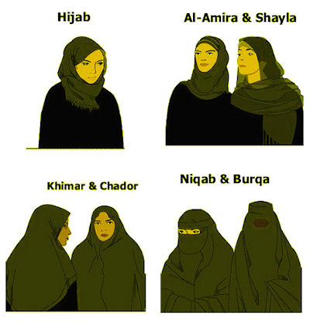
The Rise of Islam
Muslim Law cont…
According to Quran women spiritually equal to men
But have dif roles/rights
Different places = diff interpretations

Slide 10
Unit 2: Muslim Civilizations
Building a Muslim Empire

Slide 11
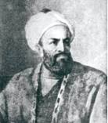
Early Challenges to Islam
Muhammad died leaving no one in charge
Some wanted Abu Bakr - early convert/father-in-law
Abu Bakr became leader/first caliph (successor to Muhammad)
Able to unite Muslims
Victories under first 4 caliphs
Took Persian emp & areas from Byzantine emp

Slide 12
Divisions Within
Muslims divided over true successor & still divided today
Sunni & Shiite
Sunni – believe anyone could be good leader / wanted political leader
Today ~ 90%
Shiite – believed only ancestors of Muhammad & son-in-law Ali could lead
Iran, Lebanon, Iraq, Yemen
Further split

Slide 13
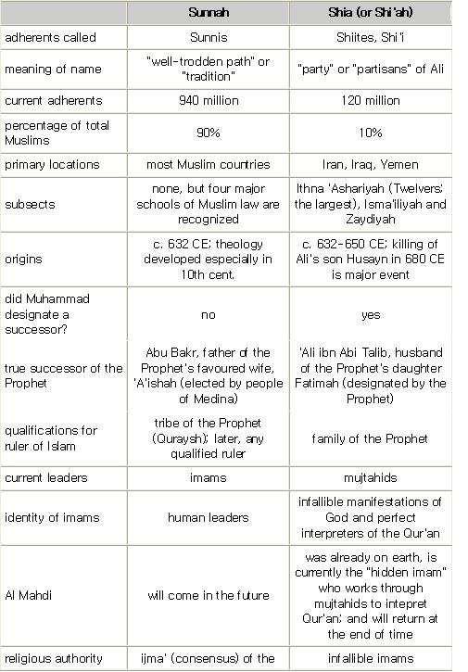

Slide 14
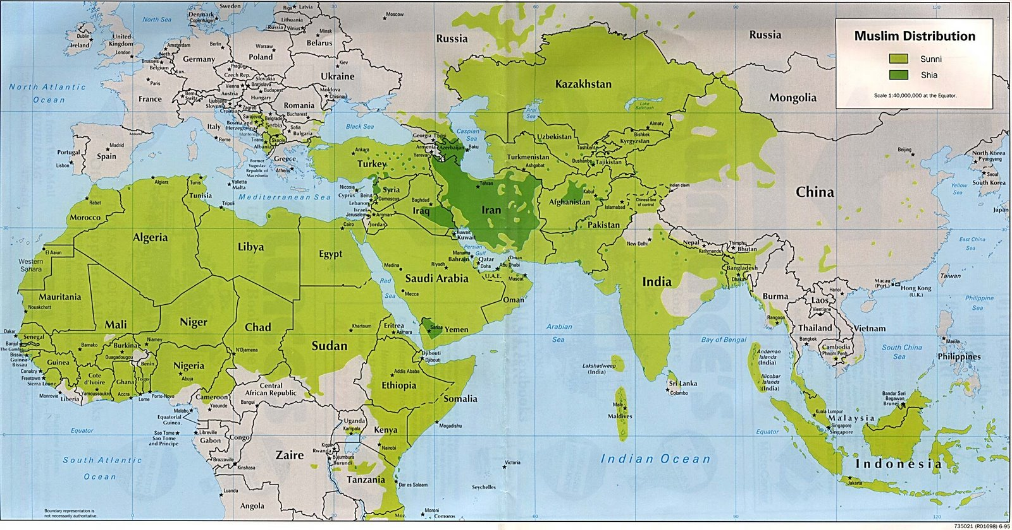
Divisions Within
Sunni/Shiite split bc of religion, law, daily life
Sufis – Muslim mystics communicate w/ God & travel spreading Islam

Slide 15
Umayyad Empire
Meccan clan set up Umayyad caliphate in Syria
Sunni caliphs: ruled 661-750
Expanded Muslim emp into France, Spain, & Byzantine emp (N. Africa)
Successful bc…
Weak Byzantine & Persian emps
Islam (common faith)
Viewed as liberators
Provided order

Slide 16
Umayyad Empire
Taxed non-Muslim ppl
Able to practice own religion / most converted
Non-Muslims separate from Muslims
Umayyad caliphate eventually declined
Empire = too large
Economic problems
Caliphs had life of luxury = angry poor
Problems btwn Arabs & non-Arab Muslims

Slide 17
Rise of the Abbasids
Abbasid dynasty replaced Umayyads
750-1258
Change under the Abbasids:
Stopped military conquest/expansion
Islam more diverse/discrimination ended
Encouraged learning
Moved capital from Damascus to Baghdad
Persian influence

Slide 18
Rise of the Abbassids
Baghdad called “City of Peace, Gift of God, Paradise on Earth”
Independent Muslim state est in Spain by last Umayyad
Welcomed other religions/cultures
Still lasting Muslim influence

Slide 19
Muslim Empire Declines
Probs caused Muslim emp to decline
Local & regional rulers challenged emp
Seljuk Turks became ruler or sultan & controlled Baghdad
Shiite rulers challenged power
Invasions 900-1400
1258 – Mongols attack Baghdad / kill last Abbasid ruler

Slide 20
Unit 2: Muslim Civilizations
India’s Muslim Empires

Slide 21
The Delhi Sultanate
India broken into kingdoms
Mainly Hindu & Buddhist
Sultan = Muslim ruler
Muslim Turks & Afghans pushed into India ~1000
Sultan of Ghur made Delhi his capital
Organized a sultanate – land ruled by sultan
Delhi Sultanate – 1206-1526 – start of Muslim rule in India

Slide 22
The Delhi Sultanate
Changed Indian govt & society
Muslim traditions & govt
Trade & learning & art/culture increased
1398 – Tamerlane invaded India (Mongol)
Sultans no longer ruled
India broke into rival Muslim & Hindu kingdoms

Slide 23
Muslims & Hindus Clash
Hindu vs. Muslim
Hindu – very old faith; many gods & sacred texts; prayed to statues; caste system w/ Brahmans
Islam – newer; monotheistic; statues were bad; 1 sacred text; no religious hierarchy
Hindus allowed to practice if paid tax
Some rajahs (Hindu rulers) left in place
Cultures combined; ppl converted
Sikhism – new “combined” religion

Slide 24
Mughal India
Mughal (Mongol) dynasty est in India by Babur (1526-1857)
Akbar – Babur’s grandson, built up emp, policy of toleration, ended Hindu tax…
Used paid govt officials, land reforms, modern army, international trade…
Shah Jahan – Akbar’s grandson, built Taj Mahal as tomb for his wife

Slide 25
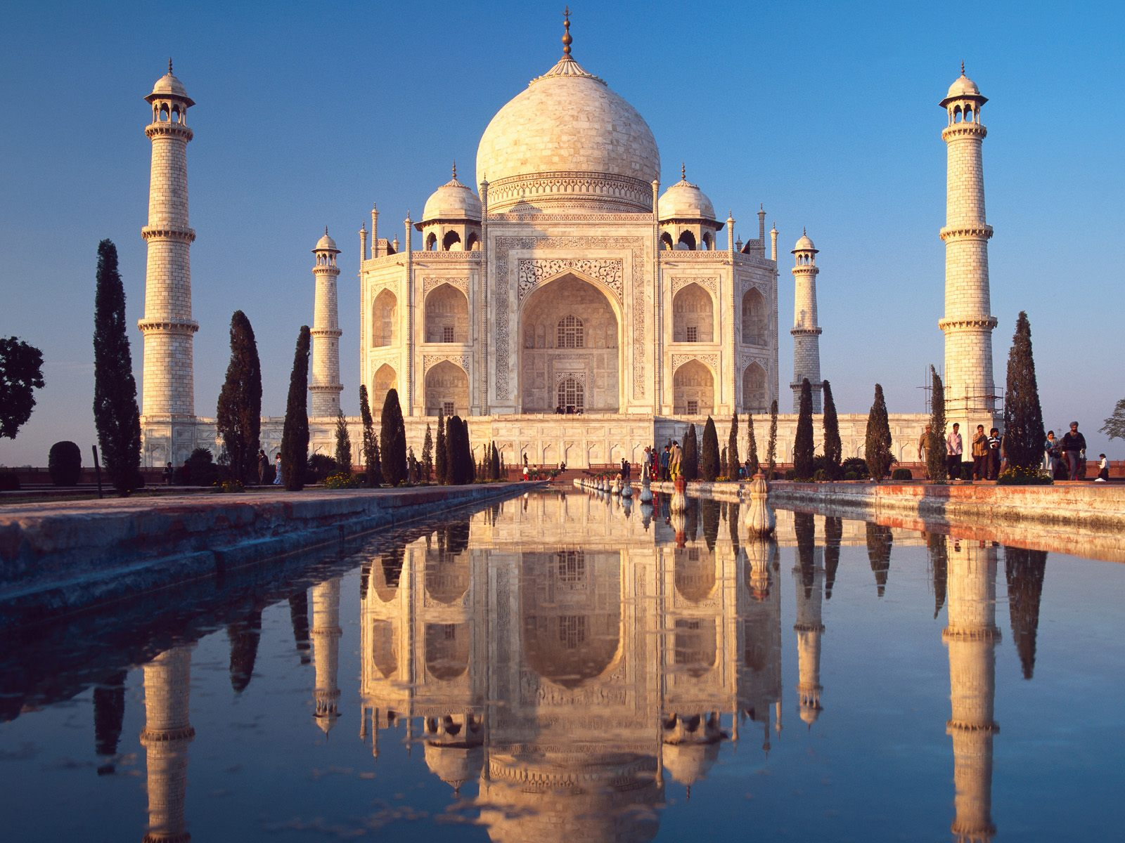

Slide 26
Unit 2: Muslim Civilizations
The Ottoman & Safavid Empires

Slide 27
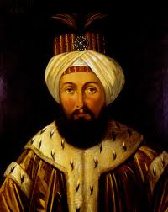
The Ottoman Empire
Ottomans = Turkish-speaking nomads – Sunnis
Empire spread from Asia Minor to Balkans
Captured Constantinople in 1453
Renamed Istanbul
Became capital of Ottoman Emp
Golden age under sultan Suleiman (1520-1556)
Expanded emp / modernized army
Had absolute power & council to help
Sharia law / royal edicts

Slide 28
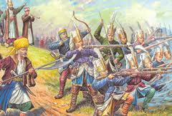
Ottoman Culture & Society
Social classes
Soldiers : “men of the sword”
Intellectuals: “men of the pen”
Farmers: “men of husbandry”
Merchants: “men of negotiation”
Divided into religious communities - millets
Dealt w/own educations, laws, etc…
Converted boys & trained for govt service
Some chosen for janizaries - elite army force
Non-Mus girls made slaves in Muslim homes

Slide 29
Decline of the Ottomans
Suleiman killed 2 “best” sons
Empire declines after Suleiman’s death 1566
Corruption begins
Don’t keep up with advancements
Land taken by others

Slide 31
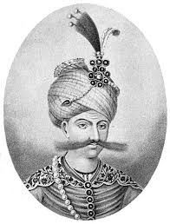
Safavid Empire
Safavid dynasty/empire in Persia
Shiite Muslims – fought w/ Sunni Ottomans
King called a shah
Greatest shah = Shah Abbas (1588-1629)
Created strong mil & dev mil alliances w/Europeans
Lowered taxes / encouraged industry
Tolerated non-Muslims
Built capital at Isfahan – became center of silk trade

Slide 32
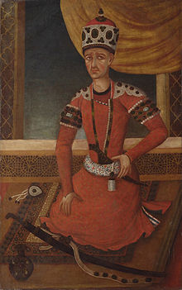
Safavid Empire Declines
Shah Abbas dies & conflict begins
Religious conflict & persecution until end of emp
Sunni Afghans rebel & force out last Safavid ruler
Qajars took over Iran & est dynasty in late 1700s
Made Tehran capital / ruled until 1925

