Slide 1
Unit 2: Government Systems & Politics
How a Bill Becomes a Law

Slide 2
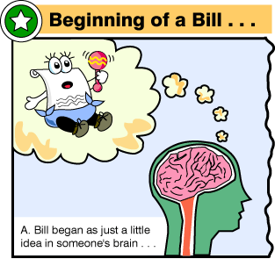
Ideas can come from
Congress
Private Citizens
White House
Special Interest Groups
M.A.D.D. or NAACP

Slide 3
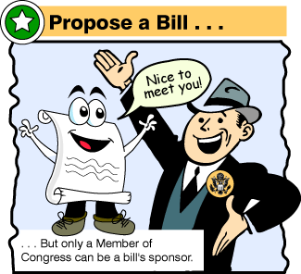
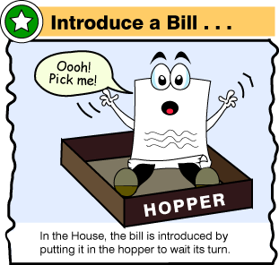

Slide 4
When introduced – all bills dealing with money begin in the House of Representatives
Other bills can be entered into either house

Slide 5
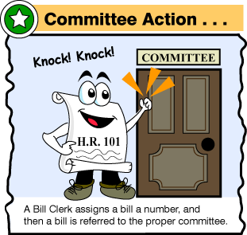
Committees can:
Pass a bill without changes
Add changes and suggest it be passed
Replace the original bill with a new alternative
Pigeonhole the bill—ignore it and let it die
Kill the bill by majority vote

Slide 6
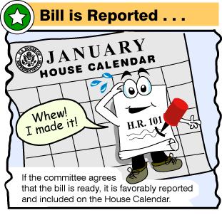
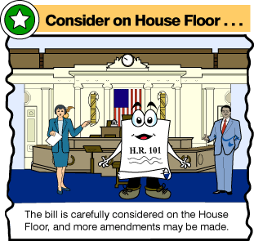

Slide 7
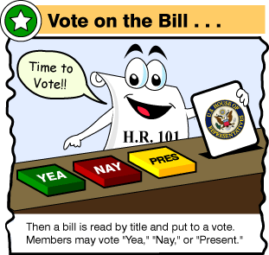
Only takes a majority to pass a bill and then it goes to the other house
If either house wants to change it before voting it through then a conference committee can be formed

Slide 8
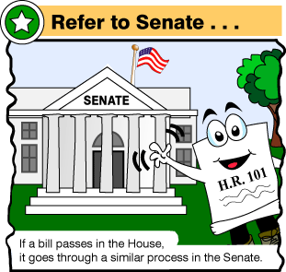
Senators can talk as long as they want on the floor—known as a filibuster
Filibuster can be ended with a cloture—61/100 votes needed

Slide 9
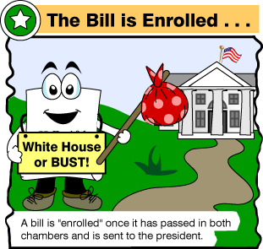

Slide 10
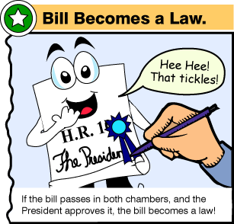
The president can…
Sign the bill into law

Slide 11
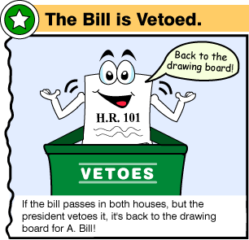
Veto, or refuse to sign, the bill

Slide 12
Sit on a bill for 10 days, while Congress is in session, to automatically make it a law
Sit on a bill for 10 days, while Congress is NOT in session to kill it—a.k.a. Pocket Veto

Slide 13
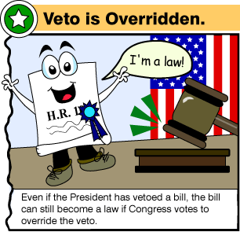
To overturn a veto a 2/3 vote in BOTH houses is needed

