Slide 1
Unit 2: Government Systems & Politics
Party systems and Organization

Slide 2
Political Parties
Political party – grp of citizens w/ similar views on issues & work to put ideas into govt
PP nominate candidates to run for political office
Candidate – person who runs for govt office
5 functions of PPs:
Campaigning for candidates – help politicians get elected
Informing citizens – give info ~ issues & how govt operates
Help manage govt – appoint local members to certain jobs
Linking diff levels – provide link btwn local, state, & federal govt
Watchdog – alert public of wrongdoing

Slide 3
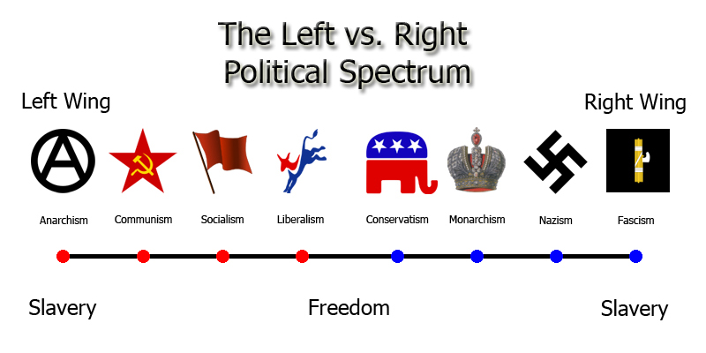
Political Parties
Often labeled “liberal” or “conservative”
Placed on political spectrum – differences in political views held by dif PP
Platform – overall views/principles/beliefs of PP
Plank – individual issues in platform

Slide 4
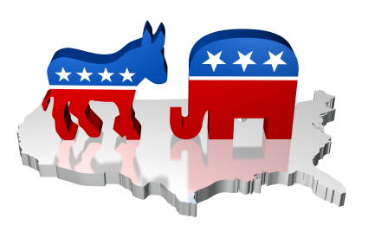
Party Systems
Two-party system: 2 main PPs
2 major PPs battle for control of govt
Ex: U.S. = Democrats & Republicans
One-party system: 1 major PP; voters have no choice; PPs usually forbidden
Dictatorships or totalitarian govts
Ex: Communism – China, North Korea, Cuba
Multi-party system: 3+ strong PPs fighting for govt control
have to compromise/work together: coalition: agreement btwn 2+ PP to work together to run govt
Ex: France, Germany, England

Slide 5
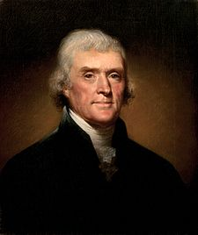
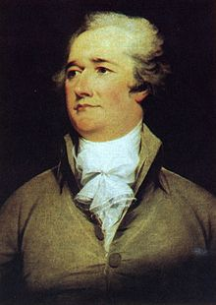
History of Political Parties
Democratic-Republican Party – Thomas Jefferson
Wanted limited power of natl govt & stronger state govts
Federalist Party – Alexander Hamilton
Wanted strong natl govt to protect ppls rights & solve probs

Slide 6
Democrats & Republicans
Democratic Party (Democrats):
more liberal & more govt involvement
Govt active in solving social probs
Bigger govt, ↑ taxes, more change, controlled economy
Republican Party (Republicans):
more conservative & less govt involvement
Less change, less taxes on rich, less govt spending
Social probs solved w/ less govt
Social programs handled by state/local govts & nongovt orgs

Slide 7
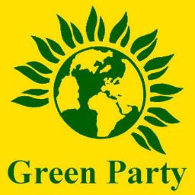
Third Parties
Minor PPs in a 2 party system – third parties
Not enough ppl to compete/win national elections
Alt to major PP; have influence on laws & elections

Slide 8
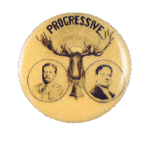
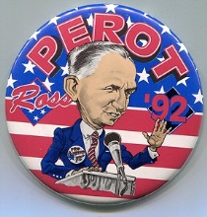
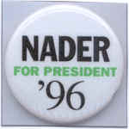
Third Parties
1912: Theodore Roosevelt: Progressive Party
1992: Ross Perot: United We Stand America, Reform
1996: Ralph Nader: Green, Independent

Slide 9
ORGANIZATION OF PPs
Political
Party
Organization
Federal Level
National committee
hold national
convention.
Delegates
nominate candidates for
President & VP
State Level
Each state has
committee or
organization.
Focus on state offices.
(Governor, Lt. Governor,
Attorney General)
Local Level
Precinct
Organize volunteers
Distribute Leaflets
Register Voters

Slide 10
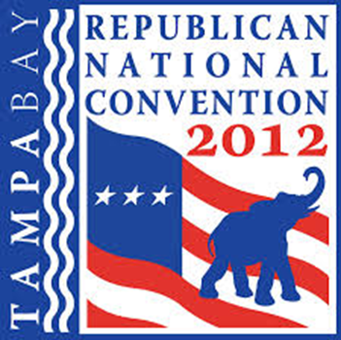
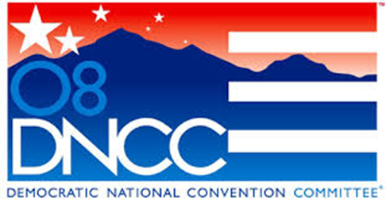
Party Organization & Committees
Party must be organized at ALL levels
Leaders, Committees, Workers
Party committees plan for PPs
Each PP has national committee:
Sets up national convention
Aids presidential candidate
Raises funds for pres election

Slide 11
Party Committees
Each PP has a state committee in all 50 states
Supervises party organization in each state
Raises $ & Organizes campaigns
Committees at local level:
Conducts all local campaigns
Raise $ for party & candidates

Slide 12
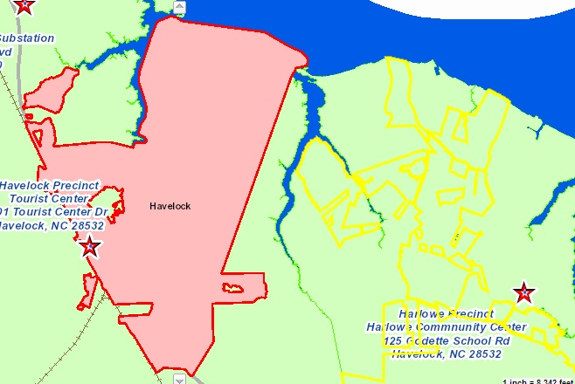
Local Organization
Each city or county is divided into election or voting districts = precincts
Ppl vote at polling place – voters in precinct all go to same polling place

Slide 13
Financing Campaigns
Running for office = VERY EXPENSIVE
Ex: 2004 pres candidates raised $900 million +
Private Financing = large % of funds
Voters, business groups, unions, organizations
Contributions limited – no more than $2000
Unlimited donations to activities not a part of campaign
“soft money” contributions

Slide 14
Financing Campaigns
Public Financing: Presidential Election Campaign Fund
U.S. Treasury gives $ to candidates
Rules & regs for cands who accept public financing
Political Action Committees (PACs) – grps created by corps, union, & orgs to raise $ for a candidate – cannot exceed $5000

