Slide 1
Unit 2: Govt Systems & Politics
The Right to Vote

Slide 2
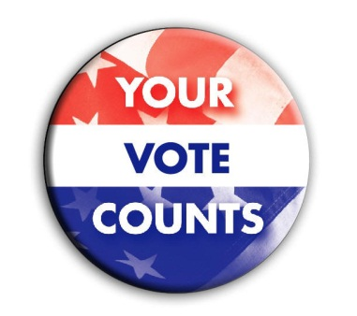
Becoming a Voter
Right to vote = one of most important rights
Citizens 18+ are eligible to vote
Cant be denied right to vote based on
Race, gender, etc…
Voters’ rights protected by Voting Rights Act
Must register to vote
Ppl register as member of PP or as independent voter – not member of a PP

Slide 3
Elections
Most states have 2 types of elections
Primary elections – happen 1st; spring/summer; det candidate
General elections – voters choose leaders; “Pres Election”
Primary elections: 2 types:
Closed primary – only ppl registered as certain party member can vote to choose party candidate
Independents can’t vote
Open primary – anyone can vote for party candidate

Slide 4
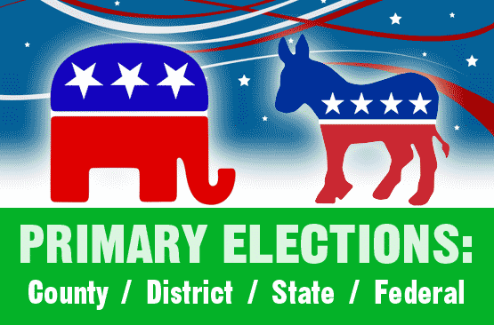
Elections
Primary election results in diff states vary
Winner = whoever gets most votes
Winner = whoever gets majority of votes
If no majority there is a runoff election
PPs in some states choose candidate in nominating convention

Slide 5
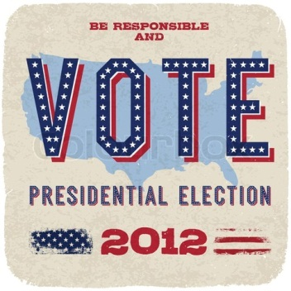
Elections
Independent candidates – don’t belong to PP
Can be on general election ballot if enough supporters sign a petition
Some states allow write ins
General elections
Presidential & congressional election date set as 1st Tuesday after 1st Monday in November
Every 4 yrs; even-numbered years

Slide 6
Voting
Various voting options today:
Mechanical lever machines
Punch cards
Marksense: fill in circles/arrows
Direct recording electronic systems (DRE)
Voting straight ticket – vote for all candidates of one party; based on party
Voting split ticket – based on candidate; may vote for diff PPs

Slide 7
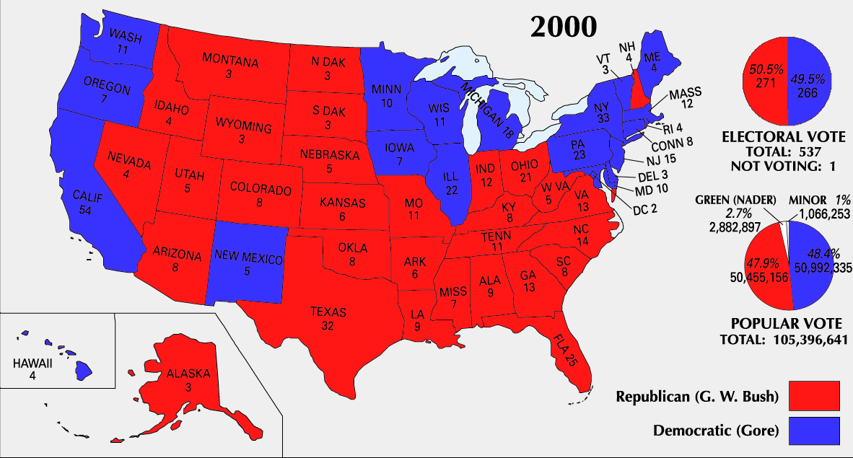
Electoral College
System of officially electing the president
Each state has certain # of electors who vote for the pres; # = to # of reps + 2 senators (NC = 15)
Electoral votes to be same as pop vote
Doesn’t always happen (2000)
Total votes = 538
270 to win

