Slide 1
Unit 3: Early Modern Times
Exploration

Slide 2
Unit 3: Exploration
Search for Spices

Slide 3
Motives
Trade
Plague
Asia
Greed
Curiosity/Glory
Spices
Moluccas islands
Used for many things
Cinnamon, clove, nutmeg…

Slide 4
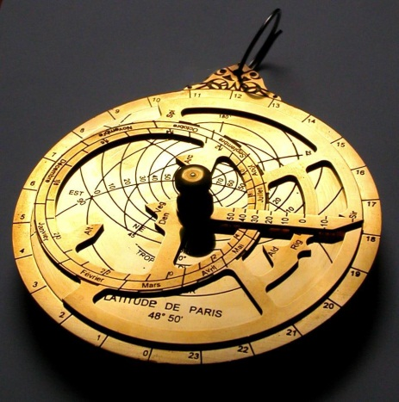
New Technology
Better Ships
Triangular sails; sturdy rudder
Better Tools
Magnetic compass; astrolabe
Better Maps
Cartographers – map makers

Slide 5
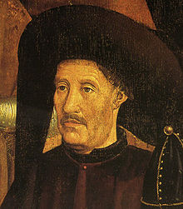
Portugal Begins
1400s – Prince Henry “The Navigator”
Started nav school
Sent explorers to Africa
Discovery of Gold Coast

Slide 6
Portuguese Explorers
Bartholomeu Dias – rounded tip of Africa
Led to route to Asia
Vasco da Gama- sailed around Cape of Good Hope to India
Spices
Trading empire

Slide 7
Spanish Explorers
Columbus- 1492- funded by Spanish sailed West (W. Indies / Asia)
Explored Cuba & Hispanola
Thought reached Asia
Magellan- 1520- sailed south of S.Am., ended up in Philippines
Strait of Magellan
Circumnavigated the globe – sailed around
Balboa – 1513- passage through Panama to discover Pacific Ocean

Slide 8
Agreements
Treaty of Tordesillas: Spain & Portugal drew line of demarcation through Atlantic Ocean & S. Am to divide unexplored lands

Slide 9
Other Explorers
John Cabot- for England, explored NE USA
Amerigo Vespucci: explored for Italy, described the land, led to the name “America”

Slide 10
Unit 3: Exploration
Struggle for North America

Slide 11
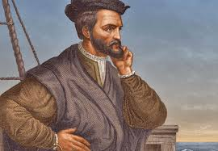
New France
1600s – France, Netherlands, England, Sweden settle N. America
1700 – France & England had majority control = big $
1500s France claimed Canada (New France)
St. Lawrence Riv discovered - Jacques Cartier

Slide 12
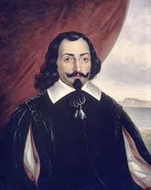
New France
Missionaries, Explorers, fur traders went inland
Native allies
Permanent settlement 1608
Grew slowly
Champlain est. Quebec
Fur trading/fishing = big $

Slide 13
New France
1600s – King Louis XIV (14th) wanted more power / boost $ from taxes
Sent soldier & settlers (included women)
Refused Protestant settlers
French forts, missions, trading posts…by 1700s
Still not as populated/big as English colonies

Slide 14
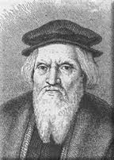
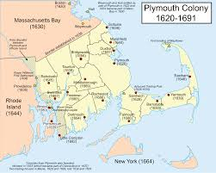
13 English Colonies
1497 – Cabot claimed land for Eng
1600s – English est colonies along Atlantic coast
1st perm colony 1607 = Jamestown, VA
starvation & disease
Native allies
Growth bc tobacco
1620 – Plymouth, MA settled by Pilgrims – English Protestants rejected Ch of Eng
Signed Mayflower Compact – 1st form of self govt; compact = agreement
Mass Bay Colony est by English Protestants

Slide 15
13 English Colonies

Slide 16
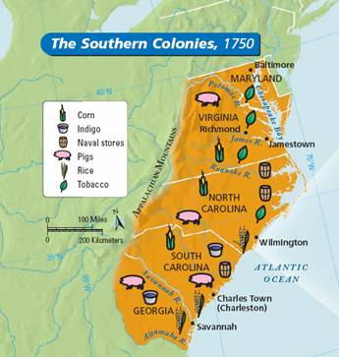
13 English Colonies
1600 & 1700s – English est total 13 colonies
MA, NH, RI, CT, NY, PA, NJ, DE, MD, VA, NC, SC, GA
Some for profit, religious freedom, as gifts from king
Harsh conditions / helped by natives / profit
NE – timber, fishing, shipbuilding
Middle – grew grain / some industry
South – cash crops / plantation economy

Slide 17
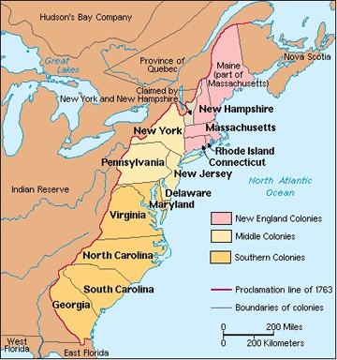
13 English Colonies
King controlled colonies
Had royal governors in colonies
Trade regs – only w/ British
Self-govt among colonies to an extent
Representative assemblies

Slide 18
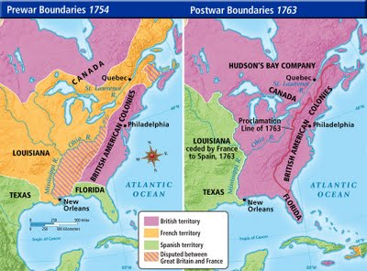
Struggling for Power
Fighting among Spain, France, England, Netherlands
Protection & expansion
Natives got involved
French & English Caribbean islands colonized in 1700s
Sugar cane / used Af. slave labor
Britain & France = big rivals
1754-1763: French & Indian War
AKA Seven Years War
Btwn French & British
Winner = British
Treaty of Paris ended war
British dominance in N. Am.

Slide 19
Unit 3: Exploration
The Atlantic Slave Trade

Slide 20
Background
Colonies served as sources of raw materials and markets for goods
13 British Colonies:
3 Regions
Different industries

Slide 21
Need for Slaves
1490’s: sugar cane plant. start in Spanish Colonies
Natives killed by invaders / disease
Africa was newest source of labor

Slide 22
Triangular Trade Route
Guns / cloth from Europe to Africa
Slaves to Americas from Africa
Tobacco, molasses, sugar, cotton, & other goods to Europe from Americas

Slide 23
Triangular Trade
Industries grew:
Shipbuilding
Tobacco
Sugar
Successful port cities

Slide 24
Slave Trade Statistics
1500s: 275,000 slaves
1600s: 1 million slaves
1700s: 6 million slaves

Slide 25
Slave Trade
Middle Passage: the part of trip btwn Africa and Americas
3 wks – 3 mos
High death rate
Harsh conditions
Disease, starvation, and suicide

Slide 26
Sources of Slaves
Prisoners of War in African Wars
Captured by leaders who saw ability to make profit

Slide 27
Unit 3: Exploration
The Global Effects

Slide 28
The Columbian Exchange
Exp brought European global domination & changes to ppl everywhere
Columbus started large global exchange known as the Columbian Exchange
Foods & Animals
Americas -> Europe: corn, potatoes, peppers, cocoa, turkeys, beans…
Europe -> Americas: wheat, bananas, sugar cane, cattle, pigs, chickens, horses, diseases…

Slide 29
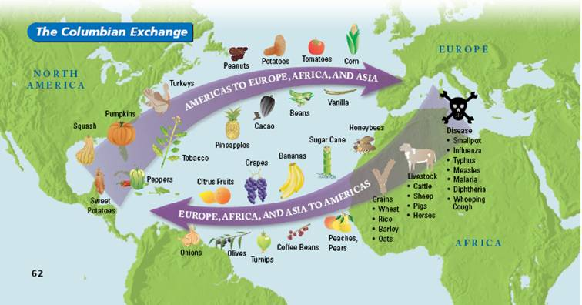
The Columbian Exchange
Effects of the Columbian Exchange
Population growth
Migration
Population decline

Slide 30
Economic Effects of Exploration
Price Revolution: time in Europe when inflation rose rapidly
Prices rose in Europe & more $ in circulation – inflation
Lots of silver & gold coming from Americas
Capitalism Emerges:
Capitalism – econ sys where businesses owned privately
Entrepreneurs key to capitalism – ppl who organized & managed businesses
New business class – wanted to make profits

Slide 31
Economic Effects of Exploration
New ways to gain wealth
Bookkeeping
Increase in banks
Joint stock companies
Merchants increased production
Used “putting-out” system to bypass guilds (“cottage industry”)
Used peasants / separated capital & labor
Led to capitalist-owned factories

Slide 32
Mercantilism
European monarchs profited
New econ policy - mercantilism – nation tries to export more than it imports to make $ (g&s)
Colonies were for profit of parent country
Strict trade & business regulations
Policies to increase national wealth & govt resources
National currencies
Sold monopolies
Imposed tariffs – taxes on imported goods

Slide 33
Mercantilism
Rise in national economies
Social Classes / Society Effected (1700s)
Merchants gained wealth
Nobles lost wealth
Middle class – comfortable life

