Slide 1
Unit 3: States & NC
The States

Slide 2
State Governments
Reserved powers: powers held by the states
Establish rules for health, safety, welfare of ppl
Ex: marriage, driving, traffic, education
Conduct all elections
control over govts in their boundaries
Ex: districts, cities, towns, townships, etc.
Local govts get power from the state

Slide 3
State Government Powers
Concurrent powers: powers shared by state and federal govt
Ex: taxation
National = federal income tax
State = sales tax, income tax, property tax
Ex: making & enforcing laws
States have police forces to help

Slide 4
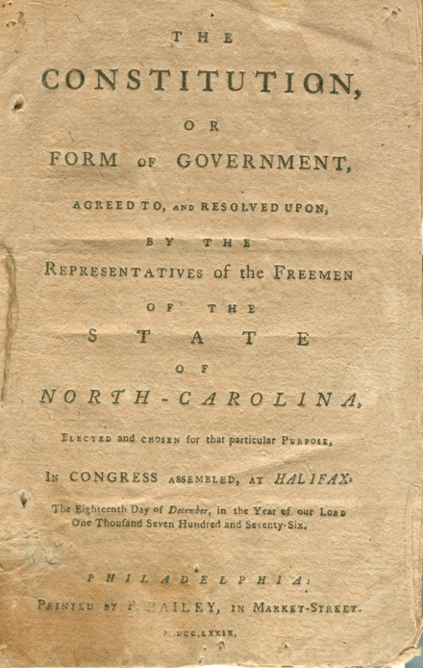
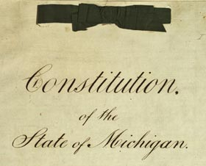
State Constitutions
Each state has own constitution
Usually contain:
Preamble
Bill of rights
Longer & more detailed than US Constitution

Slide 5
Our Federal System
States work together & with the federal govt
States work together: Article 4:
Full faith and credit clause – each state will accept decisions of courts in other states
Ex: marriage certificates, birth certificates, wills, contracts

Slide 6
Our Federal System
States work together: Article 4:
Extradition: returning fugitives to the state where the crime was committed
A person cannot get away with a crime by fleeing to another state
Inter-state projects
Bridges, pollution reduction
Ex: Hoover Dam

Slide 7
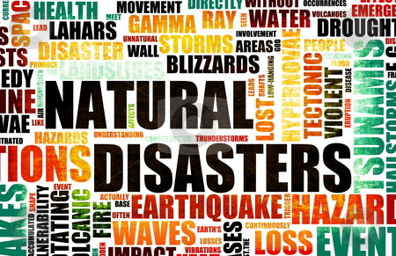
Our Federal System
States work with the federal government:
Work together to share costs of providing services
Ex: build highways, help the unemployed, help ppl with low income, conserve natural resources
Cooperation in times of crisis
Ex: natural disasters, 9/11

