Slide 1
Unit 4: Law & the Legal Sys
Crime in the United States

Slide 2
Types of Crime
Crime = act that breaks law & has punishment
Criminal = person who commits crimes
Felonies = serious crimes
Misdemeanors = less serious crimes
5 main types of crime

Slide 3
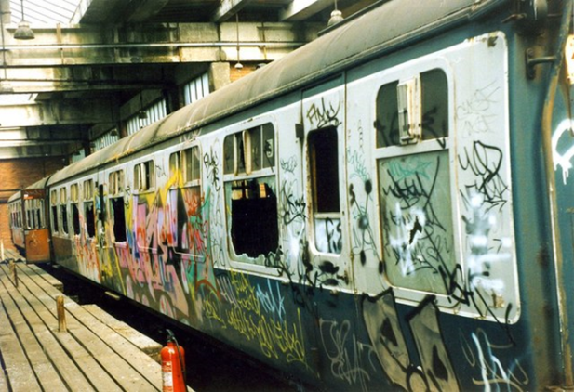
Types of Crime
Crimes against persons: violent crimes w/ force or threat of force
Murder/Rape/Aggravated assault (most common)
Hate crimes – violent crimes bc of prejudice
Crime against property: stealing/destroying
Majority of crimes
Larceny & car theft/Vandalism/Arson/Robbery (ppl)

Slide 4
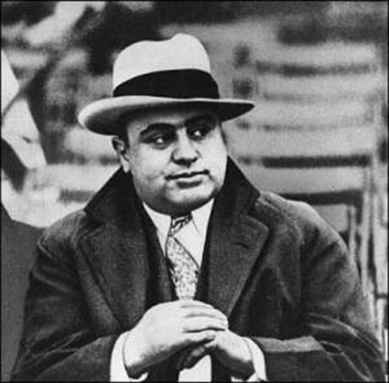
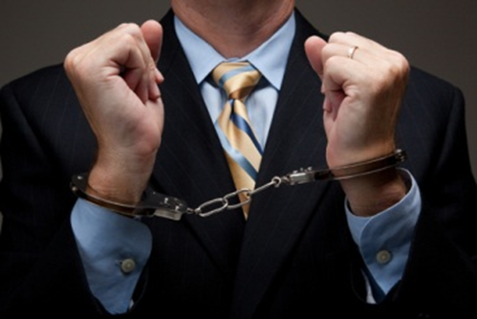
Types of Crime
Victimless – other ppls rights not violated
Illegal gambling/drugs
White-collar – committed in their work
Fraud, embezzlement, cybercrime, identity theft…
Organized – group of career criminals
Gambling, drugs, prostitution
Threats of violence

Slide 5
Causes & Fighting
Causes
Poverty/Unemployment
Drug use/Addiction
Permissive society: kids w/out rules
Urbanization
Other: technology, social change, education, lack of $ in govt
Fighting/Preventing Crime
1994 – National crime bill passed
Tougher sentences
$ for new jails & more police
Crime prevention taught in schools
Citizens can help fight crime
How????

