Slide 1
Unit 5: Dem & Citizenship
America / Duties & Responsibilities

Slide 2
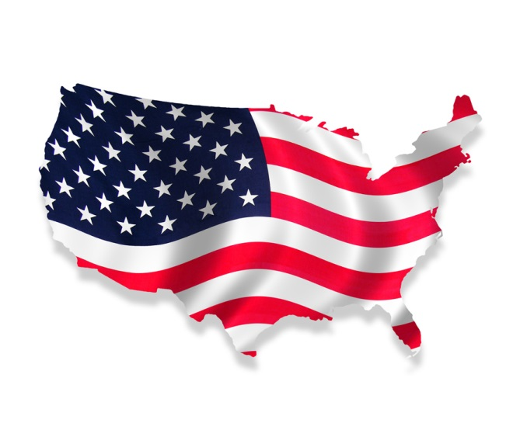
Citizenship
Ppl given rights & freedoms as U.S. citizens
Citizens expected to fulfill certain duties & responsibilities in return

Slide 3
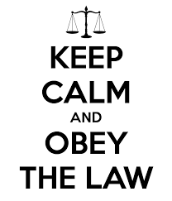
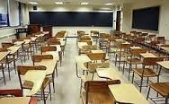
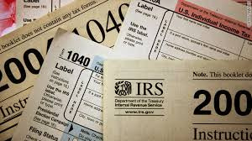
Duties: Things citizens MUST do
Key to making govt run/work
Know & obey laws
Attend school
Required until16
Pay taxes

Slide 4
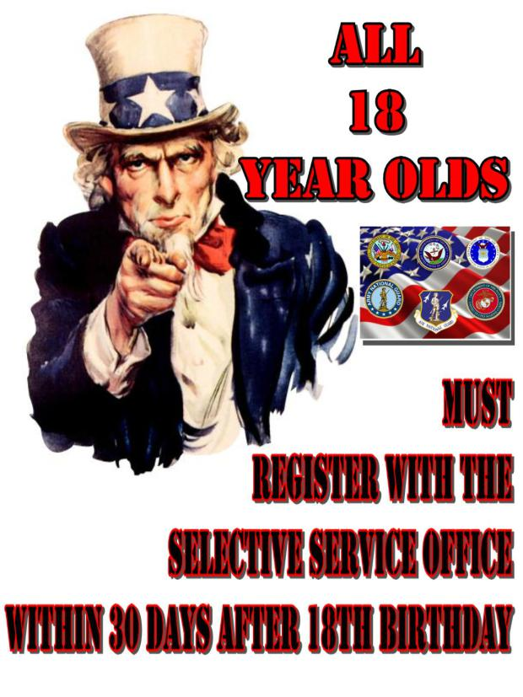
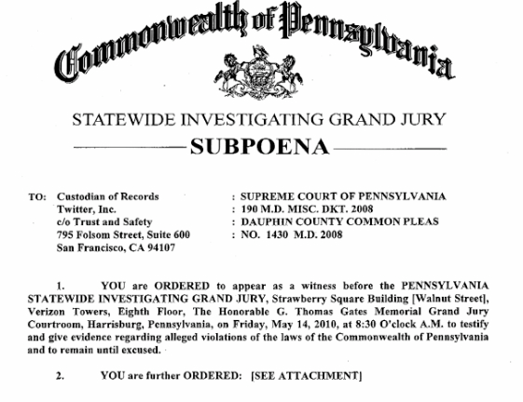
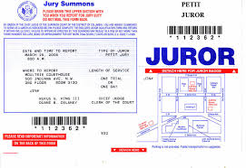
Duties
Military service
Draft may be issued
Serve from home if not in military
Ex: rationing
Appear in court
Jury duty
As witnesses if called

Slide 5
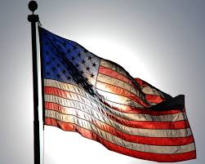
Responsibilities: Things SHOULD do as citizens
Vote / Be informed
Participate in govt / patriotism
Public service – hold office / services
Volunteer local/domestic/worldwide
AmeriCorps / Peace Corps
Help community
Respect/protects others’ rights

Slide 6
Diversity in America
Immigration
Many ppl from other nations – multicultural
Nationality/ethnicity – birth origins
Assimilation – become part of new land/society
“Melting Pot” theory – old thought; diff grps “melt” into 1 American identity/way
“Tossed Salad” theory – new idea; being Amer & keep culture/self; no single Amer. identity

Slide 7
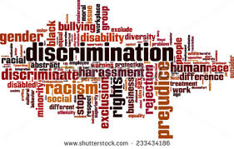
Discrimination
Types:
Religious
Sexism – based on gender
Bias – unfair preference for/against
Racism
Ageism – age discrimination
Disability, sexual pref, etc…
Illegal in some instances

