Slide 1
Unit 6: Review, Competition & Conflict

Slide 2
Voting
Citizens 18+ are eligible to vote
Can’t be denied right to vote based on
Race, color, or sexMust register to vote
Ppl register as member of PP or as independent voter – not member of a PP
Voting straight ticket – vote for all candidates of one party
Voting split ticket – vote for diff PPs

Slide 3
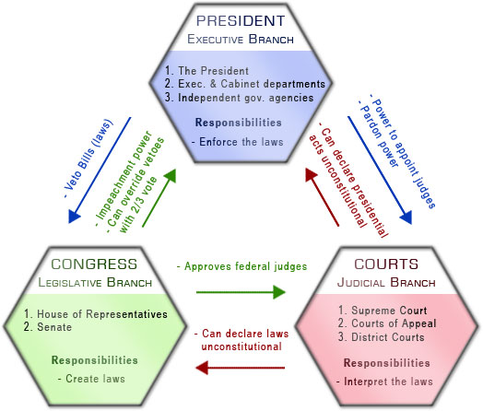
Checks and Balances

Slide 4
Conflict Resolution
Public issues: taxation, unemp /underemp, poverty, aging pop, immigration, pollution
Taxes:
Progressive – wealthy pay more
Regressive – low income pay more
Proportional – equal % for all
Apathy = lack of interest
Resolving conflict: compromise/negotiation
Mediation – 3rd party help reach agreement; not forced decision
Arbitration – 3rd party listens & makes final decision

