Slide 1
Unit 7: Economics & Choices
US Economy

Slide 2
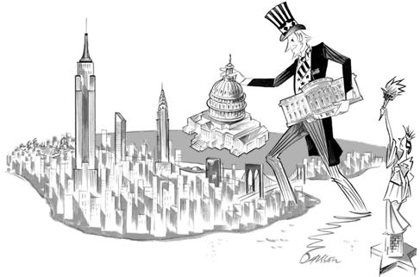
US Economic System
US = market/mixed econ
Market economy also called capitalism
Has free enterprise system – comp for $ w/ little govt involvement

Slide 3
Goals & Characteristics of the US Econ
Goals:
Provide jobs
Efficient use of resources
Cont econ growth
Equal access to jobs & ed
Characteristics:
Private prop
Profit incentive
Competition
Freedom of choice
Limited govt involvement

Slide 4
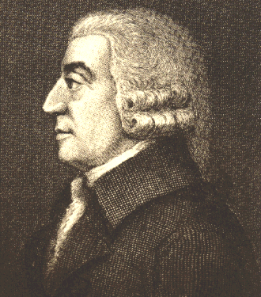
Adam Smith’s Ideas
Wrote “Wealth of Nations”
Gave basic outline of econ theories in market econ
Invisible hand: supply, demand, comp will regulate free market
Laissez Faire: govt shouldn’t interfere w/ economy
Hands off approach; laid back

Slide 5
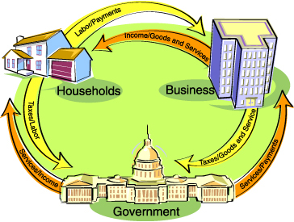
Circular Flow

