Slide 1
Goal 7: Economics
The Business Cycle

Slide 2
Business Cycle
Business cycle = economic pattern where econ goes through good & bad times
Common in free markets
Phases of the BC:
Recovery/expansion: general increase in bus. act.
Peak/boom: econ operating at high level
Contraction: general decline in bus. activity
Recession: econ in decline for a per. of 6 mo

Slide 3
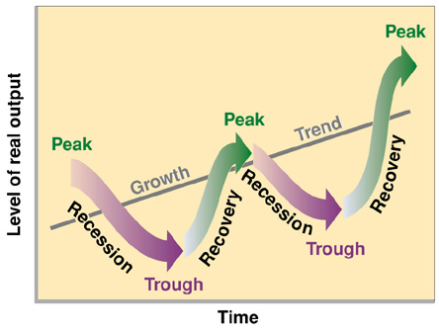
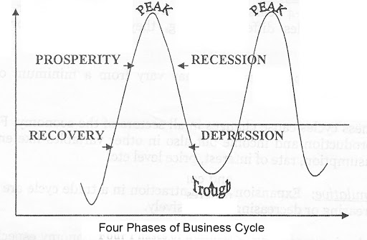
Business Cycle
Phases continued…
Trough: econ at lowest point; it’ll begin expansion
Depression: extended period of contraction; very low trough w/ very high unemployment

Slide 4
Business Cycle & Economic Probs
When econ booming the Gross Domestic Product (GDP) increases
GDP = total amt of goods/serv produced by a country in 1 year
Economic problems:
Inflation: rise in the price/costs of goods/services
Caused by too much $ in circulation/society
Costs of doing bus / cost of production goes up & prices rise

Slide 5
The Great Depression
Probs began Oct. 1929 w/ stock market crash
Banks failed
Ppl lost savings
Decline in production
Businesses closed
Farms fail
High unemployment
High home loss
Lasted 10 years

Slide 6
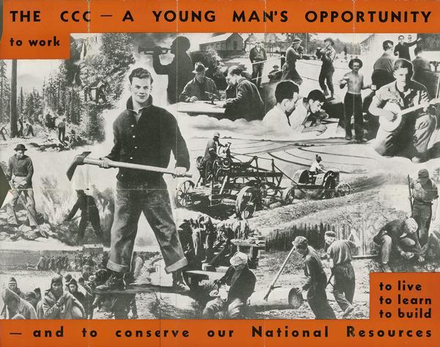
Government Response
Govt stepped in to create more jobs / fix econ
FDR – the New Deal
WPA: Works Progress/Project Administration
FDIC – Federal Deposit Insurance Corporation
SEC – Securities and Exchange Commission
Social Security System

Slide 7
Predicting the Business Cycle
3 types of indicators:
Leading – make predictions about future of econ
come before major changes in bc
Ex: increase in # of building permits
Coincident – shows how econ is doing at present time & tells if upturn/downturn is coming
Ex: if there’s an increase in ppl’s income
Lagging – helps tell how long current phase of bc will last
comes after major changes in bc
Ex: increase in new businesses

Slide 8
Influences on Economy
Business investment
Money & credit - availability
Public opinion – expectations of econ
International events
Availability of resources
Human resources = labor
Location/mvmt of resources
Outsourcing of jobs (China) / foreign labor
Unexpected events
9/11: NYC bus, airline industry; weakened econ
Hurricane Katrina: ports, imports/exports, oil/gas; higher prices

