Slide 1
Unit 7: Economics
Production / Goods & Services

Slide 2
Decisions
Trade-offs: trading one thing for another
Opportunity cost – the value of choosing one thing over another
Ex: living in city vs. living in country
Cost-benefit analysis - Econ model; compares costs & benefits of a decision

Slide 3
Goods & Services
Goods – physical/tangible items; things made/manufactured for ppl to buy/own
Food, cars, buildings, television
Services – not physical objects; things ppl do
Doctors, translators, tutors, painters, mechanic
Combination
Movie theater, restaurant, theme park

Slide 4
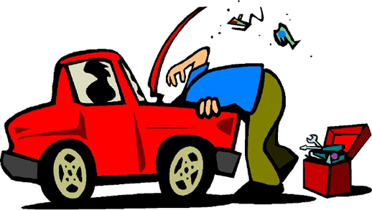
Goods & Services
Productivity – rate at which g/s are produced & efficient use of resources…production vs. resources/costs
Specialization - ppl, bus, regions, nations focus on things they do better than others
Types of services:
Personal – performed on consumers
Medical, hair, fitness…
Repair – performed on goods you own
Mechanic, heating & cooling…
Other – retail services, entertainment services, banking, legal

Slide 5
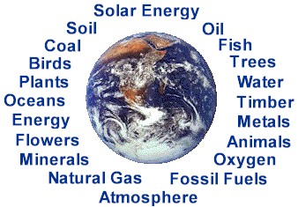
Factors of Production
Key questions of production:
1) What to produce?
2) How to produce?
3) For whom are we producing?
4 factors of production:
Natural resources / Land
Capital
Labor
Entrepreneurship
Questions help to decide how to use the 4 factors

Slide 6
Factors of Production
Natural resources – things provided by nature w/out human intervention
Ex: land, animals, water, minerals, timber, etc.
Many limited
Factor of prod only when pay for use
Capital – equipment used to make other g/s
Ex: tools, trucks, machines, etc. (capital goods)
Financial capital - $ used to buy tools/equipment
Get from loans, investors, stock

Slide 7
Factors of Production
Labor – Human effort, skills, & abilities to produce g/s
Workers
Paid – hourly vs. salary
Entrepreneur – person who organizes & manages the factors of prod for creating a bus
Very important to econ

Slide 8
Government’s Role
Regulates comp / outlaw monopolies
Provide info to bus owners to help plan
Census, statistics
Protects workers’ health & safety – OSHA
Protects consumers
Protects environment – pollution from bus

