Slide 1
Unit 8: Econ 2
Supply & Demand

Slide 2
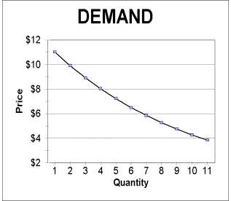
DEMAND
Demand Schedule/Curve – a chart/graph that shows how many products will be bought at a particular price.
Determinants of Demand – Things that effect what & how much of an item will be bought.
Examples
tastes, quality, price, substitute good, complementary good, elastic/inelastic demand

Slide 3
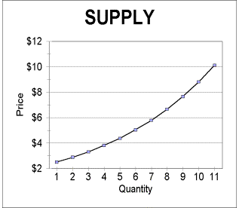
SUPPLY
Supply Schedule/Curve – a chart/graph that shows how many products will be produced at a particular price.
Determinants of Supply – things that effect what & how much of an item will be produced.
Examples
Cost of labor, cost of materials, advertising

Slide 4
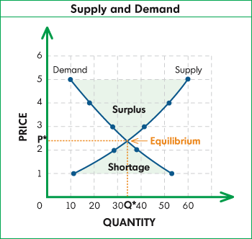
MARKET PRICE - EQUILIBRIUM
Market Price/Equilibrium – The point at which the quantity supplied is equal to the quantity demanded.
Surplus – When the quantity supplied exceeds the quantity demanded.
Shortage – When the quantity demanded exceeds the quantity supplied.

Slide 5
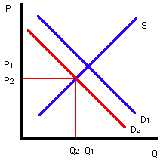
CHANGES IN SUPPLY & DEMAND
Changes in Supply
If the supply of an item goes up, the price of the item will decrease. How to graph?
If the supply of an item goes down, the price of the item will increase. How to graph?
If the demand for an item increases, the price of the item will increase. How to graph?
If the demand for an item decreases, the price of the item will decrease. How to graph?

