Slide 1
Unit 8: Economics 2
Problems, Policy, and The Fed

Slide 2
Economic Probs
Economic Problems:
Inflation
Loss of wages for workers
Lowered standard of living
Unemployment
Recession
Causes of the Probs:
Money Supply: too much $ in circulation / too many loans
Gov’t Spending & Borrowing
Productivity – amt that workers produce/hr
Higher productivity can = better econ

Slide 3
Monetary & Fiscal Policy
Monetary policy – controls the $ supply; changes help to stabilize prices, employment & econ growth
Controlled by the Federal Reserve “The Fed”
Fiscal Policy – changes in govt spending or taxes to help stabilize & grow the econ
Controlled by the federal govt

Slide 4
The Federal Reserve System
Called the Fed – set up 1913/14
Created to stop bank failures & regulate banks
banks must keep certain amt of $ in reserve
US divided into 12 federal districts w/ Federal Reserve bank in each
Fed banks work only with govt & other banks

Slide 5
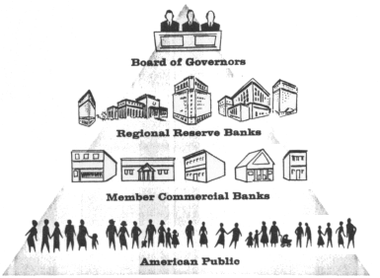
The Federal Reserve System
Purpose – govt banking & control nation’s $ supply
7-member board of governors in D.C.
Appointed by president / approved by Senate
Serves 14 years

Slide 6
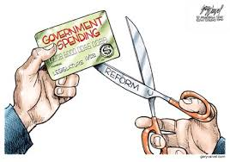
Help the Economy
Other ways to help the economy:
Cut govt spending
Consumer saving
Buy American-Made
Increase productivity

