Slide 1
Unit 5: Global Wars & Rev
World War II

Slide 2
Rise of the dictator
Unit 5: Global Wars & Rev

Slide 3
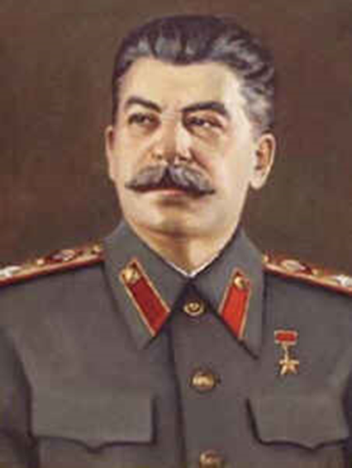
Background
New democracies formed after WWI
Econ problems caused collapse
Opened opp for dictators to take over
Stalin – Russia:
Totalitarian Communist
Goals: agric & industrial growth
By 1937: USSR #2 world power
8-13 million killed by Stalin’s regime

Slide 4
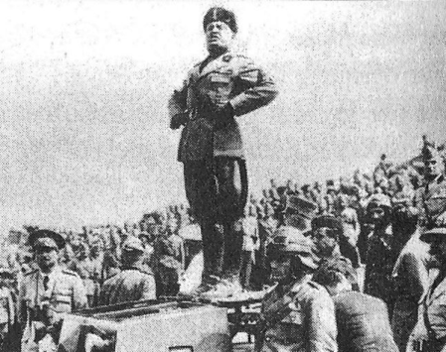
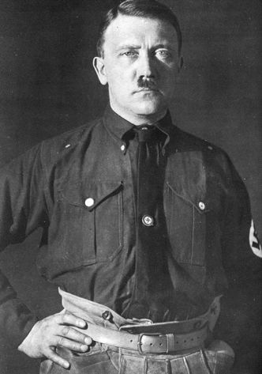
Background
Mussolini – Italy: “Il Duce”
Fascist: state>individual; appointed by king
Appealed to national pride
“Black Shirts”: personal army, marched on Rome
1935: Ready to attack North Africa
Hitler – Germany: “Der Furher”
Facist leader of Nazi party
Mein Kampf: his plan for Nazi Party
Desire to create German-speaking empire

Slide 5
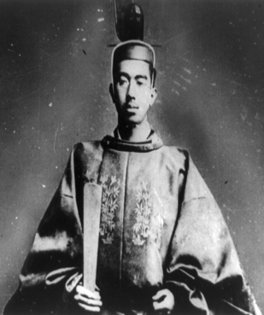
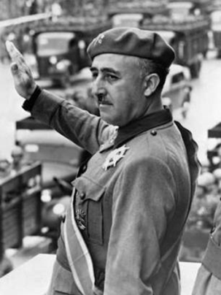
Background
Hitler Cont…
1933: Appt Chancellor, broke up Germ democracy
Goals: Racial purification & territorial expansion
Hirohito – Japan: Emperor
Japan: small and crowded
Wanted “living space” for the Japanese
Attacked China – 1931
Franco – Spain: Dictator
1936: took power / led soldiers in rebellion
Started Spanish Civil War
US backed Spain / Hitler & Mussolini backed Franco

Slide 6
Unit 5: WWII
The War begins

Slide 7
Important People
United States: President Franklin D. Roosevelt
United States: Supreme Commander of Allied Forces in Europe Dwight D. Eisenhower
United States: General in the Pacific Douglas MacArthur
Great Britain: Prime Minister Winston Churchill
Japan: Emperor Hirohito

Slide 8
Before the War
Hitler rebuilds German military
1936: Hitler militarized the Rhineland
March 1938: German Annexation of Austria
Hitler wants to take control of Sudetenland region of Czechoslovakia
GB, France, & other nations don’t stand in Hitler’s way
Appeasement

Slide 9
Alliances and Agreements
Axis Powers:
Germany
Japan
Italy
1936: Japan & Germany – Anti-Comintern Pact
1939: Italy & Germany - military alliance
1939: Stalin & Hitler – non-aggression pact

Slide 10
War Begins
September 1, 1939: Germany attacked Poland
WWII begins
“Blitzkrieg”: lightning war, attack quickly and win with surprise
France/GB declare war on Germany
Germany quickly gained control of Poland
Allied Powers
France
Great Britain

Slide 11
Hitler Continues
1940: Hitler invades Denmark, Norway, France
June 22, 1940 France surrendered to Germany
Battle of Britain: Aug-Oct 1940: GB wins
London Blitz

Slide 12
More Alliances Form
Atlantic Charter- US joins UK and France, but…
US didn’t want to fight
Lend/Lease Act: US agreed to provide supplies to Allied powers

Slide 13
Pearl Harbor
December 7, 1941: Japanese attack on Pearl Harbor, HI
Brought the US into the war
After PH, 5 million volunteered to serve
Draft enacted, 10 million more called up
Women’s Auxiliary Army Corps: nurses, radio operators, pilots, electricians

Slide 14
Production
All factories converted to war production
6 million women went to work, earned 60% of a man’s salary
1941: Office of Scientific Research and Development: drugs, weapons, “Manhattan Project”: atomic bomb

Slide 15
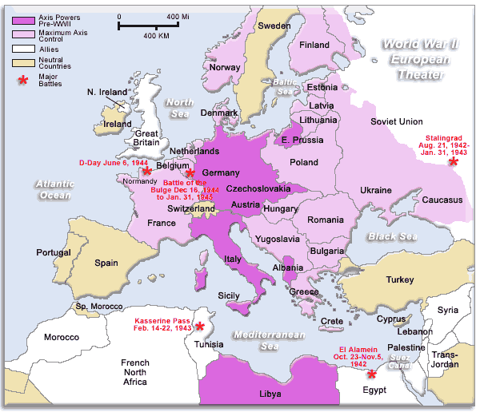
2 Parts to the War
European Theater

Slide 16
2 Parts to the War
Pacific Theater

Slide 17
Unit 5: WWII
The War in Europe

Slide 18
The War Continues
Battle of the Atlantic: German U-boats attack allied ships
“wolf packs” of U-boats sank 87 ships in 4 months
US developed convoys to protect against U boats

Slide 19
The War Continues
Germany attacked Russia in 1941
Battle of Stalingrad: Winter 1942-43
Street fighting for city
German Surrender
1 million plus Russian deaths
Turning Point

Slide 20
Operation Torch- North Africa
General Dwight Eisenhower
Fighting against Italy/Germany in North Africa
Edwin Rommel: The “Desert Fox”, German General
Surrendered 1943

Slide 21
Italy
Allies captured Italy in 1943 from North Africa
Mussolini resigned
Germany came to Italy to defend it

Slide 22
D-Day
June 6, 1944: Allied Invasion of Occupied Europe
3 million allies attacked Normandy
3 divisions parachuted in, thousands of seaborne soldiers
Allies took beaches

Slide 23
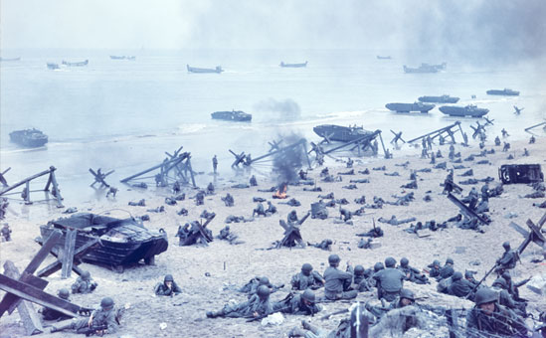
D-Day

Slide 24
Success in Europe
August 25, 1944: Allies Liberated Paris
By September, liberated Belgium and Luxembourg
October 1944: took Aachen, first town in Germany

Slide 25
Battle of the Bulge
December 1944
German counter attack in Belgium
Lasted one month
Germans pushed back, but lost many weapons
January 1945: German retreat, allied victory

Slide 26
German Surrender
April 25, 1945: Soviets stormed Berlin
Hitler refused to surrender, killed himself
May 8, 1945: VE Day
April 12, 1945, FDR had died, replaced by Truman

Slide 27
Unit 5: WWII
The War in Asia

Slide 28
Japan
Hirohito=Emperor
Tojo=Prime Minister
1937: Japan invaded China, wanted to take all of Europe’s colonies in Asia
1941: Took Vietnam, Cambodia, Laos

Slide 29
Japan
US responded to Japan by cutting off trade, especially oil
Made Japan MAD!

Slide 30
Pearl Harbor: 12/07/1941
Damaged/sank nearly the whole Pacific Fleet
3 Aircraft carriers were at sea

Slide 31
The Fighting
1941: US got bogged down in Philippines
FDR commanded MacArthur to leave
MacArthur: “I Shall Return”

Slide 32
The Fighting
Midway: turning point in the Pacific, begins Island hopping strategy
Guadalcanal: first US offensive, first land victory

Slide 33
The Fighting
Iwo Jima: critical island as base of attack, heavily defended
7,000 Americans die, 20,500 Japanese die
Okinawa: Huge US victory, 12,000 US deaths, 110,000 Japanese, 2 generals choose ritual suicide

Slide 35
Atomic Bomb
August 6, 1945: Little Boy dropped on Hiroshima
August 9, 1945: Fat Man dropped on Nagasaki
September 2, 1945: VJ Day, official surrender

Slide 36
Unit 5: WWII
After the War

Slide 37
Yalta
February, 1945, attended by Stalin, Churchill, and FDR
Stalin wanted a harsh approach, wanted to divide Germany into four zones of occupation
FDR agreed because he wanted Stalin’s support

Slide 38
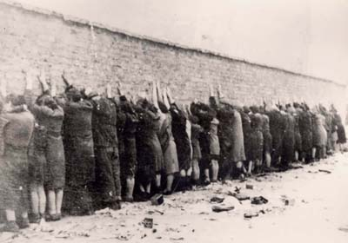
Nuremburg
After the war, 24 German Nazi leaders were put on trial
12 of the 24 were sentenced to death, the rest to prison
Later, 220 were sentenced to prison

Slide 39
Japanese Occupation
Douglas MacArthur was in charge of the Japanese Occupation
1100 Japanese were put on trial for war crimes
Occupation lasted 7 years

Slide 40
Japanese Occupation
MacArthur restructured the Japanese economy and government

Slide 41
Internment
In 1941, there were 120,000 Japanese in the US
Feb 19, 1942: executive order forced Japanese-Americans into internment camps
Approximately 110,000 were rounded up. Of these, 2/3 were American born

Slide 42
Internment
1944: Korematsu v. US: Supreme Court declared the incarceration is constitutional
1965: Congress allocates $38 mil. For reparations
1990: checks are finally sent to the survivors. They receive $20,000/person

